Slide 1

An Introduction to IPBES
www.ipbes.net

Slide 2
Outline
What is IPBES?
Why does IPBES matter?
What does IPBES do?
How is IPBES structured?
What does an IPBES output look like?
How can you get involved?

Slide 3

What is IPBES?
1.

Slide 4

The Intergovernmental Science-Policy Platform on
Biodiversity and Ecosystem Services (IPBES)
An independent intergovernmental body, established by Governments in 2012 – currently 126 Members.
In response to requests from Governments, IPBES provides policymakers with objective scientific assessments about the state of knowledge regarding:
  The planet’s biodiversity, ecosystems and their contributions to people
  Tools & methods to protect and sustainably use these vital natural assets
Provides options for responses based on the best-available science.
IPBES’s Mission:
  To strengthen knowledge foundations for better policy through science, for the conservation and sustainable use of biodiversity, long-term human well-being and sustainable development.
IPBES does for biodiversity what the IPCC does for climate change

Slide 5
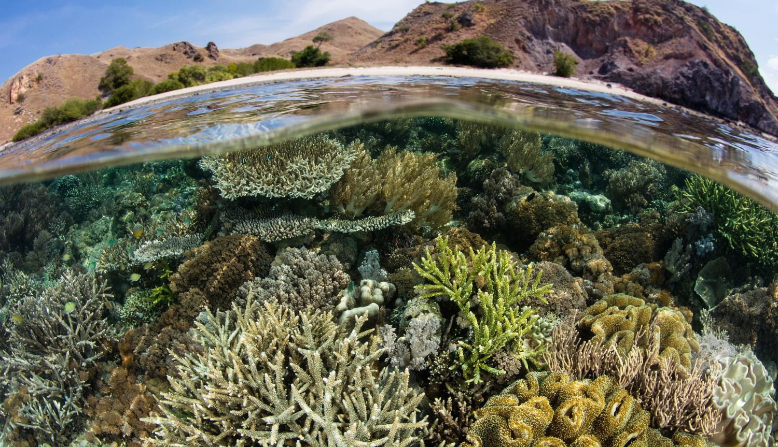
Why Does IPBES Matter?
2.

Slide 6
Why Does IPBES Matter?
Biodiversity & nature’s contributions to people underpin almost every aspect of human development.
  Production of food
  Clean water
  Climate regulation
  Disease control
Also key to the success of the Sustainable Development Goals (SDGs)
Yet they are being depleted & degraded faster now than at any point in human history
IPBES is unique:
  Harnessing best expertise from across disciplines & knowledge communities
  Providing policy-relevant knowledge and options for responses
  Catalysing implementation of knowledge-based policies at all levels of Government, the private sector and civil society

Slide 7
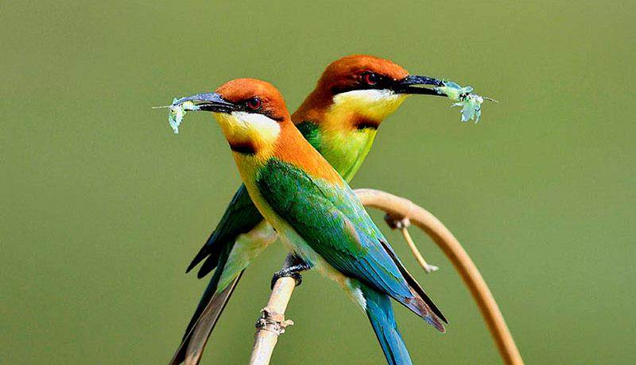
What Does IPBES Do?
3.

Slide 8
What Does IPBES Do?
The work of IPBES can be broadly grouped into four complementary areas:
Expert Assessments (synthesis & critical evaluation of available knowledge)
  On specific themes (e.g. “Pollinators, Pollination & Food Production”)
  On methodological issues (e.g. “Scenarios and Models”)
  At both the regional and global levels (e.g. “Global Assessment on Biodiversity and Ecosystem Services)
  Scientific credibility ensured by IPCC-inspired processes: selection of experts by experts, based on CVs and thorough peer-review (thousands of comments, addressed individually, posted online).
Policy Support
  Identifying policy-relevant tools and methodologies
  Facilitating their use & catalysing their future development
Building Capacity & Knowledge
  Identifying & meeting priority capacity, knowledge & data needs of IPBES Members, experts & stakeholders.
Communications & Outreach
  Ensuring the widest reach and impact of IPBES’s work

Slide 9
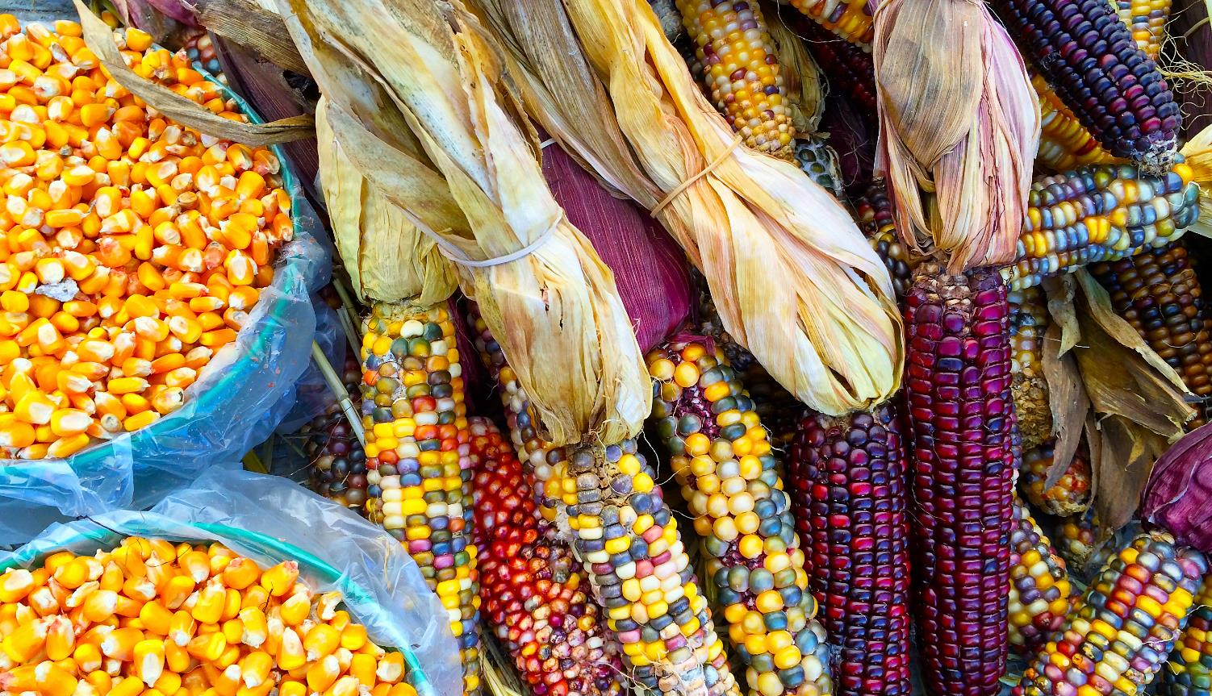
How is IPBES Structured?
4.

Slide 10
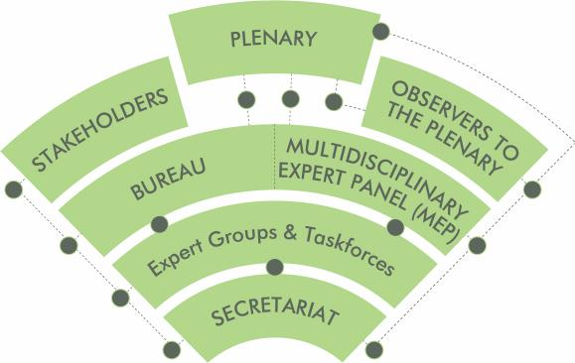
How is IPBES Structured?
The Plenary
  Governing body of IPBES
  Made up of member States
  Usually meets once per year
Observers to the Plenary
  States not yet Members
  Biodiversity-related conventions (e.g. CBD)
  Related UN bodies
  Other accredited organizations & agencies
Stakeholders
  All contributors to & end-users of IPBES outputs.

Slide 11

How is IPBES Structured?
The Bureau
  Oversees all administrative functions
  Comprises Chair, four Vice-Chairs & five additional officers.
Multidisciplinary Expert Panel (MEP)
  Oversees all scientific & technical functions
  5 Experts from each of the 5 UN regions
Expert Groups & Taskforces
  Selected scientists & knowledge-holders
  Carrying out assessments & other deliverables
Secretariat (incl. Technical Support Units)
  Implements IPBES work & administration
  Supports Plenary, Bureau & MEP
  Led by Executive Secretary
  Hosted in Bonn, Germany

Slide 12

What Does an IPBES Output Look Like?
5.

Slide 13
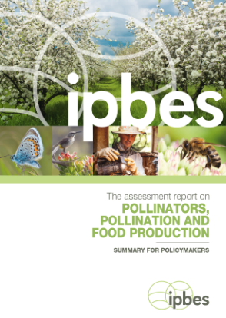
What Does an IPBES Output Look Like?
1st IPBES Thematic Assessment on Pollinators, Pollination & Food Production
  Completed in 2016
  Result of 2 years work by 77 experts from around the world
  Cites about 3,000 scientific papers
  Includes info about indigenous & local knowledge from more than 60 locations
  Summary for Policymakers (SPM) approved word-by-word by the IPBES Plenary

Slide 14
What Does an IPBES Output Look Like?
Examples of Findings & Key Messages:
  Up to $577 billion in annual global food production relies on pollinators.
  Agricultural production dependent on anima pollinators increased 300% over past 50 years.
  Nearly 90% of wild flowering plants depend on animal pollination.
  16% of vertebrate pollinators are threatened with global extinction.
  Pesticides threaten pollinators worldwide, although long-term effects still unknown.
  Range of actions can be taken to safeguard pollinators such as:
        Ensure greater habitat diversity
        Promote sustainable agriculture
        Support traditional practices such as crop rotation
        Improve managed bee husbandry

Slide 15
What Does an IPBES Output Look Like?
Policy Impact?
Formal endorsement of key messages by the Parties to the CBD COP13 in Mexico.
The formation of a “Coalition of the Willing” by a growing number of Governments around the world, to protect pollinators and to promote pollination.
The publication, in both the Nature and Science journals, of major articles building on and reviewing the assessment.
An ever-expanding list of national strategies and action plans on pollination, premised on the outcomes of the assessment, in countries including, among others: France, the Netherlands, Brazil, South Africa and the Republic of Korea.

Slide 16

How Can You Get Involved?
6.

Slide 17
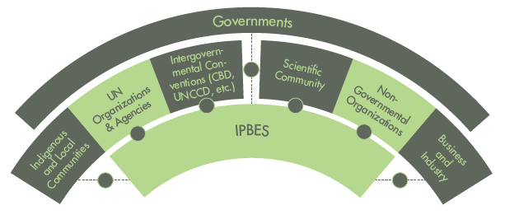
How Can You Get Involved?
IPBES currently has 126 Members. A large number of NGOs, organizations, conventions and civil society groups also participate in the formal IPBES process as observers, with several thousand stakeholders, ranging from scientific experts to representatives of academic and research institutions, local communities and the private sector, contributing to and benefitting from our work.

Slide 18
How Can You Get Involved?
There are a wide range of opportunities to engage with IPBES, some of which include:
Joining as a Member (Governments only)
Contributing as a nominated expert to ongoing IPBES assessments – as an:
  Author
  Editor
  Reviewer
Supporting capacity & knowledge-building work by contributing expertise, data or other resources.
Serving as a regional or subregional communication and outreach partner
Coordinating a sectoral or industry-specific network of stakeholder engaging with IPBES
Participating in the IPBES Fellows Programme

Slide 19

How Can You Get Involved?
The first step is to register as an IPBES Stakeholder. It’s free and will ensure you receive regular information about the work of IPBES as well as opportunities to get involved.
To register go to: www.ipbes.net/stakeholders
Or use any smartphone or mobile device to scan this QR Code:
Follow us on
Twitter: @IPBES
Youtube.com/ipbeschannel
www.facebook.com/ipbes

Slide 20

Want to Know More? Watch the 5 Minute Video Below

Slide 21

Thank you!
IPBES Secretariat, UN Campus
Platz der Vereinten Nationen 1, D-­53113 Bonn, Germany
secretariat@ipbes.net
@IPBES
www.ipbes.net

