Slide 1
SK- HU WORKING GROUP ON NATURE CONSERVATION
13 September 2019
Budapest
UPDATE ON COMMON PROJECTS

Slide 2
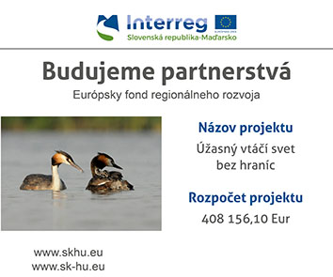
Project „Úžasný vtáčí svet bez hraníc“ – Birds without Borders
Main aqctivities realised in 2018-2019:
Construction of two birdwatching towers in Hrhov and of Green footpath in Drienovec
Environemntal education activities realised at Station Drienovec and also by using the mobile EE lab.
Environemntal education stationary elaborated and printed (colouring book, project leaflet and brochure)
Removal of sucession bushes at Drienovec – improvement of bird nesting habitats
Activities to finish-up:
- leaflet on birdwatching places in project area
- interactive map on sightseeeing places in the area on both side of the border (visitor centres, viewpoints, birdwatching areas, caves, etc.)
- 17 Sept 2019 -final conference in jablonovec nad Turňou
Lifetime:
Nov 2017 – Oct 2019
Budget: 408,156.10€
Partners: SNC SR- ANPI

Slide 3
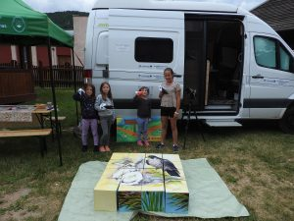
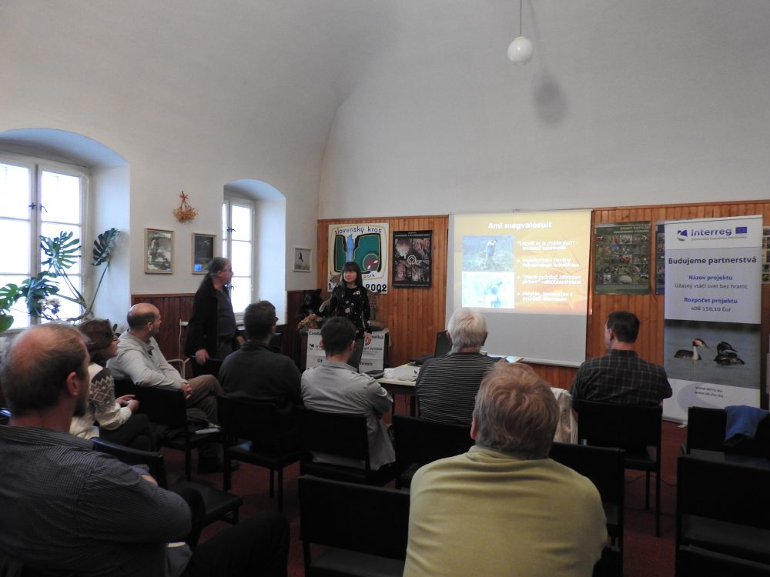

Slide 4
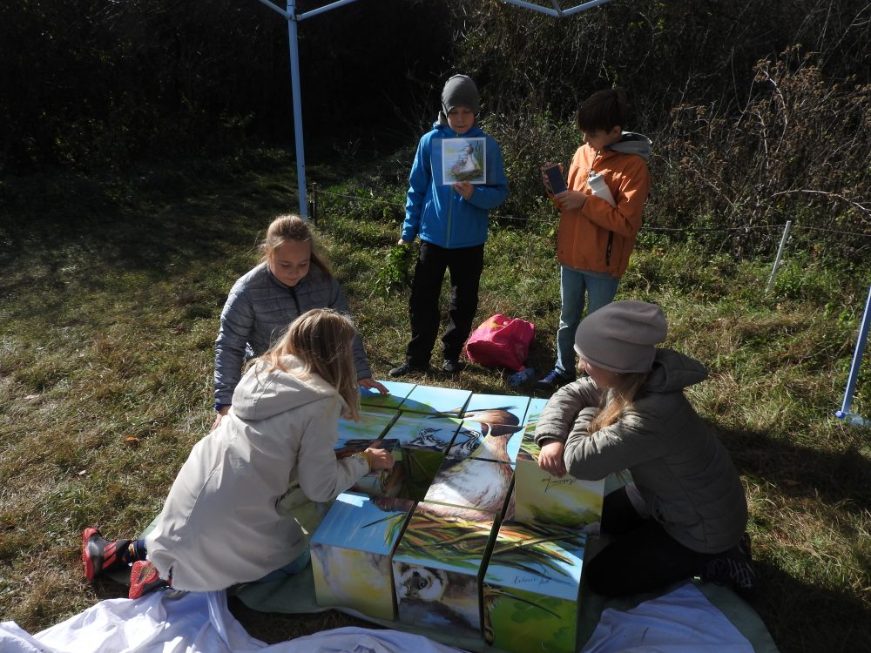
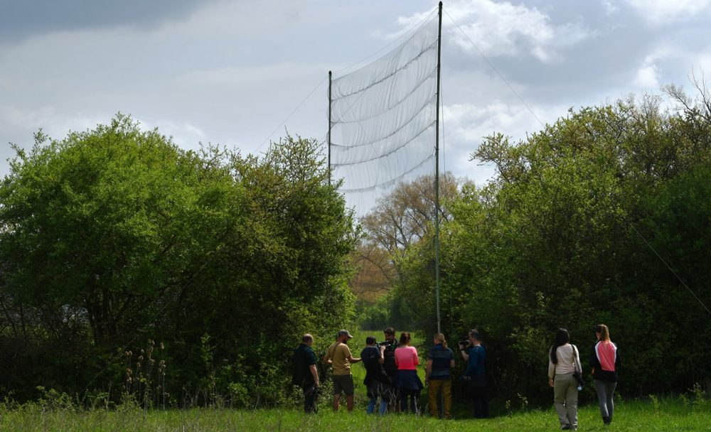
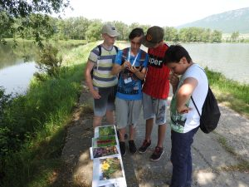

Slide 5
Natural park Szigetköz – Žitný ostrov
Done: Leaflet, poster and brochure on habitat revitalisation elaborated and printed
To do: Organise the workhsops and excursions.
Realise the management measures in the field.
Lifetime:
Nov 2017 – Oct 2019
Budget: 464,458.41€

Slide 6
Contact for Bükk NP
PLA Cerová vrchovina
Eva Belanová, Director
+421 903 298 147
eva.belanova@sopsr.sk
2019-2020 Work Plan between Bükk and SNC SR to be signed at the Conference on 03/10/2019 in Slovakia.
Contact for Fertö-Hanság NP
PLA Ponitire and Dunajské Luhy
Radimír Siklienka, Director
+ 421 903 298 310
radimir.siklienka@sopsr.sk
Contact for new LIFE project
SNC SR Headquarters in Banská Bystrica
Daniel Baláž, Head of Section for Projects
+ 421 903 298 116
daniel.balaz@sopsr.sk

