Slide 1


Meeting of Slovak - Hungarian Committee for Nature Conservation and Landscape Protection
Budapest, 13. 09. 2019.
„Bükk National Park Directorate”

Slide 2

Projects and common activities
Cooperation Agreement between Štátna ochrana prírody Slovenskej Republiky and Bükk National Park Directorate
Since 1994 a Cooperation Agreement has been started between our organisations which we renewed every/every second year. In the frame of the agreement we had iniciated joint projects, bilateral research activities, common environmental education programmes, workshops for experience-changes, trainings, published books and publications, etc.
We have prepared the next Cooperation Agreement for the next two year. We plan get the signature in the autumn of 2019.

Slide 3



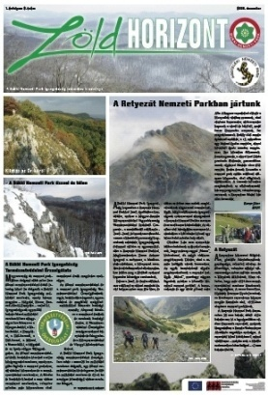

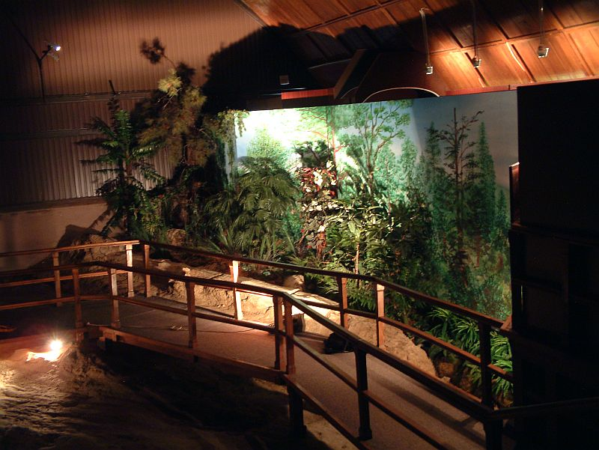
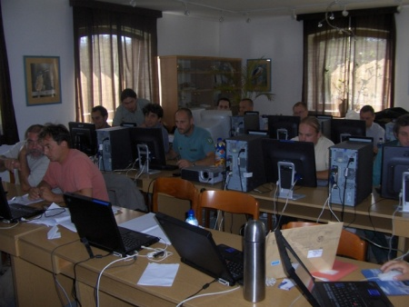
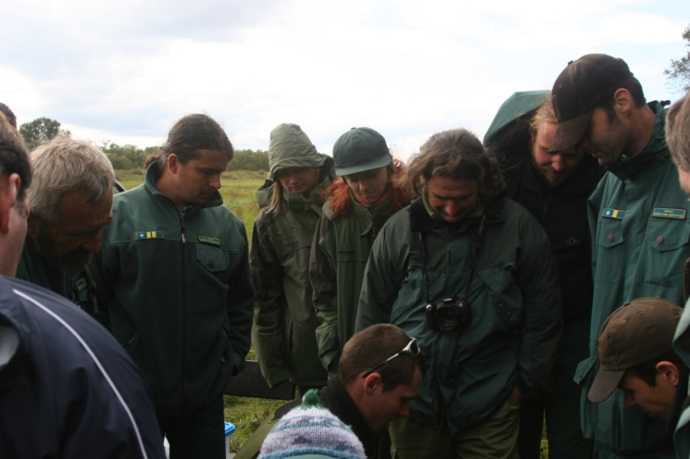
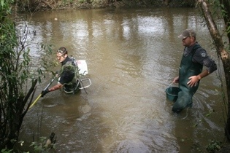
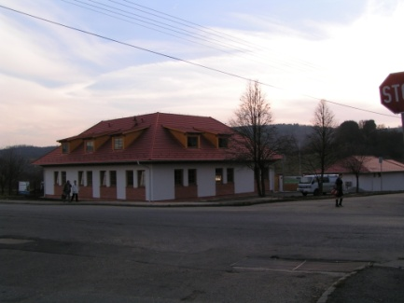
Projects and common activities
Activities supported by joint projects in the last 10 years: GIS education, cross-border biotic research, common field training for rangers, building a visitor center (Baglyaskő), published books and publications, exhibition development

Slide 4
Projects and common activities
Enhancement of the ancient cultural cross border heritage profile of historical Nógrád (Living Heritage, SKHU/1601/1.1/267) Interreg V-A. Slovakia Hungary Cross Border Cooperation Programme (Lead Beneficiary: Mesto Fil’akovo). (09. 2017 – 12. 2019).
Intention of BNDP is to increase the attractiveness of Baglyas-kő fortress in Salgótarján (Visitor Center of BNDP in Nógrád-county) by exploring the archaeological heritage, conserving unearthed artifacts on the site and developing the conditions for demonstration and visitor friendly infrastructure.

Slide 5
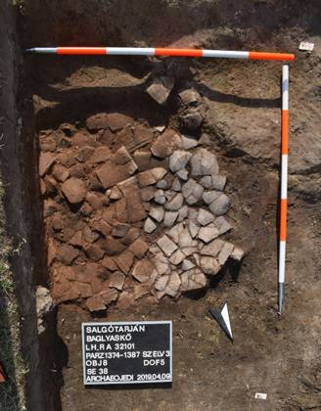
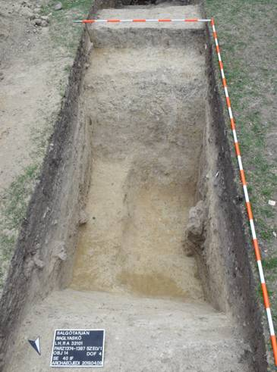
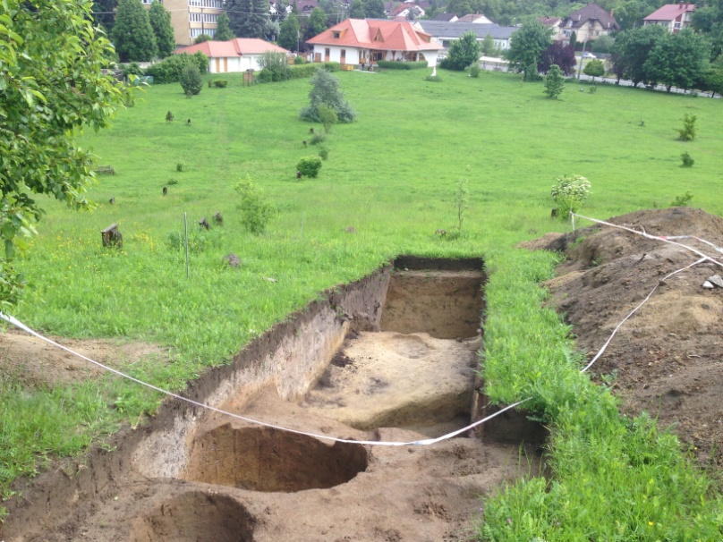
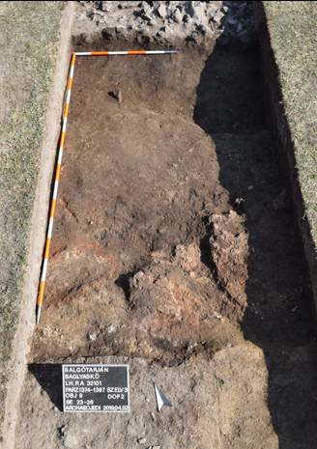
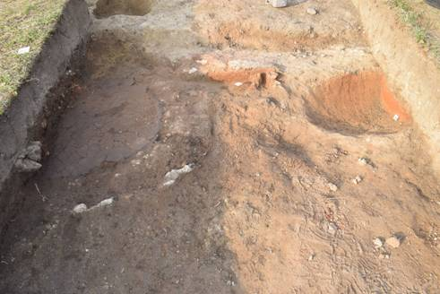
Exploring the archaeological heritage, Baglyas-kő Visitor Center
ceramic foundation of the platinum of prehistoric furnace
the closure of the excavated north defenses - probably the gate to the east
a medieval ground level cut by a prehistoric defenses, with multiple period ovens on it
prehistoric furnaces during excavation

Slide 6

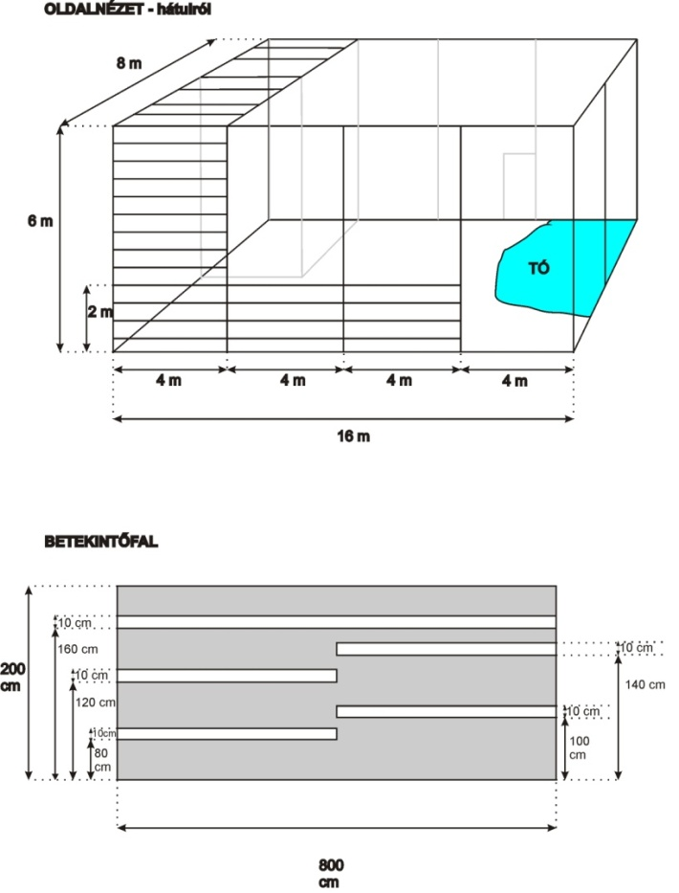
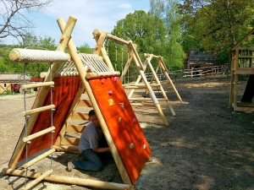

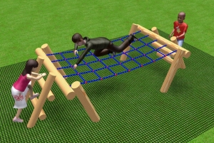
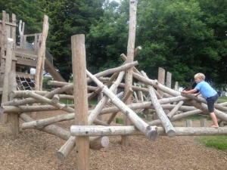
Design elements to be realized, Baglyas-kő Visitor Center
planned stork volier
planned playground

Slide 7
Meeting of Slovak - Hungarian Committee for Nature Conservation and Landscape Protection
Budapest, 13. 09. 2019.
„Danube-Ipoly National Park Directorate”

Slide 8
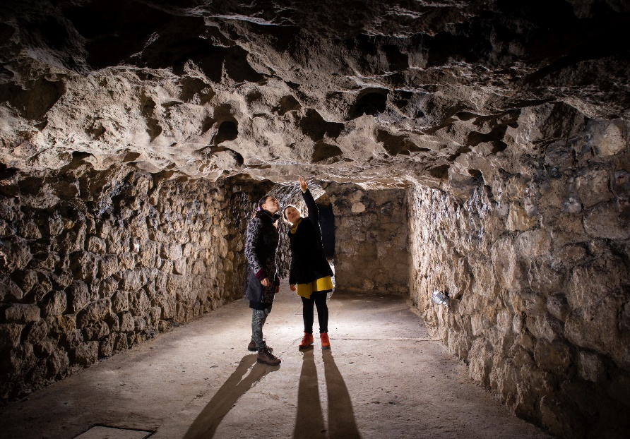
Projects and common activities
A delegation of State Nature Conservancy of the Slovak Republic - Slovak Caves Administration visited the caves of Budapest
Between 16-18 of May 2019, András Füri, director of DINPD received Lajos Gaál and his six colleagues. We guided them in the Molnár János Cave and Buda Castle Cave.

Slide 9
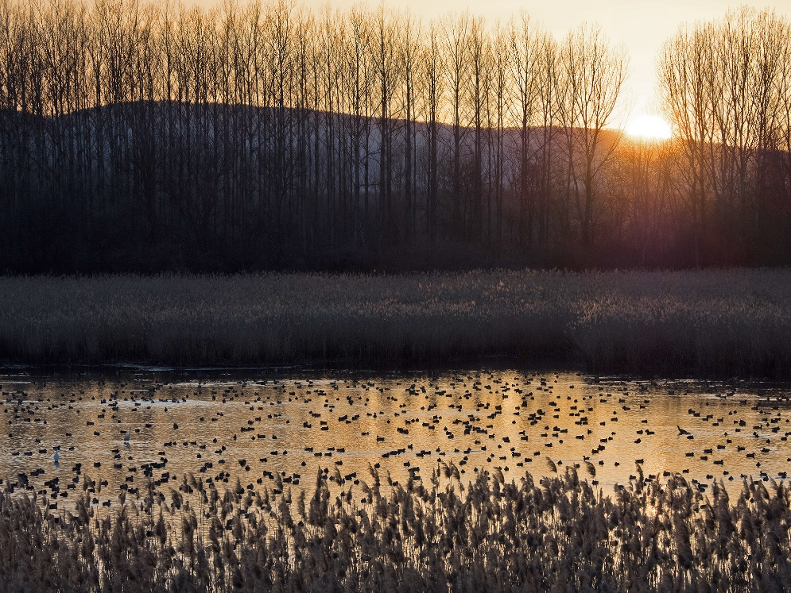
Projects and common activities
Cooperation between professionals of the NGO SOS BirdLife Slovakia and DINPD
Common waterbird survey along the Ipoly river in January-May 2019
Changing experiences

Slide 10
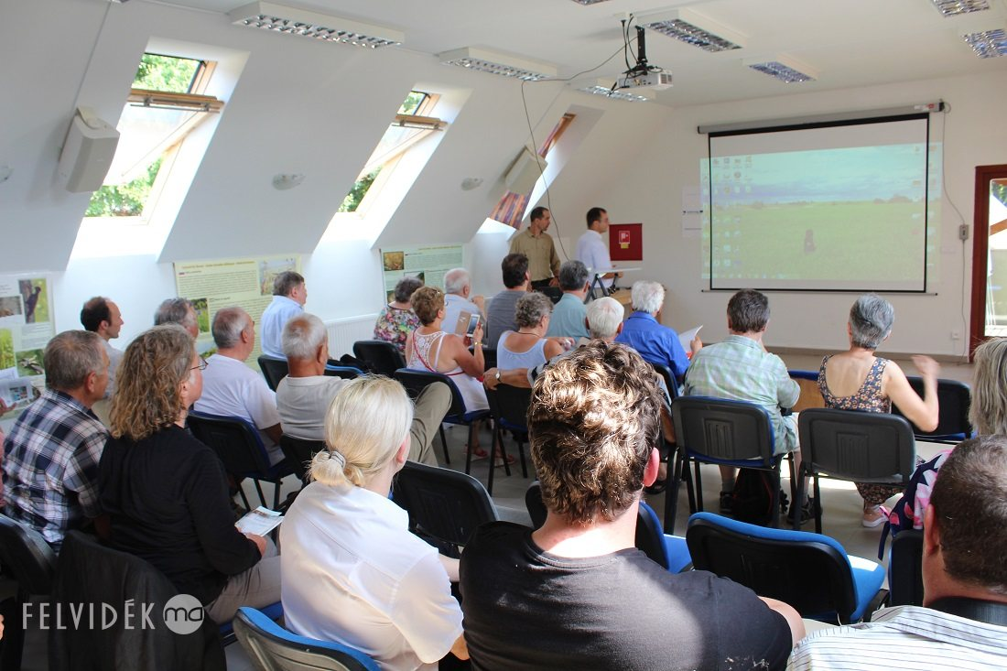
Projects and common activities
Cooperation between professionals of the NGO Ipeľská Únia and DINPD
In August 2019, Ádám Selmeczi-Kovács (DINPD) gave a presentation on the „Ipoly-day” in Kingfisher Visitor Center, Ipolyság
Changing experiences

Slide 11
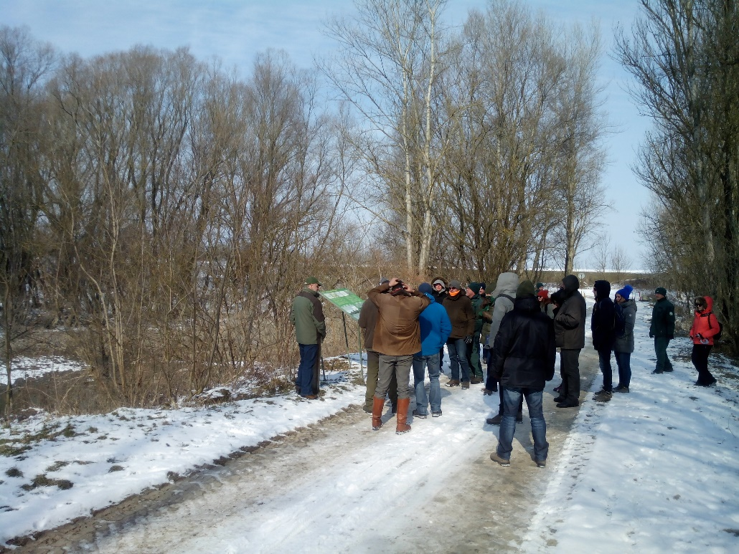
Projects and common activities
Cooperation between professionals of the NGO BROZ and DINPD
Working together in the Danube Transnational Program „Danubeparks Connected”
Working together in a DTP-SeedMoney Fascility Program
Working together in the LIFE+ project „Danube Floodplains”

Slide 12
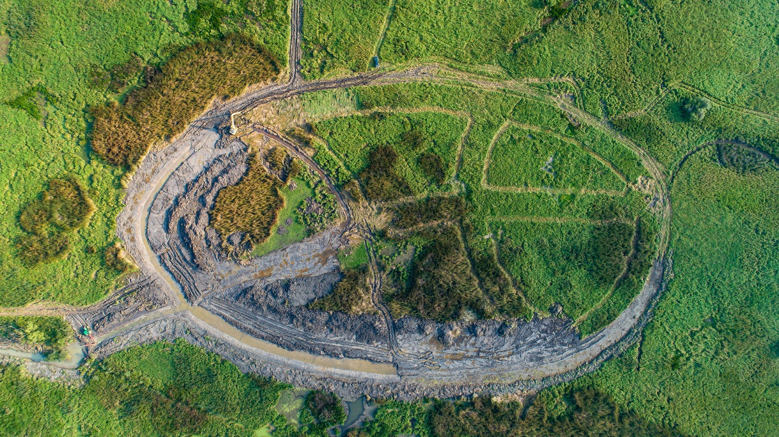
Projects and common activities
Residential forum about an EU-project in the Ipoly Valley
In May 2019, DINPD gave information for local Hungarian and Slovakian people about an ongoing project in the Ipoly Valley, financed by KEHOP

Slide 13
Meeting of Slovak - Hungarian Committee for Nature Conservation and Landscape Protection
Budapest, 13. 09. 2019.
„Fertő-Hanság National Park Directorate”

Slide 14




Preparation of Szigetköz-Žitný ostrov Nature/National Park and implementation of other joint activities in the field of nature education and tourism
Title of the project: Nat-Net Duna/Dunaj 2
Duration of the project: 01.07.2017 – 31.10.2019
Total project budget: 464 460,20 EUR
ERFA contribution: 394 791,17 EUR
Nat-Net Duna/Dunaj 2

Slide 15
Project objectives:
.
- further development of transboundary nature tourism in the area.
.
- further development of joint transboundary activities of rural development institutes on both sides of the border.
.
- development of joint nature education activities of schools on both sides of the border.
Nat-Net Duna/Dunaj 2

Slide 16
Lead partner: Fertő-Hanság Nemzeti Park Igazgatóság
.
Other Partner:
.
- Regionálna rozvojová agentúra Šamorín
- Štátna ochrana prírody Slovenskej republiky
- Pisztráng Kör Waldorf Természetvédő és Természetjáró Egyesület
- Mosonmagyaróvár Város Önkormányzata
Nat-Net Duna/Dunaj 2

Slide 17
Activities within the project
Preparation of a joint transboundary Nature/National Park
Create a new Nature Park in Szigetköz
To make a basic documentation of a new National Park in Csallóköz/Žitný ostrov
Prepare a joint transboundary management plan of a transboundary Nature/National Park
Nat-Net Duna/Dunaj 2

Slide 18
to develop Gombócos Nature Education Center with some new equipments and buildings
- Implementation joint nature education programs for HU and SK kids from both side of the border
- joint program
- joint mobile exhibitions
- joint trainings for teachers
- joint PR actions etc.
Nat-Net Duna/Dunaj 2

Slide 19
Problems:
The project will be closed in one and half months.
While all partners are ready with their own activities within the project to close soon, we kindly ask update information from SOP SR as soon as possible.
Nat-Net Duna/Dunaj 2

Slide 20
Meeting of Slovak - Hungarian Committee for Nature Conservation and Landscape Protection
Budapest, 13. 09. 2019.
„Aggtelek National Park Directorate”

Slide 21
Projects and common activities
Medical/wellness tourism development in the world heritage caves of the Aggtelek and Slovak Karst
Birds without borders

Slide 22
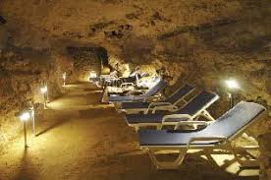
Medical/wellness tourism development in the world heritage caves of the Aggtelek and Slovak Karst
Project number: SKHU/1601/1.1/035
Project duration: 01.11.2017 - (31.10.2019) 30.06.2020.
Total budget: ~ 500 mil. HUF / 1.616.098 EUR
ANPI budget: ~ 400 mil. HUF / 1.303.524 EUR
Cross-border partner: State Nature Conservancy of the Slovak Republic
Target:
The aim of the project is to conduct obligatory surveys required for obtaining the certification of the caves of the cross-border cave system of the Aggtelek and Slovak Karst as therapeutic caves... (Béke cave, Baradla cave, Domica cave)

Slide 23
Activities:
Conduction of basic surveys such as geophysical surveys, water staining surveys, geophysical surveys, water chemistry, pedology, microbiology and radiology, contaminants survey, hydrodinamic modelling, cave atmosphere model.
Development of medical tourism infrastructure including real estate purchase, necessary construction and renovation works inside and outside the cave, evolving a place for climate therapy
Procurement of equipment related to medical therapy
Conduction of test therapy
Professional publication, leaflets and publications
As the result of the project, the certified therapeutic cave will become a rare tourist attraction both in Hungary and Slovakia.

Slide 24
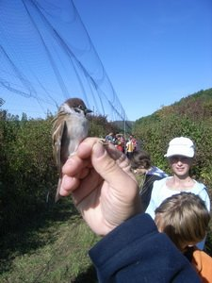
2. Birds without borders
Project number: SKHU/1601/1.1/065
Project duration: 01.11.2017 – 31.10.2019.
Total budget: ~ 126 mil. HUF / 480.156 EUR
ANPI budget: ~ 48 mil. HUF / 154.625 EUR
Lead partner: SOP SR (State Nature Conservancy of the Slovak Republic)
Target:
The project aims to improve quality of conditions for migratory birds observation in the ornithological camps, to improve conditions for study, research and field demonstration activities contributing to a better quality of field presentation.

Slide 25
Activities:
Improving access to bird watching stations
Renovation of bird catching and presentation equipment
Construction of nature trails, bird watching towers
Expanding education and training programs
Widespread promotion of the program
The project also contributes to expanding eco-touristic attractions of the cross-border region by presenting the area's ornithological values.

Slide 26

Thank you for your attention!

