Slide 1



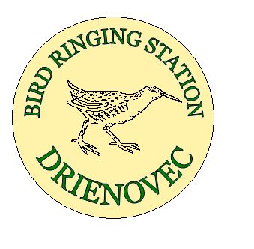
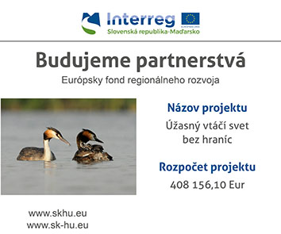
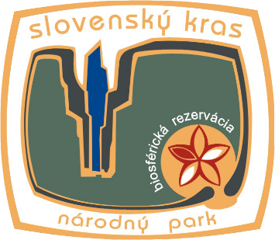
„Úžasný vtáčí svet bez hraníc“
„Birds without Borders“

Slide 2

Title of the Programme: Interreg V-A Slovakia Hungary Cross Border
Cooperation Programme
Priority Axis: Nature and culture
Specific objective: To increase the attractiveness of the border area
Acronym: Vtáčí raj - Bird of paradise
Aim: to develop eco –tourism opportunities at important ornitological sites in the Bodva valley, as part of Special Protection Areas and national parks Aggtelek and Slovenský Kras - by building infrastructure, raising awareness of visitors and improving of habitat status of protection Project time: 02. 11. 2017 – 28. 02. 2019 ( 16 months)
Overall budget: 408 156,10 EUR
LB: Štátna ochrana prírody Slovenskej republiky
B: Aggteleki Nemzeti Park Igazgatóság
Projekt „Úžasný vtáčí svet bez hraníc“ – Birds without Borders

Slide 3
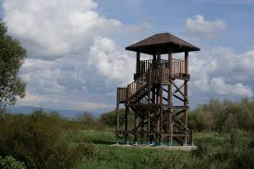
Projekt „Úžasný vtáčí svet bez hraníc“ – Birds without Borders
Activities
Building of 3 birdwatching towers (2SK- Hrhov, 1HU- Rakaca), 4 information panels, (2SK, 2HU) and 8 information panels for the towers
Organisation of birdwatching excursions
Purchase of 5 adders, counters to be placed by the towers and educational trails (3 SK, 2HU)
Development of an interactive map –to point out sites of importance on both sides of the border
Reconstruction of 1250m of the road leading to Szalonna ornithological station

Slide 4
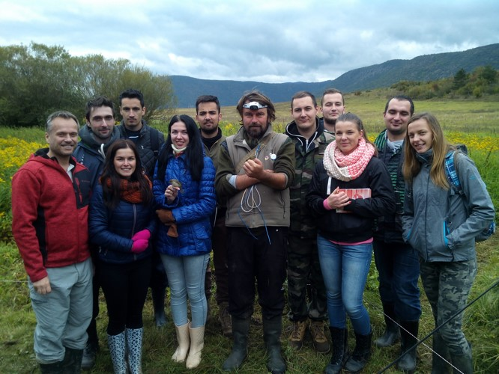

Projekt „Úžasný vtáčí svet bez hraníc“ – Birds without Borders
Activities
Building of Green trail at ornithological station Drienovec, reconstruction and finishing off the trail at Szalonna
Purchase of equipment for ornithological station
Equipping the mobile eco-lecturing room to be used in the area
Organisation of excursions for students at birdwatching stations
Removal of excess shrubs on both birdwatching stations
Perparation of children colouring book and worksheets for primary school students
Promotion materials: T-shirts, bags, pens, brochures and leaflets

Slide 5
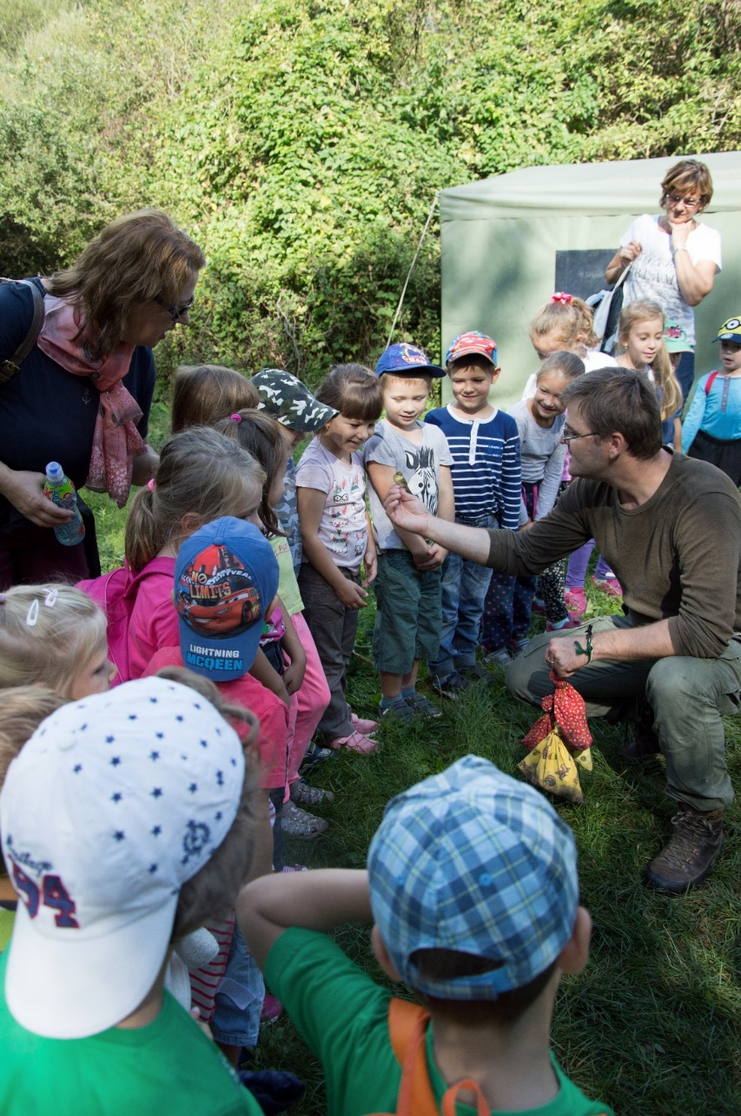
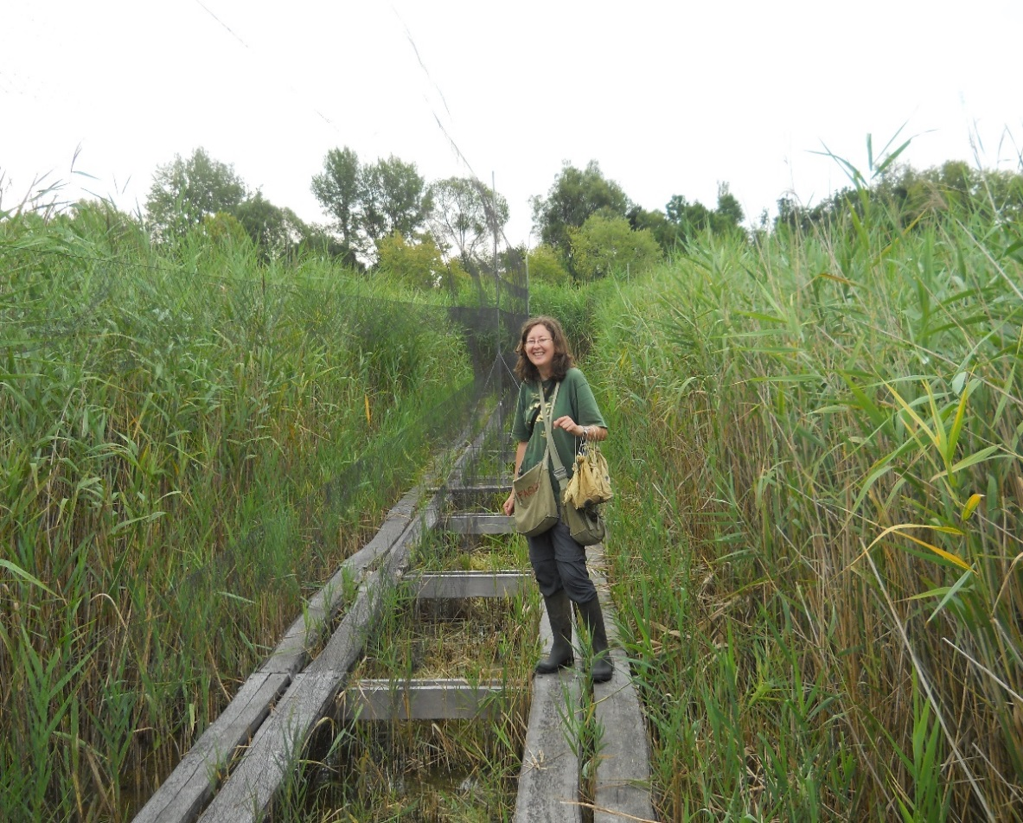
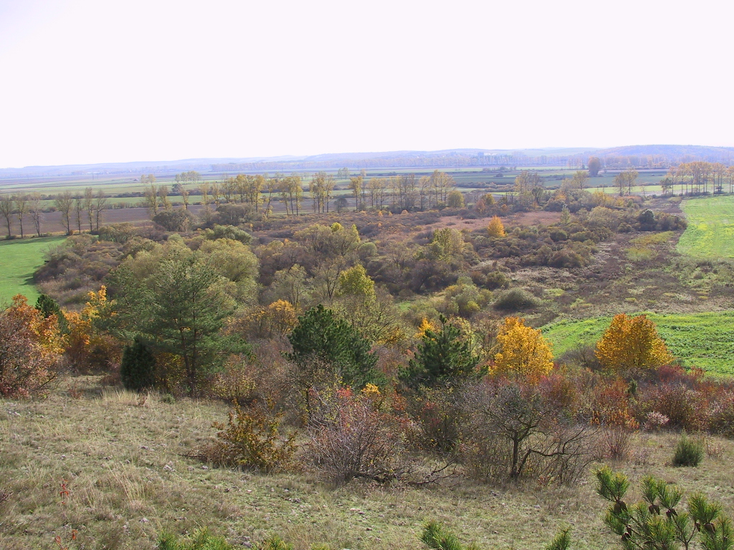
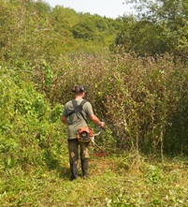
Projekt „Úžasný vtáčí svet bez hraníc“ – Birds without Borders
Indicators:
7000 visitors per year
7 ha managed
2,7 km of infrastructure
Specific Indicators:
6 women participating in the project
3 project documentations
5 pcs of infrastructure built
8 articles in media
1 interactive map created
7 events organised

Slide 6
Project Sumary in English
The Slovak Karst NP in Slovakia and Aggetelek NP in Hungary are a well-known cross-border karst region. The project "Birds without Borders" emphasises its further unique feature, the special protected area situated on both sides of the border. The waters in the valley of the river Bodva are important resting places of the migrant birds.
Both national parks have been performing research activities focusing especially on the research of bird migration, by means of the Drienovec Ornithological Station in Slovakia and the Bódva-valley Bird Migration Monitoring and Nature Conservation Camp, near Szalonna in Hungary.
The main outcome of the project is to broaden the services of the ornithological camps for both professionals and the public, by improving accessibility, providing better equipment for catching and observing birds, providing full-time professional and lecturer service for the visitors during the migration season, creating adventurous nature trails directly at the ornithological camps, creating observation towers at other venues and introduction of eco-education activities for the visitors all year, even beyond the main bird migration season.
An important part of the project is the creation of a Slovak-Hungarian interactive web map, showing the significant bird watching sites and further points of interest for the visitors focusing on nature conservancy at this cross-border karst region, providing information about eco-educational events and camps with the demonstration of bird-banding, etc.

Slide 7
In addition to the significant outcome of the project, i.e. the increase of visitors coming to the region, the project also contributes to the protection of the bird species and their habitats. One of the pillars of the project is the cooperation and mutual interchange of experience performed by the two national parks, since birds do not respect political borders and the visitors may be informed about the current news and interesting articles of the given venues.
The aim of the project is to provide more opportunities for ecotourism to unique migratory birds sites in the Bodva Valley as a part of cross-border Protected Birds Areas and National Parks Aggteleki and Slovenský Kras. It will be achieved through
-broadening the range of eco-tourism services at the bird monitoring stationary (ornithological camps),
-improvement of their accessibility for visitors,
-improvement the quality of field presentation,
-provision of full-time presence of the experts serving the visitors and schools,
-performing ornithological demonstrations and leisure all year long,
-building three bird watching towers,
-creating the adventure trails (one in the water habitats on the Slovak side and labyrinth in a fully closed scrub area on the Hungarian side).

Slide 8
Project objectives
As part of the project, a mobile eco-lecturing room shall be created, performing eco-educational activities for children at venues attractive to tourists. The significant locations appropriate for bird observation, further interesting nature facts of the cross-border region, the current activities of the ornithologists, the planned camps, the programme of the eco-lecturing room and further activities shall be published on our website with an interactive map and a mobile application.
Since wildlife camps and birdwatching stations are currently very attractive and the demand for these is constantly growing, the output of the project shall contribute not only to the increase of the number of visitors at these ornithological stations, but also to the permanent increase of the number of visitors in the region. In addition to this, by performing lectures and raising awareness, as well as by practical interference in the bird habitat it shall contribute to the conservancy of the endangered bird species and their habitats.

Slide 9
Expected outputs, results
The improvement of the access road leading to the ornithological station near the village of Szalonna, the improvement of the basic infrastructure for the professionals/lecturers and the material and technical equipment for birdwatching at the camps shall increase the numbers of visitors in both camps not The erection of 3 birdwatching towers and 2 experience trails, the installation of information boards shall broaden the possibilities of individual birdwatching, even without a professional guide. The mobile eco-education facility shall broaden the service offering of environmental and educational activities in the field, at the territory of the National Park.
We will also improve the protection of bird habitat at our an area totalling 27 hectares (3 ha of wetlands near Drienovec and the modification of 4 ha of bush habitats near Szalonna). The improvement of information sharing shall be also achieved by our website with an interactive map, a mobile application and publishing 29,000 copies of brochures and other information materials for the public.

