Slide 1
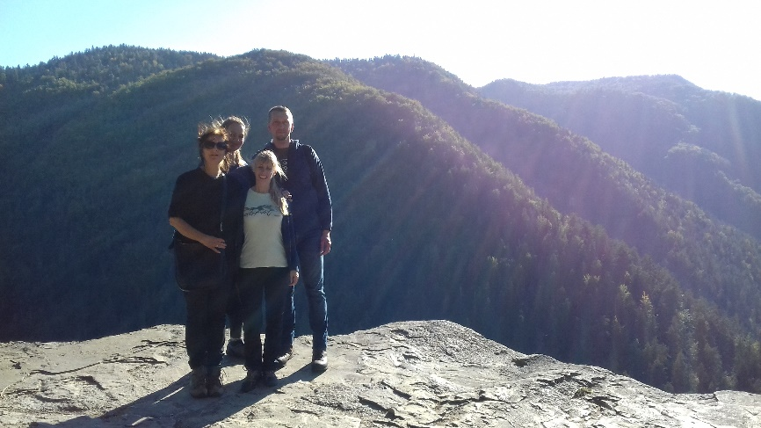
Update on Natura 2000
and other issues
HU-SK working group on Nature Conservation and Landscape Protection
Budapest, 13th September 2019

Slide 2

Natura 2000: management plans
Progress in adoption of the management plans
642 SCIs/SACs
93 plans approved for 100 SCIs (57 in Febr. 2018)
Letter EC of formal notice (July 2019) on designation, conservation objectives and conservation measures
41 SPAs
18 plans approved by the government (6 in Febr. 2018)
including 3 SPAs bordering HU: Poiplie, Dolné Považie, Košická kotlina

Slide 3
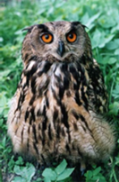
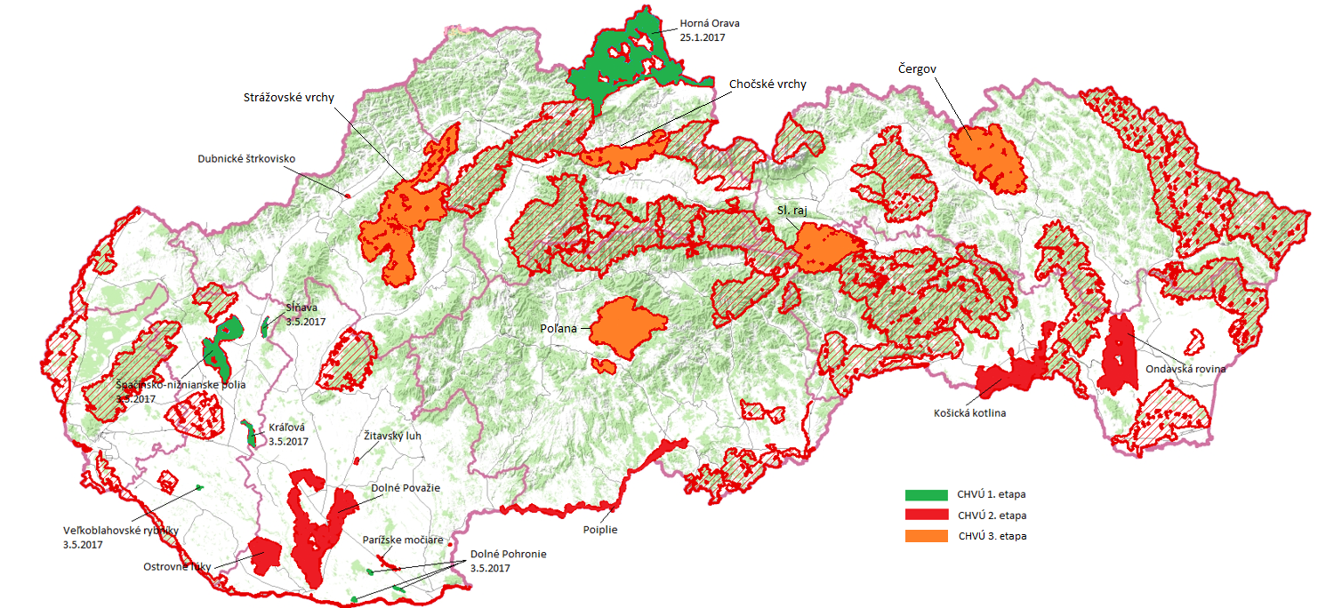
Natura 2000 - SPAs in Slovakia
+ (draft) SPA Management Plans

Slide 4
Natura 2000: negotiations
Negotiations with the European Commission
„nature dialogue“ - 30. 5.-1.6.2018 (10 issues)
- sufficiency of national list of SCIs (after addition of 169 new sites in Oct. 2017) - 13.11.2019
letter of formal notice (July 2018) – reason opinion (January 2019) on habitat protection ofTetrao urogallus
reasoned opinion (July 2019) on sufficiency

Slide 5
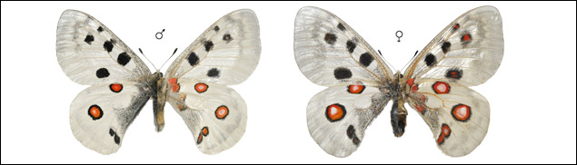
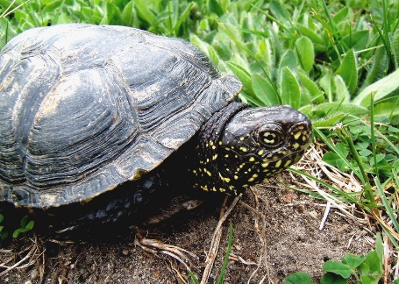
Natura 2000:rescue programs
Adoption of 5 rescue programs for 6 species.
2017:
Mountain apollo Parnassius apollo
European pond turtle (Emys orbicularis)
2018:
Western capercaillie (Tetrao urogallus) - 13. April 2018
Black Grouse (Lyrurus tetrix) - 24. May 2018
2019:
Great Bittern (Botaurus stellaris) - 22. August 2019
Ferruginous Pochard (Aythya nyroca) - 22.August 2019
https://www.minzp.sk/oblasti/ochrana-prirody-krajiny/druhova-ochrana-prirody/programy-zachrany/
Notes:
Hluchán hôrny -The western capercaillie (Tetrao urogallus) (2018)
Tetrov hoľniak – Black Grouse (Lyrurus tetrix) (2018)
Bučiak veľký – Great Bittern (Botaurus stellaris) (2019)
Chochlačka bielooká – Ferruginous Pochard (Aythya nyroca) (2019)
- Reasoned opinion – January 2019 - Non-conformity of Slovak legislation with Article 6(3) of the Habitats Directive and bad application of Article 6(2) of the Habitats Directive and of Article 4 of the Birds Directive

Slide 6
Natura 2000: reporting
Report fom 2013 – 2018 according to the Article 17 of the Habitats Directive
102 assessment for 66 habitats
316 assessments for 199 species
1 meeting of the Coordination board (MoE)
Report submitted in time (SK was the 3rd fastest)

Slide 7
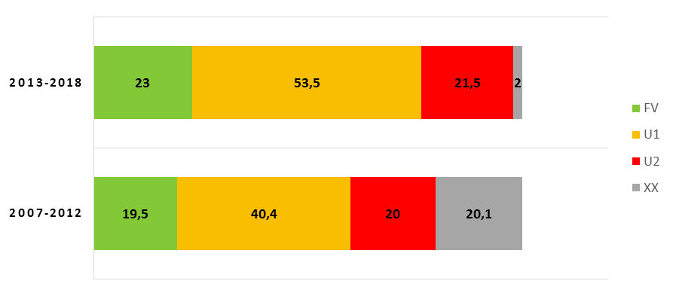
Natura 2000: summary for species and habitats assessments

Slide 8
Natura 2000: reporting
Report for 2013 – 2018 according to the Article 12 of the Birds Directive
Progress in
knowledge (75 species mapped, definitions of FCS for 235 species + 3 „national books + complex information system - www.biomonitoring.sk,
preparation and approval of the documentation,
implementation of activities (elimination of mortality – el. infrastructure, IKB etc, restoration of wetlands..
251 evaluations for 232 species (including 81 species „for SPAs“)
2 meetings of the Coordination boards (SOP SR)

Slide 9
Natura 2000: reporting
Evaluations (birds, other species, habitats) available also on:
http://www.sopsr.sk/natura/

Slide 10
other highligths ...
new 2030 envirostrategy GREEN SLOVAKIA - adopted by Government (Feb. 2019) – framework for legal changes
Stop loss of biodiversity... (OECD, strategy of protected areas, restoration of 15 % of degraded ecosystems...)
Institutional reform (competencies within protected areas, change of SOP SR, system of financing ...)
Simplify system of protected areas and unify „no intervention regime“ ...
National parks – closer to IUCN criteria, by 2025 core zone in 50 %, by 2030 core zone in 75 % of national parks, zonation finalized
Nature and Landscape Protection Strategy – on SEA
a

Slide 11
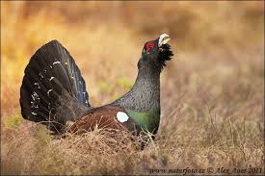
other highligths ...
Amendment of the CITES act + order of MoE
New Act on IAS
Amendment of Nature and Landscape Protection Act
– 11. Sept. 2019 adopted by the parliament

Slide 12

Thank you for your attention
www.enviro.gov.sk, www.sopsr.sk
jana.durkosova@enviro.gov.sk
branislav.hrabkovsky@enviro.gov.sk

