Slide 1
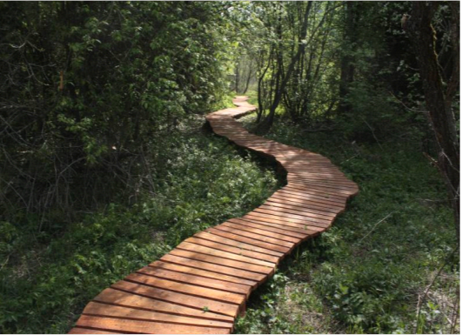
Update on Natura 2000
and other issues
HU-SK working group on Nature Conservation and Landscape Protection
Dunajská Streda, 27th February 2018

Slide 2

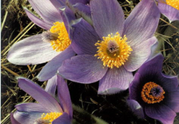
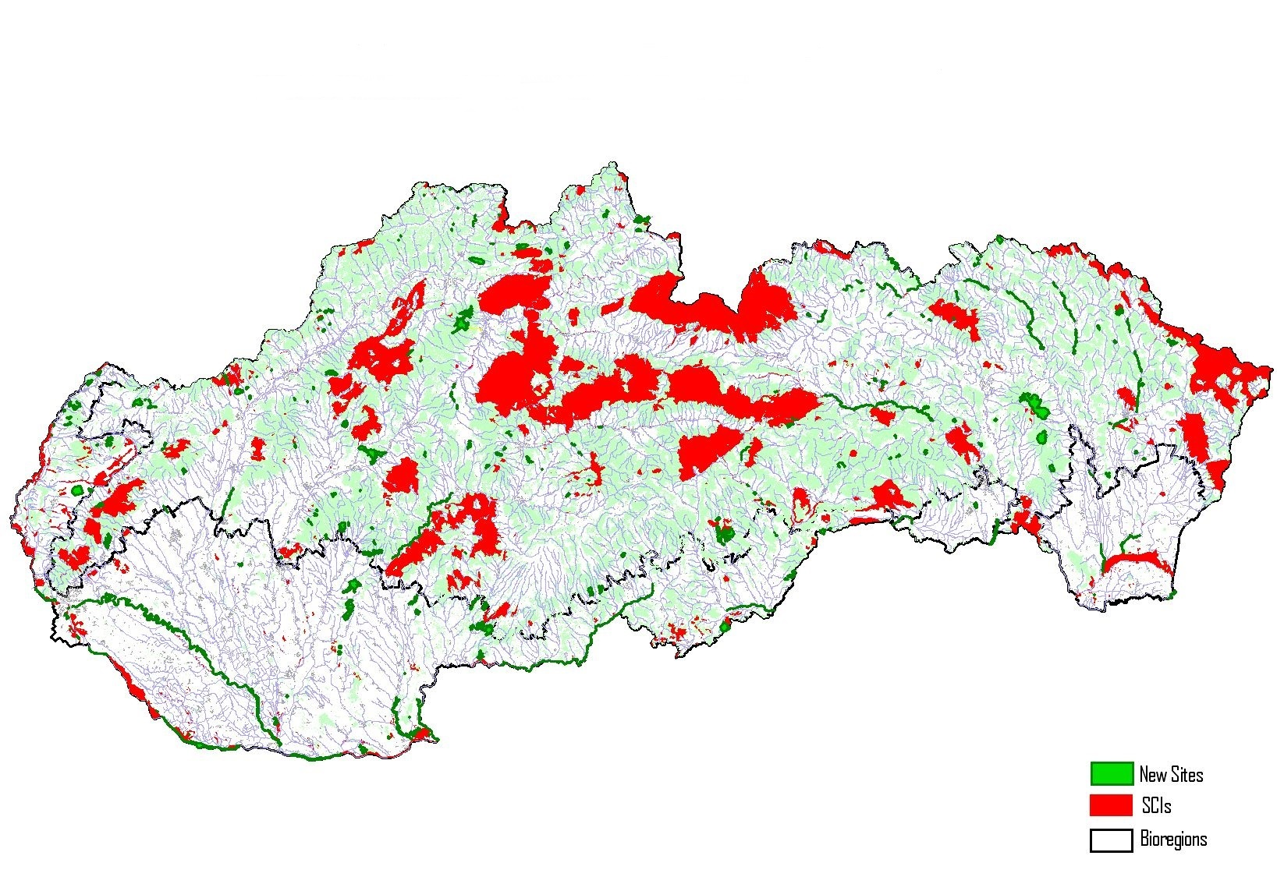
Natura 2000 – SCIs in Slovakia

Slide 3

Natura 2000 - SCIs
*642 SCIs/SACs
*12.56 % of Slovakia
*83 % overlap with other protected areas
*309 designated (EU Pilot 2016)
* 57 approved management plans (EU pilot 2016)
*3 phases: A (2004) + B (2011) + C (2017 –EU pilot 2015)

Slide 4
Natura 2000 - SCIs
!!!NEW!!!
*C phase:
*169 sites
*cca 31 656 ha
*0.64 % of Slovakia
*43 meetings
*190 official invitations/meetings at villages
*almost 500 personal invitations
*42 other meetings (sectors, associations..)
*15th October 2017 approved by Government
*30th October 2017 submitted to the Eur. Commission
*May/June 2018 bilateral meeting with the Eur. Commission

Slide 5
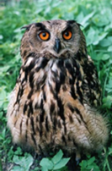
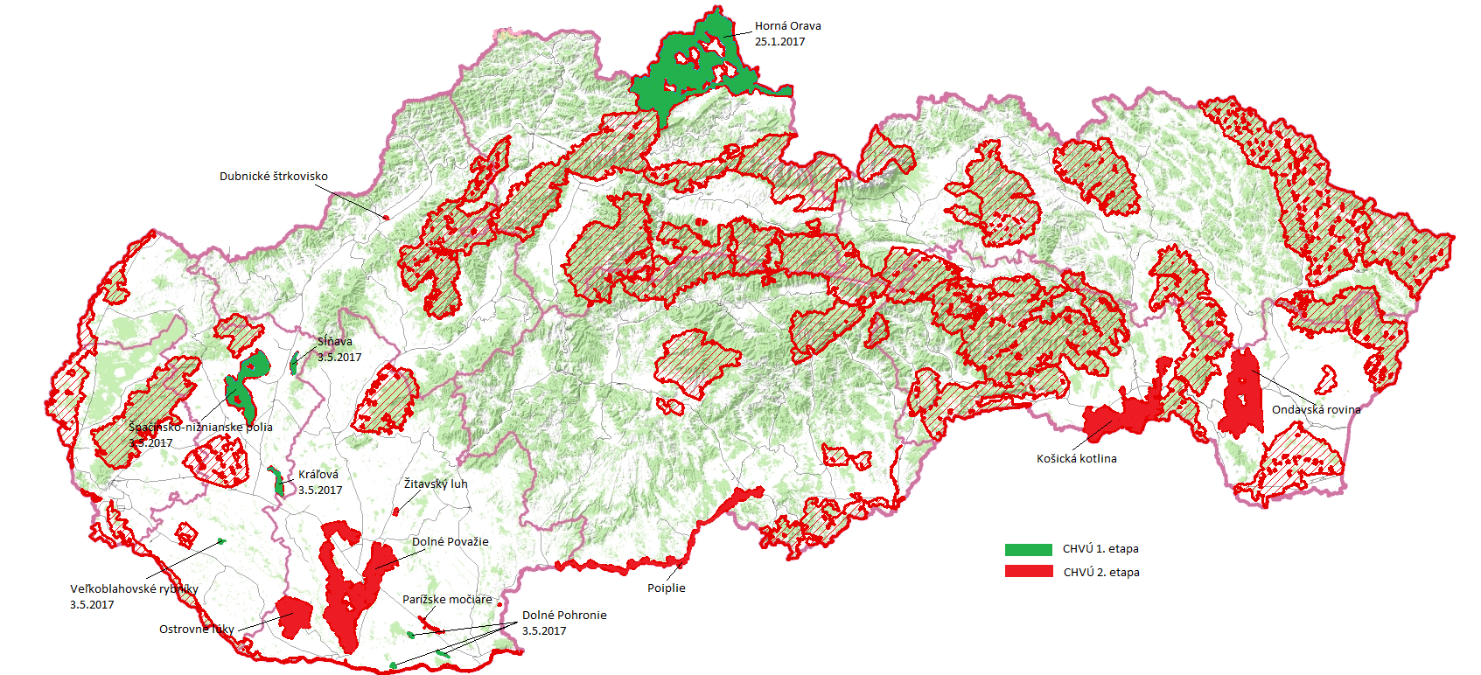
Natura 2000 - SPAs in Slovakia
+ (draft) SPA Management Plans

Slide 6
Natura 2000 - SPAs
*41 SPAs
*26.10 % of Slovakia
*51.6 % overlap with other protected areas
*all 41 designated
!!!NEW!!!
* 1 + 5 approved management plans (2017, EU pilot 2016)
* 8 negotiated management plans (2018)
*20 prepared + 7 needed (2018-2019)

Slide 7
Draft Envirostrategy
!!!NEW!!!
SEA on new 2030 envirostrategy GREEN SLOVAKIA
Stop loss of biodiversity... (OECD, strategy of protected areas, restoration of 15 % of degraded ecosystems...)
Institutional reform (competencies within protected areas, change of SOP SR, system of financing ...)
Simplify system of protected areas and unify „no intervention regime“ ...
National parks – closer to IUCN criteria, by 2025 core zone in 50 %, by 2030 core zone in 75 % of national parks, zonation finalized
Nature and Landscape Protection Strategy

Slide 8
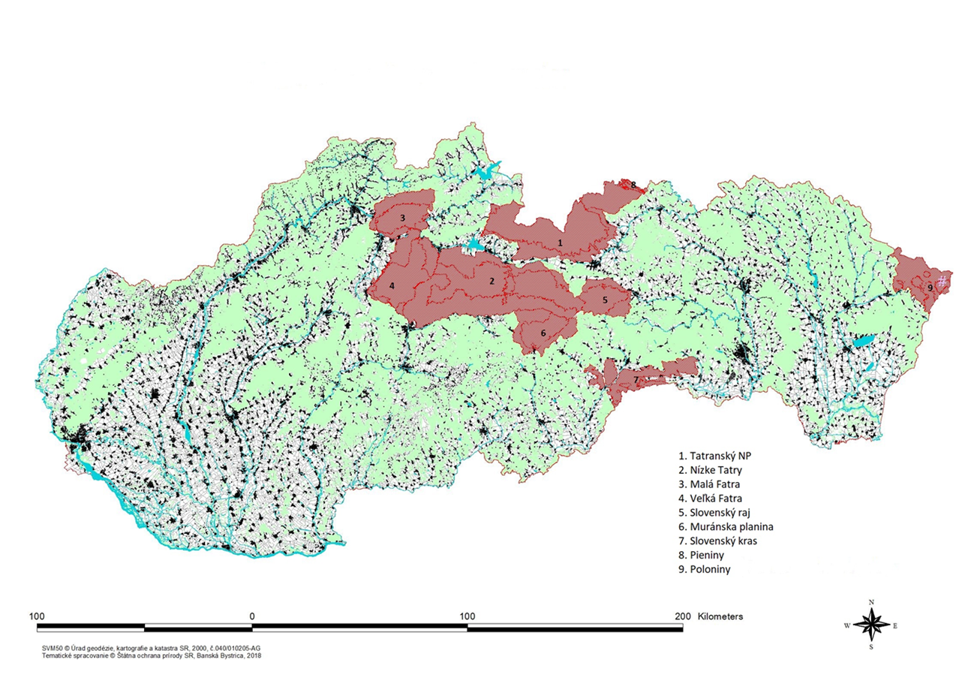
National Parks in Slovakia
National Parks of Slovakia

Slide 9
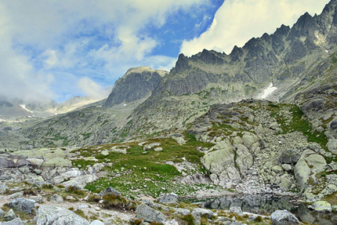
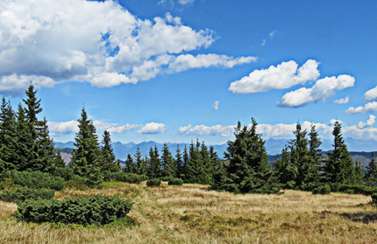
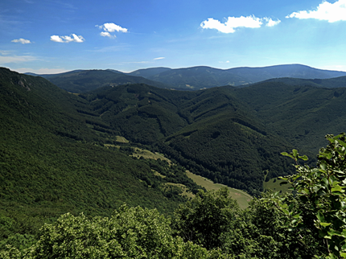
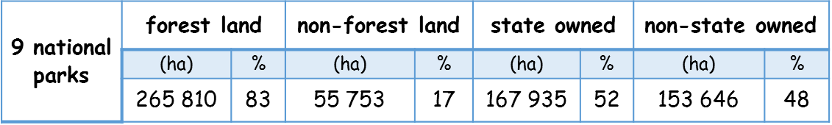
Data on National Parks
National park | Area ( ha) | Employees of Park Administration
Veľká Fatra | 41 065 | 13
Nízke Tatry | 76 759 | 26
Pieninský NP | 3 712 | 10
Tatranský NP | 73 888 | 35
Malá Fatra | 21 425 | 14
Poloniny | 30 756 | 15
Muránska planina | 20 199 | 14
Slovenský kras | 34 367 | 11
Slovenský raj | 19 412 | 20
Total | 321 583 | 158 (from 482)
Tatranský národný park
Nízke Tatry
Muránska planina

Slide 10
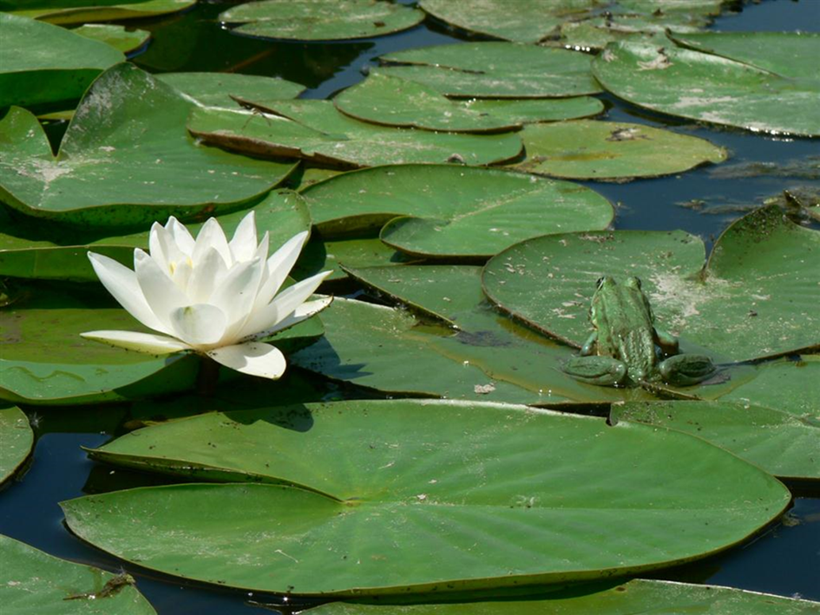
Thank you for your attention
www.enviro.gov.sk, www.sopsr.sk
Jana.durkosova@enviro.gov.sk
Janka.guzmova@enviro.gov.sk
Peter.kuric@enviro.gov.sk

