Slide 1

Programme
LIFE
Programme
interreg
ce
Programme
interreg
Sk-hu
Co-operation projects with HU partners
Bratislava, 12.06.2024

Slide 2
Programme LIFE
LIFE21 IPE/SK/069837 - Living Rivers (Implementation of the river basin management plan in selected river sub-basins in Slovakia)
Project duration: 01/2023-12/2032
Budget (SNC SR part): 650 549,30 EUR
Project partners (10): Water research institute; MoE SR; Slovak Water Management, state enterprise; SNC SR; OZ BROZ; WWF Slovakia; Catch Me If You Can; University of South Bohemia in České Budějovice; NP TANAP; Vodohospodárska výstavba, š.p.
Stakeholders_SK(13): Slovak- Hungarian commission of border waters
Stakeholders_EU (2): The International Commission for the Protection of the Danube River (ICPDR), WWF CEE
Stakeholders_HU (3): North Transdanubian Water Directorate (Ed-uviz ig), WWF Hungary, Pisztráng Kör Egyesület- Trout Circle Association,
Stakeholders_CZ (5); Stakeholders_Austria (2);
Project aim:
The main goal of the Living rivers project is to contribute to the implementation of the 3rd Water Plan of Slovakia (2021-2027). We want to achieve this through measures to eliminate hydromorphological pressures and by addressing the ecological objectives of the Water Framework Directive and the Habitats Directive.
In cooperation with all interested parties, we will create a harmonized program of measures aimed at improving the ecological status/potential of water bodies with the greatest revitalization potential on the Danube, Hron, Ipeľ, Belá.
https://livingrivers.sk/

Slide 3
Programme LIFE
LIFE strategic nature projects:
SNC SR participated at integrated and traditional LIFE projects
We currently have no experience focusing on SNAP PROJECTS (the recommended project implementation interval is 8-10 up to 14 years)
Concept notes: Deadline date: 5 September 2024
https://cinea.ec.europa.eu/programmes/life/life-calls-proposals-2024_en

Slide 4
Programme INTERREG CE
CE0100170_Supporting the coexistence and conservation of Carpathian LargE CArnivores
Project duration: 04/2023-03/2026
Budget (SNC part): 339 950,52 EUR
Project partners (12): Mendel university in Brno, WWF Poland, WWF Slovakia, WWF Hungary, Technical university in Zvolen, Bükki Nemzeti Park Igazgatósága (HU), Tatrzański Park Narodowy (PL), SNC SR, Hnutí DUHA Šelmy (CZ), Ministerstvo životního prostředí (CZ), Asociatia Zarand (RO), Zavod za gozdove Slovenije (SI)
Associated beneficiares (12): International Council for Game and Wildlife Conservation (HU), Aggteleki Nemzeti Park Igazgatóság (HU), Agrárminisztérium (HU)
Project aim:
The main goal of the LECA project is the establishment of cross-border cooperation in the protection and management of large animals in the Carpathian countries. The result of the project is the provision of effective measures within important topics such as the harmonization of international monitoring of large animals, the prevention of poaching and the prevention of conflicts between animals and people.
https://www.interreg-central.eu/projects/leca/

Slide 5
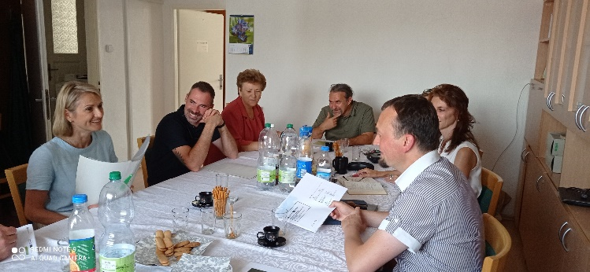
Programme INTERREG HU-SK
WETWORKS_Ecological status assessment, reconstruction, and presentation of
border wetlands
Project duration: 09/2024-12/2032
Budget (SNC part): 401 028,70 EUR
Project partners (3): NP BÜKK, Bükki Természetvédelmi, Kulturális és Ökoturisztikai Alapítvány,
SNC SR- PLA Cerová vrchovina
Core activities (SNC SR):
Mapping of invasive plant species using hyperspectral technology
Chemical analysis of soil and water at Šiatorská Bukovinka
Beaver dam mapping
Zoological research and monitoring in Fenek (9 taxonomic groups + wetland biotopes) Mollusca, Crustacea, Odonata, Coleoptera, Osteichthyes, Amphibia, Reptilia, Aves, Chiroptera, Lutra Lutra
Wetland conservation, inhabitat creation in the area of Fenek marsh
Invasive species eradication in the Šiatorská Bukovinka
Environmental education
WETWORKS project meeting_6.2023

Slide 6
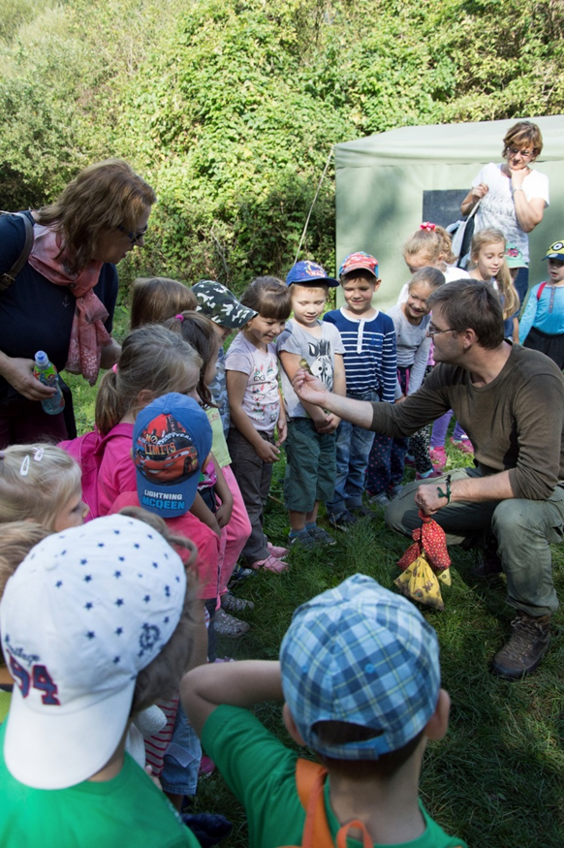
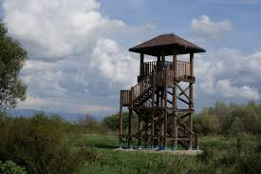
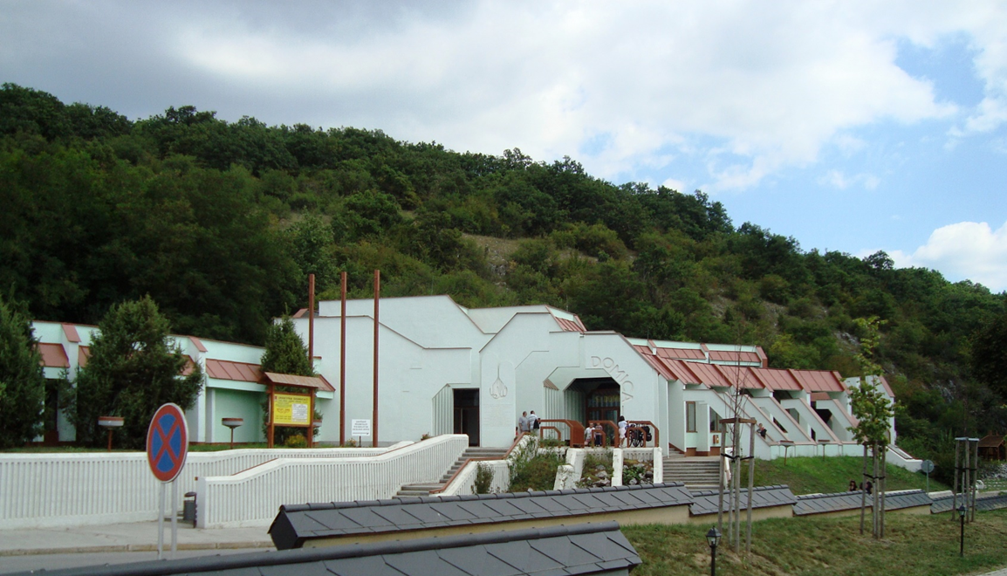





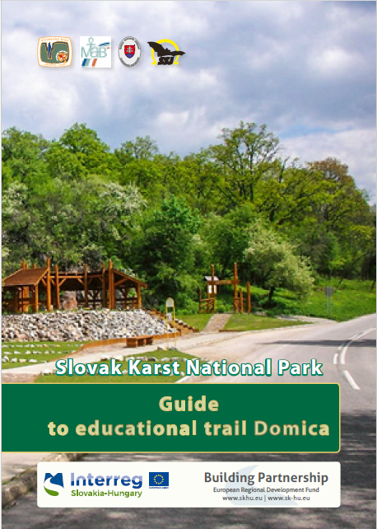
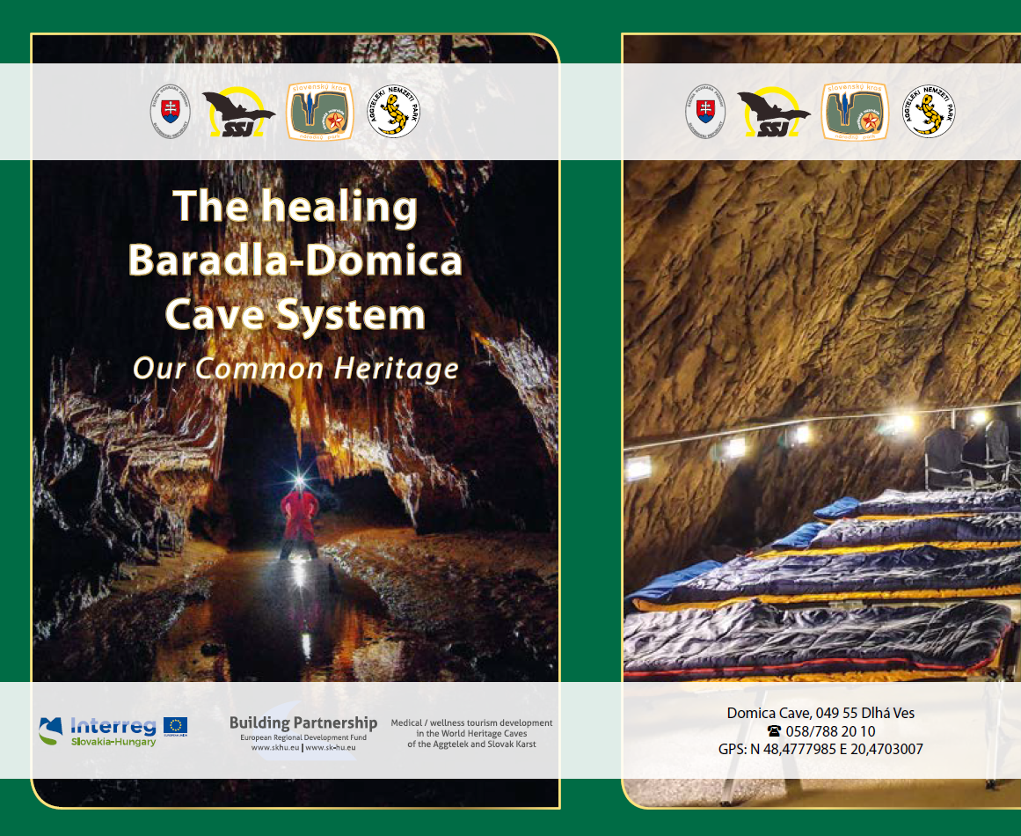
Programme INTERREG SK-HU
previous Cooperation programme 2014-2020 (3 projects):
Activities of the Szigetköz – Žitný Ostrov Nature Park and Joint Nature Protection Activities
Birds without borders

Slide 7
Contact for Bükk NP
SNC SR
Peter Brnák,
Director of Project Department
+421 903 298 101
peter.brnak@sopsr.sk
PLA Cerová vrchovina
Eva Belanová, Director
+421 903 298 147
eva.belanova@sopsr.sk
SNC SR signed a cooperation agreement with Bükk National Park_3/2023
Contact for Fertö-Hanság NP
SNC SR
Peter Brnák,
Director of Project Department
+421 903 298 101
peter.brnak@sopsr.sk
PLA Dunajské Luhy
Mária Vavrik, Director
+421 903 298 275
maria.vavrikova@sopsr.sk
Contact for Aggtelek NP
NP Slovak Karst
Martin Golian, Director
+ 421 903 298 275
np.slovenskykras@npslovenskykras.sk

Slide 8
Thank you for your atention.
www.sopsr.sk

