Slide 1

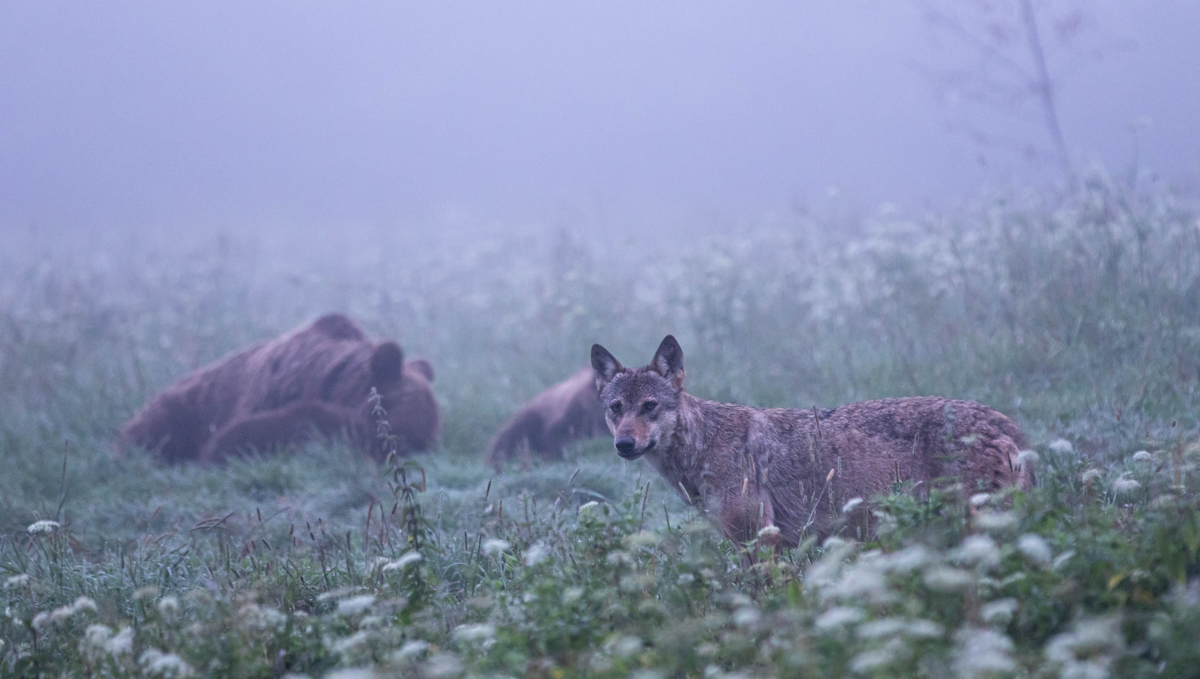


Large carnivores in Slovakia
Photo: Viktor Szabo

Slide 2
Large carnivores in Slovakia
Brown bear (Ursus arctos)
Wolf (Canis lupus)
Habitats Directive 92/43/EEC (Annexes II and V)
Annex II Bern Convention
Annex A of Council Regulation (EC) No 338/97
CITES Annex II
Eurasian lynx (Lynx lynx)
Habitats Directive (Annexes II and IV)
Bern Convention (Annex III)
CITES Annex II
Protected by law according to Act No 543/2002 Coll. and Decree No 170/2021 Coll.
Protected animal of European importance.
Social value is 10 000 €/individual.
Protected by law according to Act No. 543/2002 Coll. and Decree No. 170/2021 Coll.
Protected animal of European importance.
Social value is 3 000 €/individual.
Protected by law according to Act No. 543/2002 Coll. on Nature and Landscape Protection, and according to Decree No. 170/2021 Coll.
Protected animal of European importance.
The social value is 5 000 €/individual.
Within the European Union, the brown bear is protected through the so-called Habitats Directive 92/43/EEC (Annexes II and IV), and the species is part of the Bern Convention (Annex II).
CITES Appendix II

Slide 3
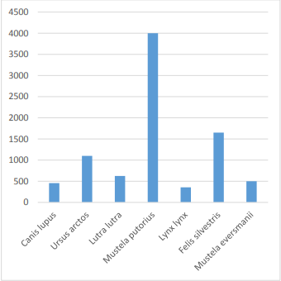
Estimated abundance of carnivores in Slovakia
Estimated population size of carnivore species of Communite interest in Slovakia (number of individuals)
Source: Reporting under Article 17 of the Habitats Directive for the period 2013-2018

Slide 4
Recording of damage
The Ministry of Environment of the Slovak Republic (MŽP SR) sends an annual letter to the Ministry of the Interior of the Slovak Republic (MV SR) requesting information on compensation for damage caused by designated species. The MV SR has data on compensation paid on the basis of decisions of district authorities.
In 2020-2021, the information system was built and in 2022 a test run was launched for the staff of the State protection of Narure of SR (ŠOP SR). The electronic system operates (password required) using the web browser www.hlasenieskody.sk.
In February 2024, MŽP SR asked the district offices, national park administrations to register complaints and decisions in the "damage reporting" system and to include them in the PHU (plan of main tasks) for 2024, which will enable the collection and processing of information and its use for further analyses.

Slide 5
Amount of damage caused by determined animals (2019-2023)
Act No. 543/2002 Coll. on Nature and Landscape Protection as amended - provisions in sections § 97 to § 102. ... large carnivores are determined animals for which the State is liable for damage to agricultural crops, livestock, bee colonies, herding guard dogs, trees, and, in addition to the lynx, game and human life and health.
The increase in the amount of compensation may be due not only to the number of events, but also to the increase in the awareness of the subjects and the prices for the damage caused (due to the consideration of the price list issued by the Association of Sheep and Goat Breeders in Slovakia in 2021)
 | Amount of damage caused by designated animals (Eur)
Year | Ursus arctos | Canis lupus | Lynx lynx | Piscivorous bird species | Lutra lutra | Castor fiber | Bison bonasus | Corvus corax | Total/€
2019 | 190034,3 | 179773,4 | 333,9 | 494948,61 | 0 | 56522,23 | 17128,24 | 0 | 938 740,67
2020 | 75551,91 | 197573,8 | 226,68 | 572048,47 | 37903 | 26232 | 1394,37 | 0 | 910 930,18
2021 | 197274,4 | 313276,5 | 2210,5 | 656290,82 | 79214 | 26607,27 | 0 | 0 | 1 274 873,45
2022 | 394908,7 | 576240,8 | 1085,39 | 800928,71 | 23419,7 | 27896,61 | 9724,35 | 0 | 1 834 204,27
2023 | 531570,5 | 533648,2 | 2104,4 | 1180889,41 | 506,88 | 55029,76 | 375,36 | 2145 | 2 306 269,53
Total cost per animal/€ | 1389340 | 1800513 | 5960,87 | 3705106,02 | 141043,6 | 192287,9 | 28622,32 | 2145 | 7265018,1

Slide 6
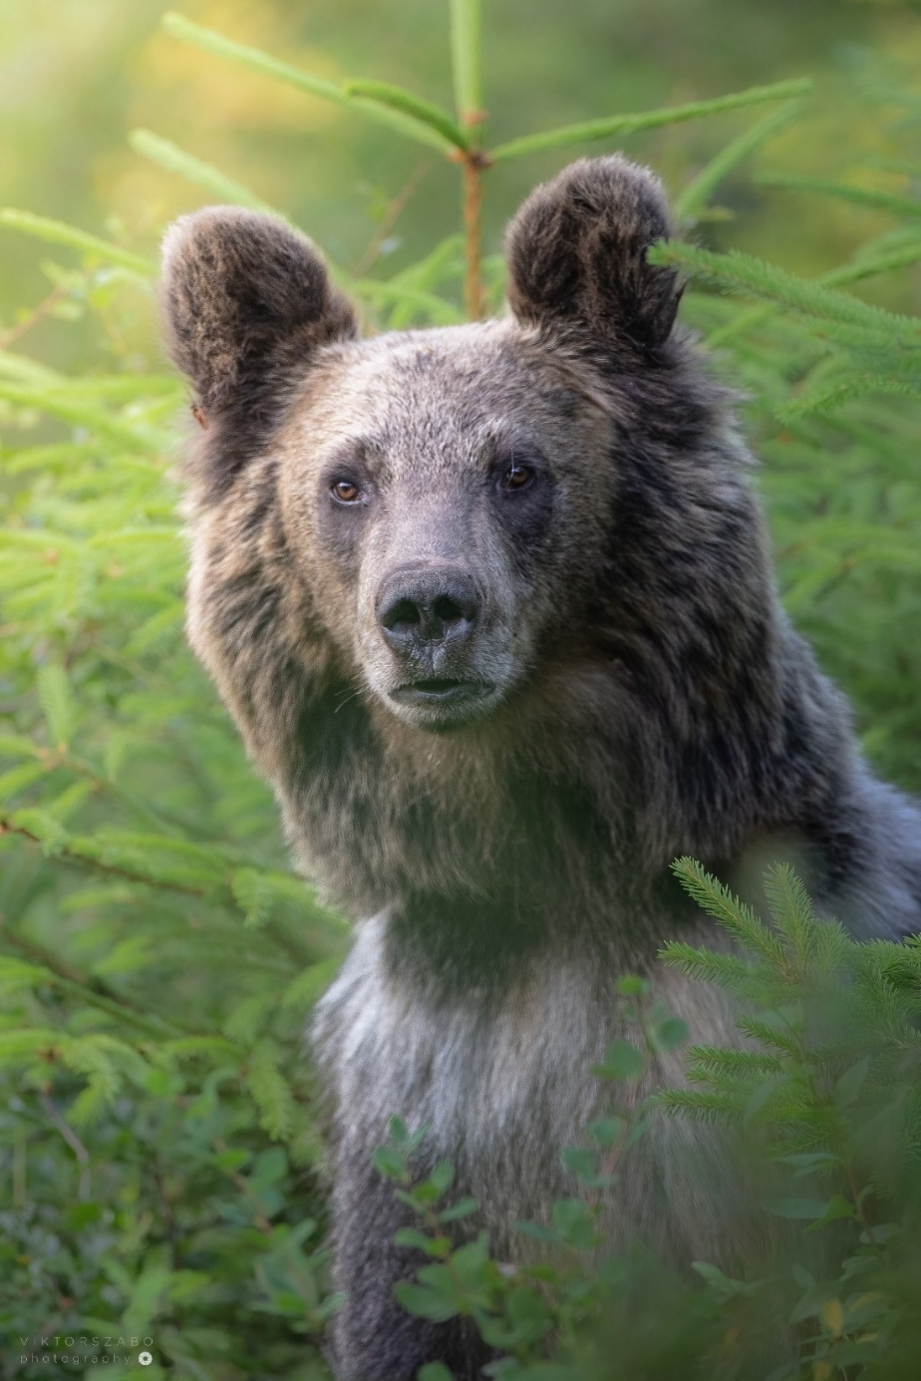
Brown bear (Ursus arctos)
Currently, the issue of damage caused by brown bears to livestock, bee colonies, agricultural crops, fruit and forest trees and property is perceived quite sensitively by the professional, but mainly by the general public.
Most bear damage in recent years has been to agricultural crops, livestock and human health.
Damage caused by both bears and wolves is rising sharply. A task force has been formed to deal with bear problems, and they consider the culling of individual bears as a last resort to resolve conflicts. As of 1 March 2024, a new provision for bear culling is in force and there are currently 5 brown bear intervention groups in Slovakia.
The State Nature Conservancy of the Slovak Republic has published a study aimed at estimating the abundance of brown bears in Slovakia. Scientists from Charles University and the Czech University of Agriculture estimate the population size of this beast at 1,056 (1,012-1,275) individuals (genetic survey in 2022).
The largest bear population of 278 individuals - in the Protected Landscape Area Poľana
Year | Livestock | Hunting hoofed g. | Agricultural crops | Bee colonies | Health/human | Fruit trees | Total/€
2019 | 16154,53 | 2038,4 | 56914,8 | 54977,4 | 59836,55 | 112,58 | 190034,26
2020 | 19903,02 | 4025 | 23242 | 16484,72 | 10914,2 | 983 | 75551,94
2021 | 42558,51 | 6362,3 | 70340,07 | 29035,24 | 48333,24 | 645 | 197274,36
2022 | 55222,85 | 2083,4 | 263680,4 | 49349 | 18936,6 | 5636,45 | 394908,7
2023 | 90933,42 | 2312,8 | 255153,1 | 59256,98 | 121976,1 | 1938,06 | 531570,48
Total/€ | 224772,33 | 16821,9 | 669330,4 | 209103,3 | 259996,7 | 9315,09 | 1389339,74

Slide 7
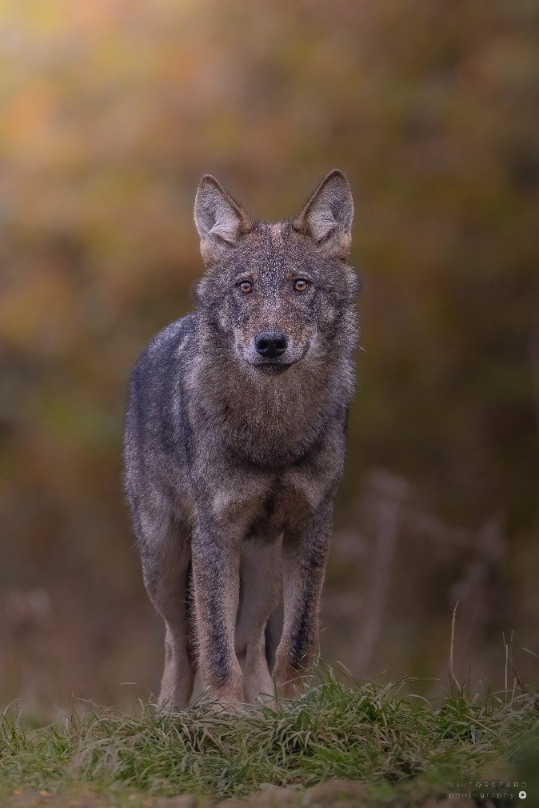
Wolf (Canis lupus)
Most of the damage caused by wolves in recent years has been recorded on livestock and game animals, and attacks on herding dogs have also been recorded.
Under Article 12 of the Birds Directive and Article 17 of the Habitats Directive, EU Member States report in detail. The reports for the current reporting period 2013-2018 were submitted by the Slovak Republic to the European Commission in April and July 2019 and are publicly available on.
Estimate - Based mainly on extrapolation from limited data for 2013-2018 300-600 individuals, + increasing; = stable (source: Reporting under Article 17 of the Habitats Directive for the period 2013-2018).
Year | Livestock | Hunting hoofed g. | Total/€
2019 | 98208,05 | 81565,38 | 179773,43
2020 | 154892,38 | 42681,37 | 197573,75
2021 | 273536,96 | 39739,54 | 313276,5
2022 | 453792,23 | 122448,58 | 576240,81
2023 | 421364,82 | 112283,42 | 533648,24
Total/€ | 1401794,44 | 398718,29 | 1800512,73

Slide 8
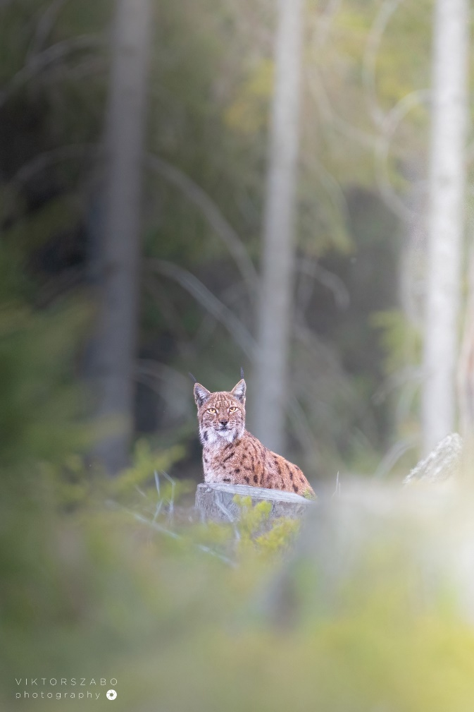
Eurasian lynx (Lynx lynx)
Most damage in recent years has been recorded on livestock and hunting hoofed game.
The damage caused by a lynx is usually minor compared to that caused by a bear or wolf, but can be a problem for farmers in certain areas. Compensation from the state helps to mitigate these financial losses.
300 - 400 individuals, stable number of individuals (source: Reporting under Article 17 of the Habitats Directive for the period 2013-2018). Estimate Partial - Based mainly on extrapolation from limited data.
Year | Hunting hoofed game | Livestock | Total/€
2020 | 226,68 | - | -
2021 | 306 | 1904,5 | 2210,5
2022 | 583,49 | 501,9 | 1085,39
2023 | 1694,4 | 410 | 2104,4
Total/€ | 2810,57 | 2816,4 | 5400,29

Slide 9
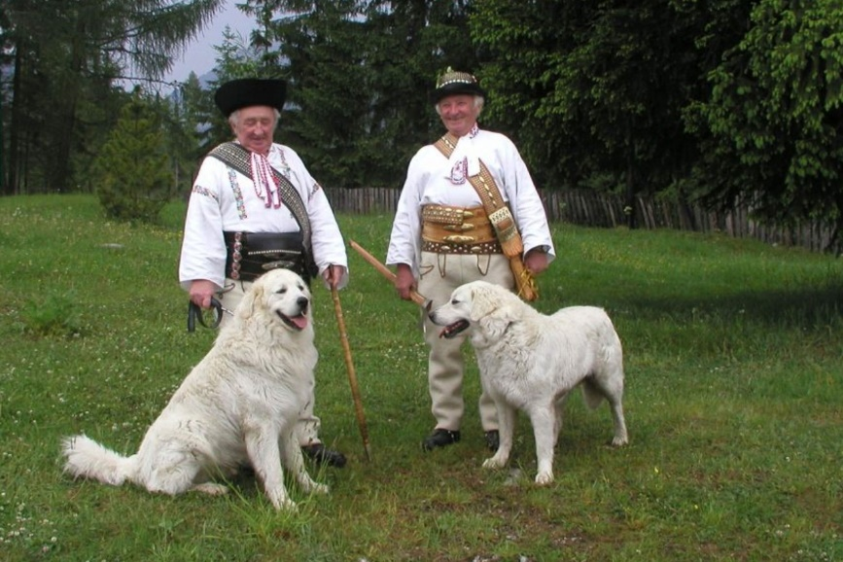
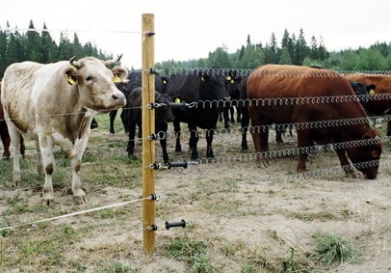
Preventive measures in Decree No 170/2021 Coll.
The granting of compensation for damage caused by designated animals pursuant to § 44 to selected domesticated animals, apiaries and apiculture installations shall be subject to the implementation of at least one of the preventive measures at the time before and during the occurrence of the damage
sheep, goats and cattle shall be actively supervised by a shepherd and a herding guard dog shall be present and let loose with the flock; active supervision by a shepherd is not required if the animals are housed in an enclosed structure such as a closed pen, fence, basket or electric fence,
location of livestock, beehives and beekeeping equipment behind the electric fence
placing the hives and apiculture equipment in a barred metal cage with a mesh size of no more than 10 cm x 10 cm or on a raised platform at a height of at least 3 m above the ground and with the edge of the platform extending at least 60 cm from the support columns,
the location of livestock, apiaries and beekeeping equipment behind an enclosed pen or fence in the built-up area of the municipality with a height of at least 140 cm or in an enclosed building such as a stable or stables.

Slide 10
Effectiveness of preventive measures
After the entry into force of Decree No. 170/2021 Coll. - registered decrease in the number of investigated damages in entities that applied the measures
In the case of farmers who had already built adequate preventive measures, the damage occurred only in critical places (uneven terrain, at the point of the flow crossing where the height parameters of the el. conductors).
Effectiveness of preventive measures - often depends on the willingness/effort of the breeder
measures according to the decree - high costs, difficult maintenance, technical infeasibility in some conditions
result - they are only partially secured - e.g. they have large breeds of dogs, but they are not let loose with the herd; fence posts are unstable, tension is off, large spacing between wires;
the human factor often fails (herdsman supervision, lack of fence maintenance, frequent staff changes and shortages).

Slide 11
Thank you for your attention!
Contacts:
  jana.durkosova@enviro.gov.sk
  katarina.borosova@enviro.gov.sk

