Slide 1
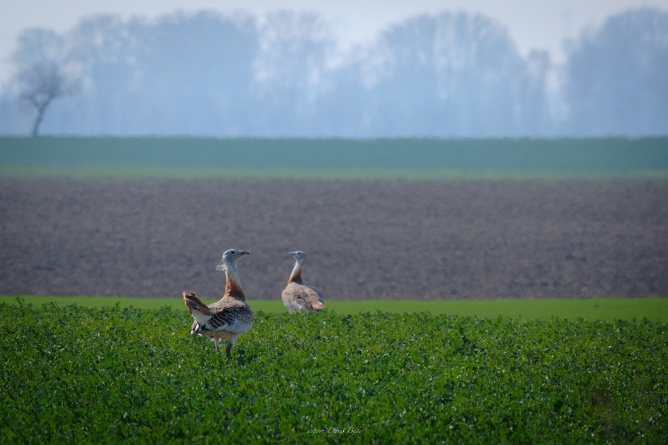
Update on Natura 2000
HU-SK working group on Nature Conservation and Landscape Protection
Bratislava, 12th June 2024

Slide 2

Natura 2000 - SCIs/SACs:
for 67 habitat types, 45 plant + 89 animal species
Updated national list of 644 sites
12,77 % of Slovakia, overlap 89 % with other protected areas;
Government order No 451/2023 Coll. valid since January 2024;
Conservation objectives completed for all sites
Conservation measures – top priority
https://www.minzp.sk/natura2000/uzemia-europskeho-vyznamu/

Slide 3
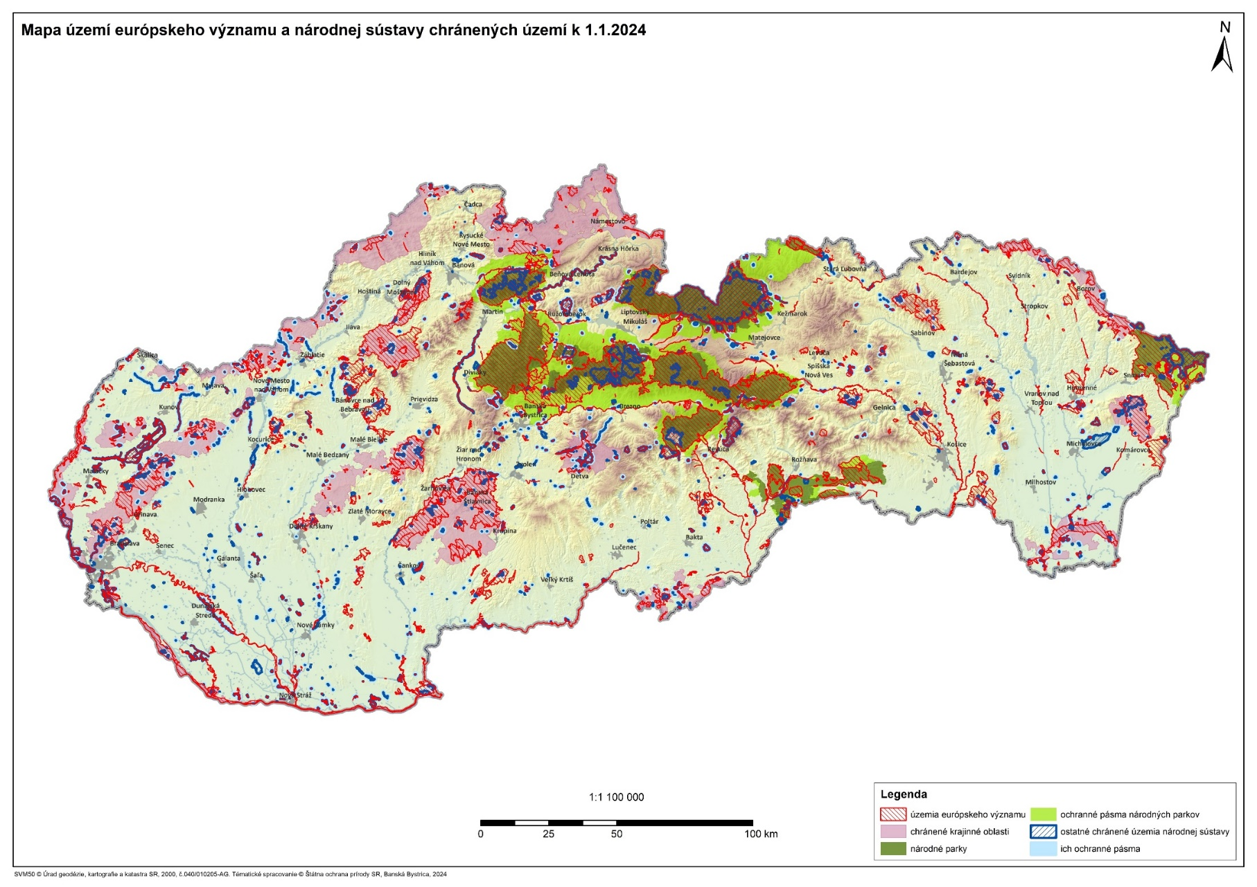
Natura 2000 - SCIs/SACs:

Slide 4
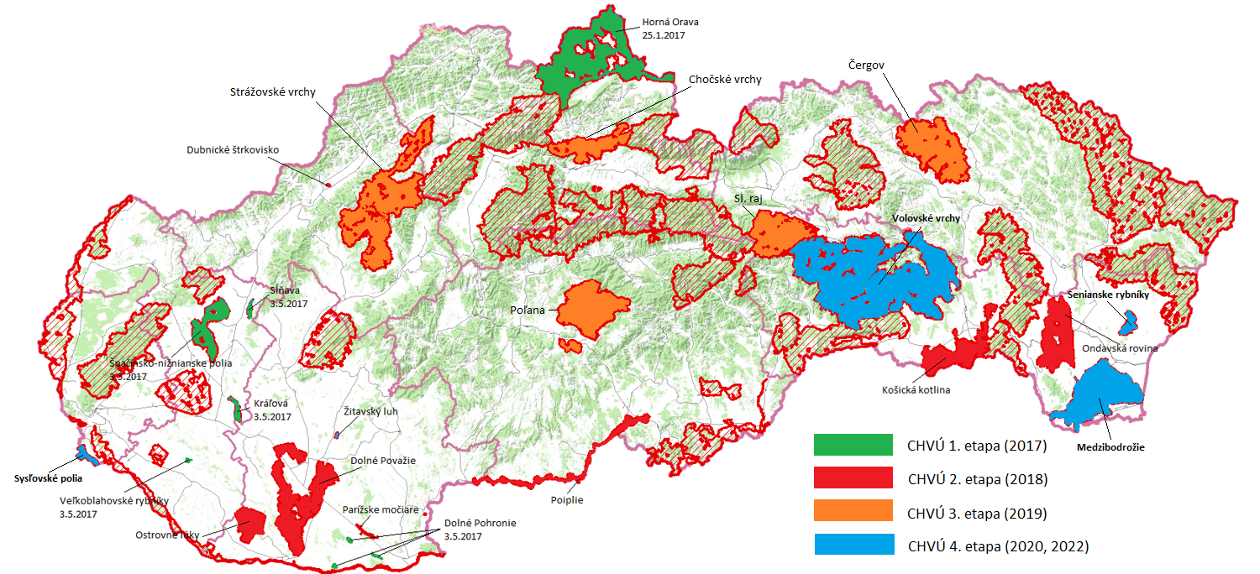
N Natura 2000 – SPAs and their
+ Management Plans

Slide 5
Natura 2000 - SPAs:
for 81 bird species
national list of 41 sites – without change
26,3 % of Slovakia, overlap 52 % with other protected areas
Conservation objectives for some sites
Conservation measures – for 23 sites with management plans adopted by the government (5 adopted from last meeting + 2 negotiated)
Capeircaillie – top priority
https://www.minzp.sk/natura2000/chranene-vtacie-uzemia/

