Slide 1


Large carnivores and their conseration status in Hungary
Slovakia| 12 June 2024
Ministry of Agriculture, Hungary

Slide 2
Status of the species
Wolf (40-60 individuals) and lynx (15-25 individuals):
Bern Convention appendix: II.
EU Habitat Directive annex: II. and IV.
National legislation: strictly protected species (13/2001 ministerial decree)
Bear (5-10 individuals):
Bern Convention appendix: II.
EU Habitat Directive annex: II. and IV. – no Natura 2000 sites, no reporting
National legislation: strictly protected species (13/2001 ministerial decree)
Notes:
Bear breeding in the country is still waiting for confirmation, for now only 1-2 over-wintering individuals

Slide 3
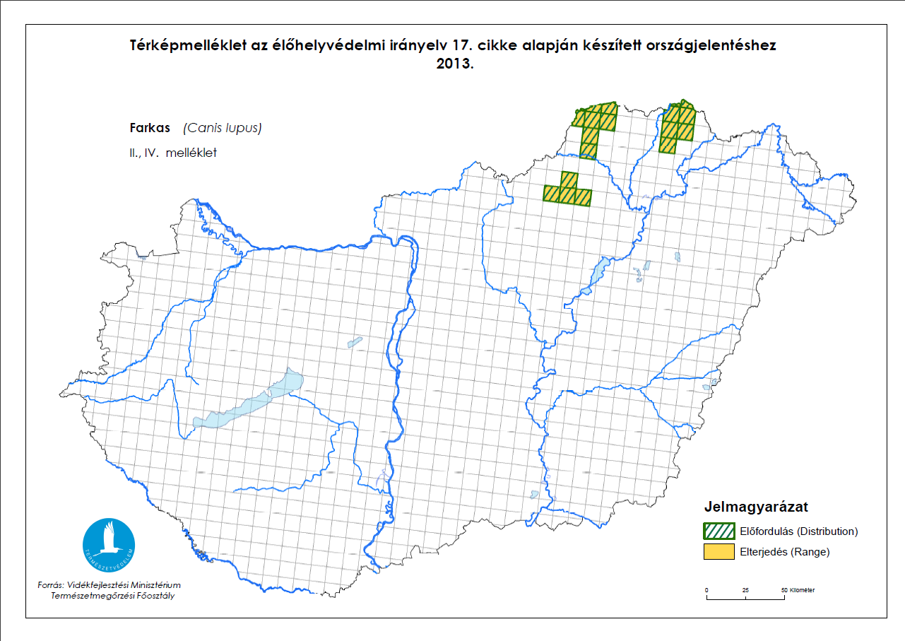
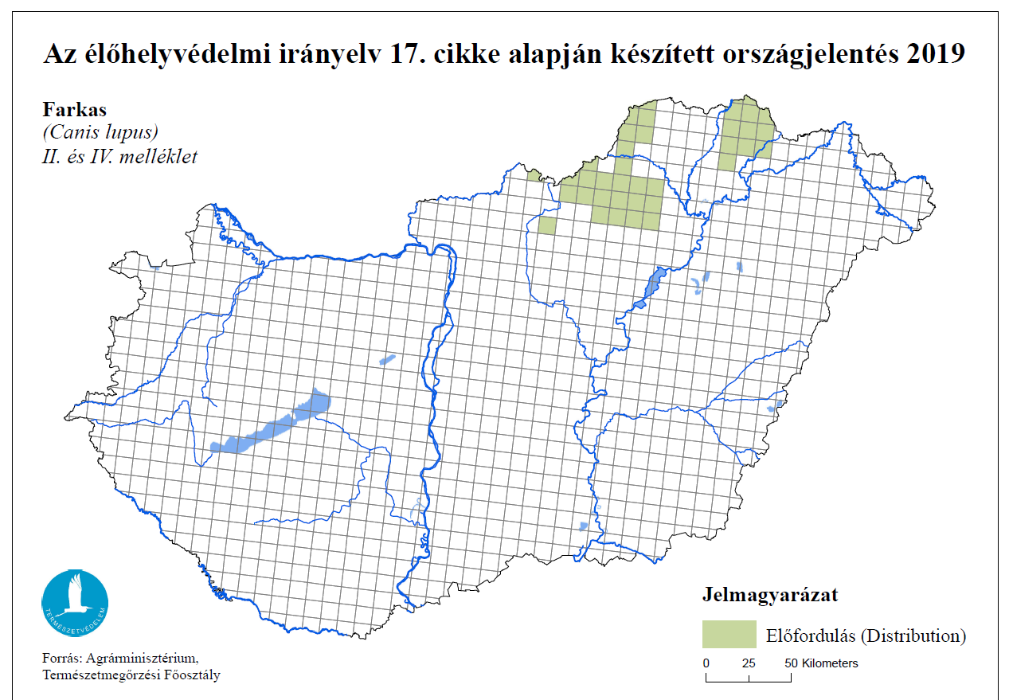

Slide 4
National legislation
Act LIII. Of 1996 on Nature Conservation
Ministerial Decree No.13/2001 (V.9.) on the Protected and Strictly Protected Species of Flora and Fauna
Government Decree No. 348/2006 (XII.23.) about the Detailed Rules on Protection, Keeping, Display and Utilization of Protected Species
Every activity regarding these species is strictly monitored and regulated by the nature conservation authority
Strict permits can be issued for keeping and utilizing these animals
Individuals of these species are only kept in zoos or other institutes – data on origin → cannot be captured in the wild to ensure the protection of the population
Notes:
The law states the general regulations regarding every aspect of nature conservation, including the basis for how the species and their populations should be protected. The 13/2001 decree lists the protected species either under Hungarian or EU law. The 348/2006 decree lays done the regulation for keeping individuals of protected species. Protected and strictly protected species can only be kept because of public interests (e.g. educational reasons) or because of species conservation activities

Slide 5
Species conservation plans
Wolf:
1st conservation plan in 2004 and 2nd is under revision
The goal is to support the spontaneous establishment of the species and the formation of a stable breeding stock and their protection
Monitoring, protection and restoration of habitats, minimizing risk factors, conflict management
Protection of known wolf dens – e.g. restriction of forestry
National park directorates and NGOs communicate with local stakeholders and the wider public
Lynx:
1 conservation plan from 2004
Basically the same goals as with the wolf
Notes:
No conservation plan exist for the brown bear.

Slide 6
Conflict management plan
For the wolf and bear
Issued by the Ministry of Agriculture in 2018
How to react, how to communicate, who is responsible for the conflict management action
Problem animals can be removed from the population
Made specifically because one bear crossed the whole country in 2018
The management plan needs revision
Establishment of an expert coordination group is underway
Notes:
Lists different situations with these animals and how to react, how to communicate, and who is responsible for the conflict management action

Slide 7
Review of the implementation
Conservation management didn’t change in the last 10 years
The goal is to reach the favorable conservation status of these species → Focus is still on monitoring, habitat protection, risk minimization and damage prevention
No derogations, no culling, no annual quota → no active interference with large carnivore populations

Slide 8
Evaluation
Population of large carnivores were slowly increasing in the last 10 years – until recently observation and passive protection was enough
More communication and cooperation is needed with (local) stakeholders
→ The wolf population now appears to be in a decline (illegal hunting, roadkills)
If populations continue to rise probably a more easily adaptable regulation and forward-thinking is needed regarding these conflicting species

Slide 9
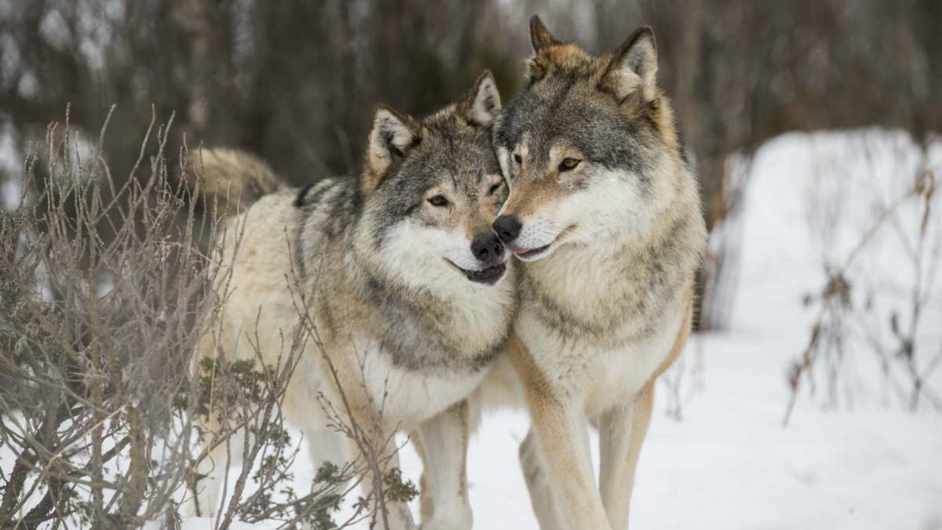
Thank you for your attention!
www /daily-dew.com

