Slide 1


Meeting of Slovak - Hungarian Committee for Nature Conservation and Landscape Protection
Bratislava, 12. June 2024
Ongoing Natura 2000 issues

Slide 2


Content
Natura 2000 management plans
Site Specific Conservation Objectives
Standard Data Forms
Reporting under Habitats and Bird Directives
Notes:
Both type of documents are quite voluminous.
I was a huge effort from NPD and AM.

Slide 3
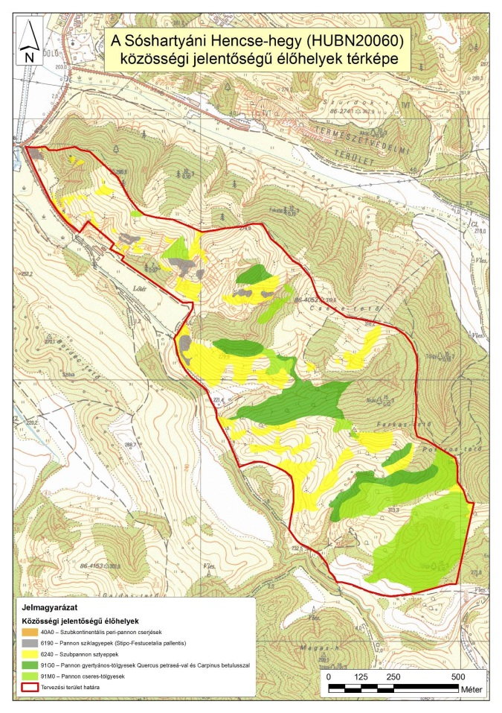
Conservation measures and objectives
in Hungary
Natura 2000 management (maintenance) plans:
detailed site specific conservation measures and general conservation objectives
Preparation period: 2008-2023
Content: 60-700 pages
SSCO documents:
detailed Site Specific Conservation Objectives
Preparation period:
I. 2010-2011
II. 2020-2024 (supervision and
rewriting based on COM guidance)
Content: 15-400 pages
Notes:
Both type of documents are quite voluminous.
I was a huge effort from NPD and AM.

Slide 4


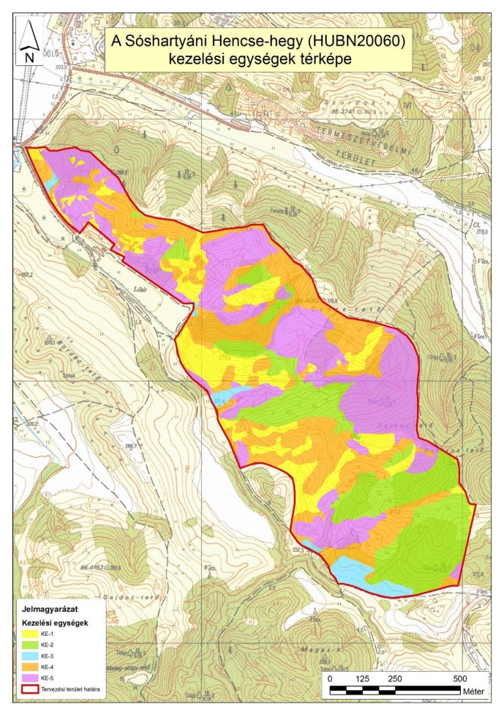
Natura 2000 management plans
→ exist for all the 525 Natura 2000 sites (finished in 2023): → http://www.termeszetvedelem.hu/elfogadott-fenntartasi-tervek
→ 275/2004 (X.8.) Natura 2000 Government Decree
→ assisted by a guidance issued by the Ministry of Agriculture
→ prepared by the national park directorates
→ mostly funded by EARDF, LIFE, state budget etc.
Content:
→ identification data of the site
→ threats, pressures
→ map of management units (based on habitat map)
→ conservation measures for each management unit:
detailed conditions for mowing, grazing, restoration,
IAS removal, species conservation etc.
→ funding possibilities
→ baseline study: natural, environmental features,
ownership structure, land use
Notes:
The plans include recommendations, but on one hand the permitting authorities use them and insert them into their decisions and in that way it can be compulsary, and on the other hand agricultural programmes and EU restoration project can support the implementation.

Slide 5


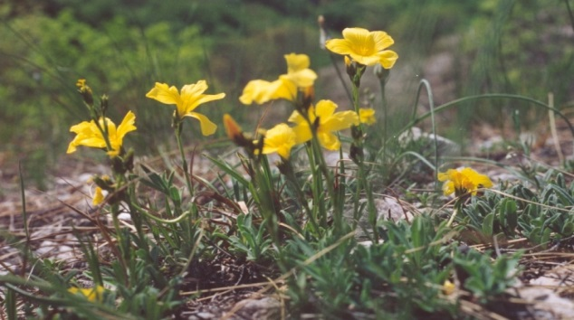
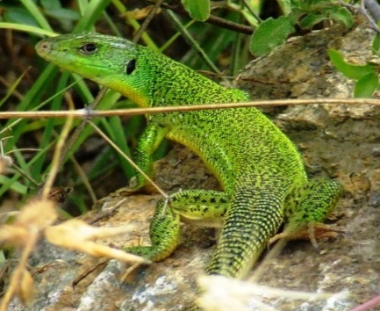
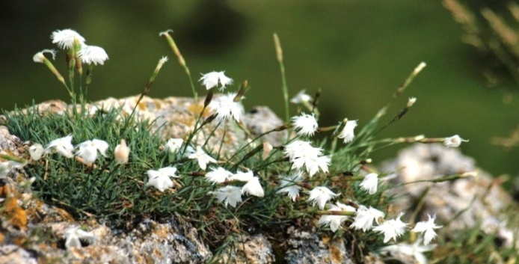
Conservation objectives
Overall conservation objective:
applies to all trigger habitats and species, laid down in:
275/2004. (X.8.) Natura 2000 Government Decree
14/2010. Decree of the Minister of Environment and Water
SDF for each HU site
Site specific conservation objectives (SSCOs):
since 2010: SDF contains SSCOs for all SACs and SPAs (priorities in SDF 4.2 Quality and importance and objectives in SDF 6.3 Conservation measures)

Slide 6
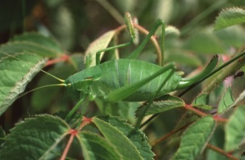
Supervision of SSCOs
goal: to be more concrete, measurable and detailed
guidance issued by the Ministry of Agriculture (involving external experts)
detailed documentation prepared by the national park directorates
detailed information for all trigger habitats and species, for each N2 site
(attribute, problem, objective, means to achieve objective, deadline)
SSCO document is ready for all 525 sites
checking all SSCOs and updating SDF: end of 2024
used already in permitting procedures in case of large
infrastucture projects (eg. motorway, railway) financed by EU
Notes:
Thank you very much for the comments and the examples, we will study them after this meeting.

Slide 7
Standard Data Forms
2022-2023:
many data updated, based on habitat mapping and monitoring
2024:
integration of revised SSCOs + habitat/species modifications, if needed
2025:
harmonisation with the reports + getting used to the new SDF format ☺
2026-2028:
filling the new content of SDF (eg. degree of conservation)
harmonisation of habitats and species data of SDF/SSCOs/management plans, with the help of database compilation in frame of a new EEEOP project of MoA

Slide 8

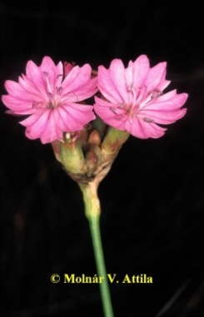
HD&BD Reporting - 2025
45 habitat types, 208 species, 212 breeding/19 migrating/53 wintering bird species
Work started in the beginning of 2024
Coordination: Ministry of Agriculture (MoA), Herman Ottó Institute (HOI: background institution of MoA)
Information source: national park directorates (NPD), external experts, Birdlife Hungary
– NPD data until 2023 have already been sent to MoA in case of many species groups
Filling the report: MoA, HOI, external experts, Birdlife Hungary
– started with plant species by MoA
HD Article 17 report:
Reporting unit: 1x1 grid, except for plants and most mammals – so we use 6.5. instead of 6.2., which is a possibility for other unit than given in the species checklist
Favourable reference values: not yet determined, and no plans for central coordination, experts were asked to determine them by species

Slide 9
Challenges/Questions
Favoruable reference values: have you already determined FRVs in case of certain habitat types or species? If yes, how did you determine the values, what was your method? Could you give us some good examples?
SDF/new content: how do you plan to fill the required new information ? eg. degree of conservation of habitats in hectare and the occupied area of species in percentage classes?
Habitat types:
Degree of conservation – area. Give the area in hectares for each of the categories:
Good condition: …[ha]
Not-good condition: …[ha]
Unknown condition: …[ha]
Species:
Degree of conservation – occupied percentage classes
Estimated occupied area of the habitat for the species with sufficient quality:
0-25 % 26-50% 51-75% 76-100%
Estimated occupied area of the habitat for the species with non-sufficient quality:
0-25 % 26-50% 51-75% 76-100%
Estimated occupied area of the habitat for the species for which the quality is unknown:
0-25 % 26-50% 51-75% 76-100%

Slide 10
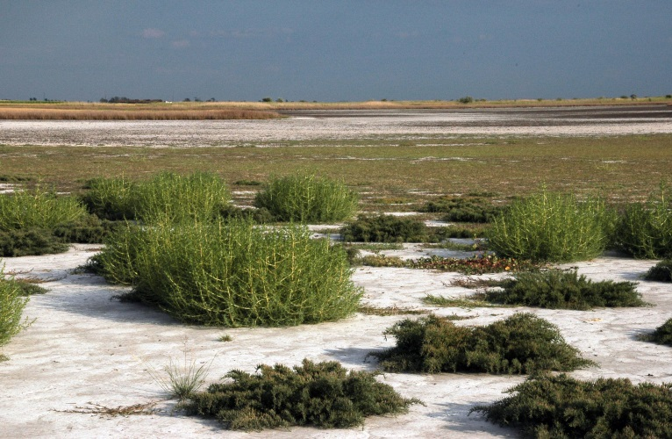
Thank you for your attention!

