Slide 1
Invasive Alien Species
Selected topics
12th of June 2024

Slide 2
Legislation
ACT No. 150/2019 on the prevention and management of introduction and spread of invasive alien species and on the amendment of some laws
Decree No. 485 of the Ministry of Environment of the Slovak Republic amending the decree of the Ministry of Environment of the Slovak Republic No. 450/2019 which establishes the conditions and ways to remove invasive alien species
List of invasive alien species of the Slovak Republic:
Plants: Animals:
Amorpha fruticosa Arion Lusitanicus Neogobius melanostomus
Ambrosia artemisiifolia Chrysemis Picta Sinanodonta woodiana
Fallopia sp. (syn. Reynoutria) Gasterosteus aculeatus
Lycium barbarum Mustela Vision
Negundo aceroides Neogobius fluviatilis
Solidago canadensis Neogobius gymnotrachelus
Solidago gigantea Neogobius kessleri

Slide 3
Our plans
The upcoming amendments to the law:
Regulation of obligations for nature protection organizations
Better connection between non-native species and invasive species
Adjustment of planting conditions and release animals of non-native species into the environment
Prohibition of feeding invasive alien species
Management actions plans:
Heracleum mantegazianum
Ailanthus altissima
Negundo aceroides

Slide 4
Our plans
Preparation of a national project and creation of an eradication team
Creation of sufficient capacities for monitoring and eradication of IAS (the use of new methods such as eDNA)
Elimination of risks from action of IAS through natural pathways of terrestrial spread and associated with the aquatic environment
Increasing the level of knowledge about the monitoring and spread of IAS
Suppression of IAS with localized spread and eradication of newly IAS species
Raising the public awareness about IAS
Asian hornet– SK situation
- Not yet confirmed occurrence
- Preparation of an eradication plan for Asian hornet
- Public engagement through an Asian hornet reporting application - in preparation

Slide 5
Management of coypu - general
- the State Nature Conservancy and National Park Administrations have permits for catching IAS animals
- in practice no regular management (lack of stuff / financial sources)
- some regulations by hunters
- future activity: management action plan (if necessary, it will also include cross-border cooperation)

Slide 6
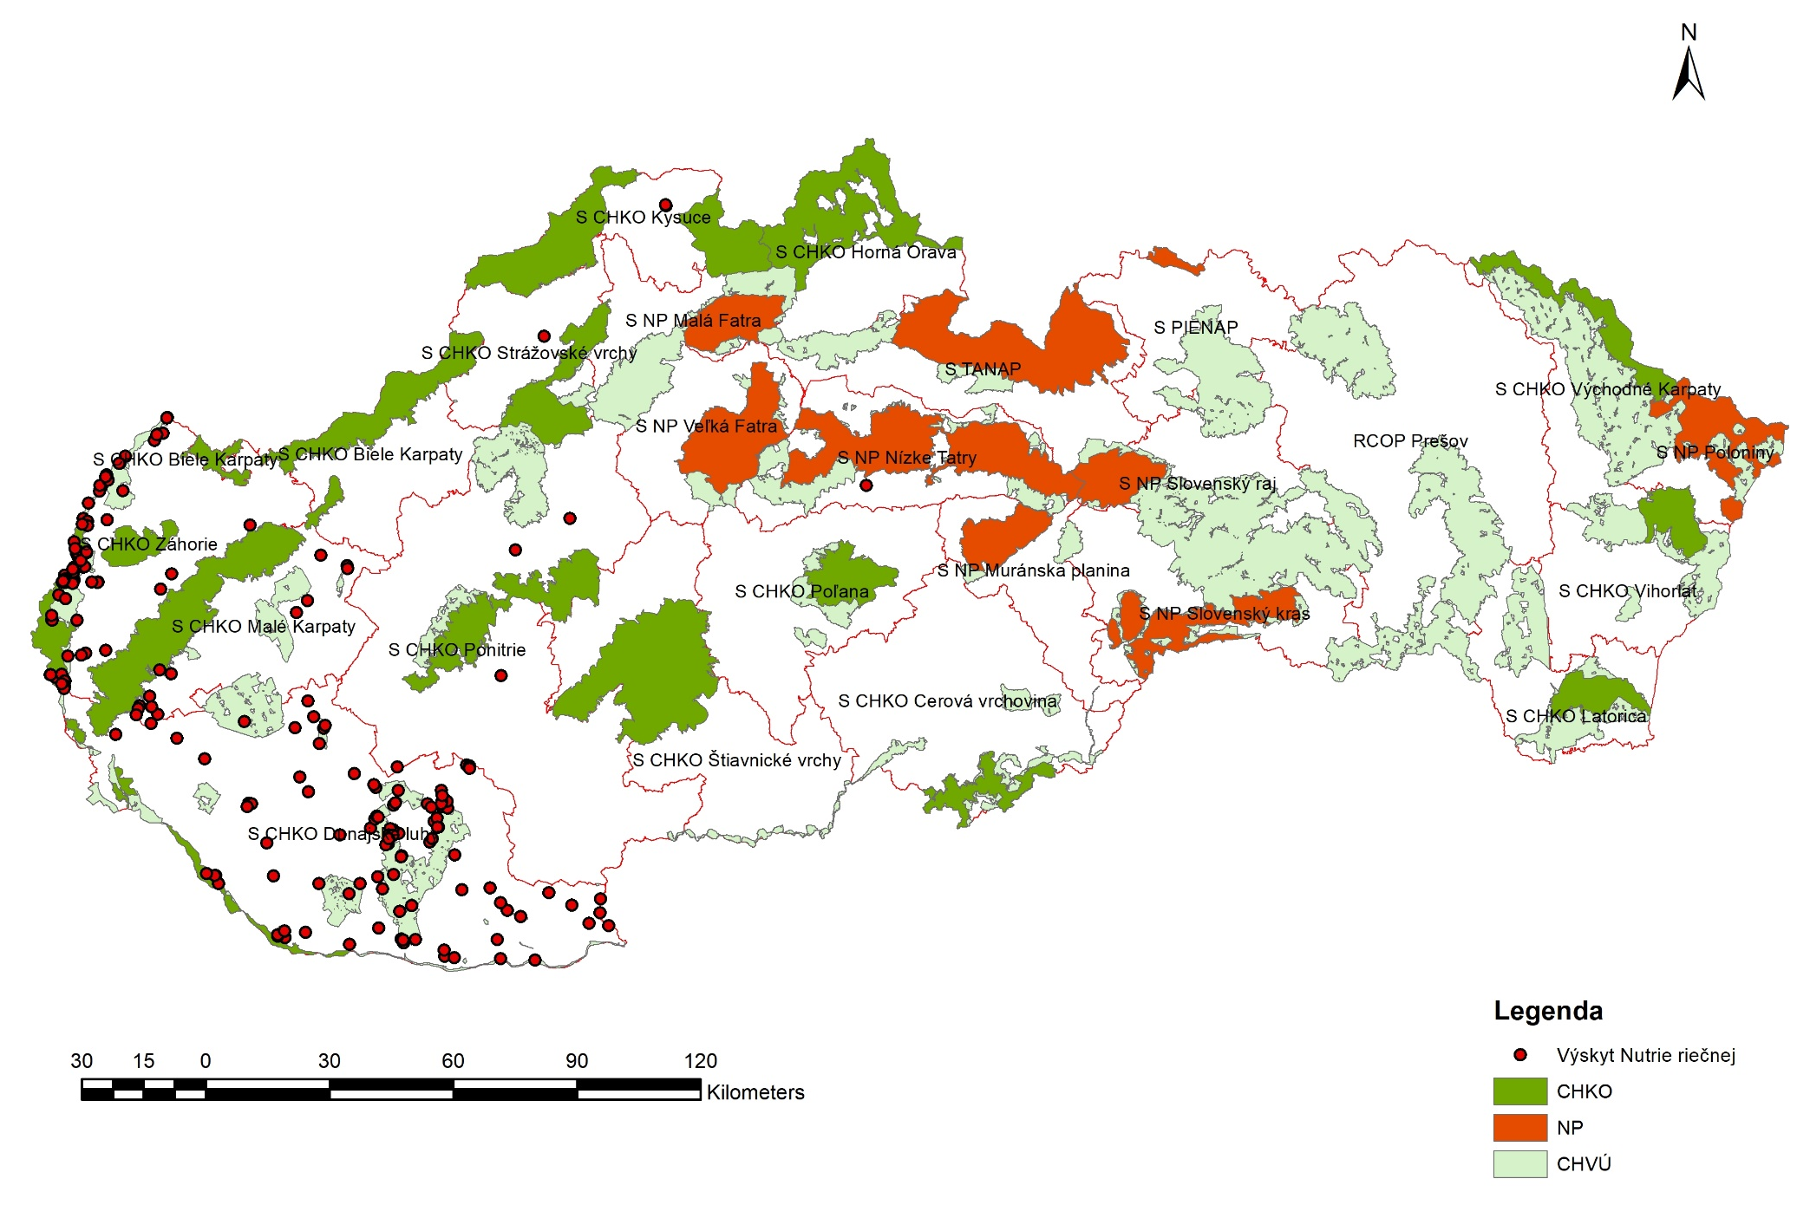
Maps of occurence of coypu

Slide 7
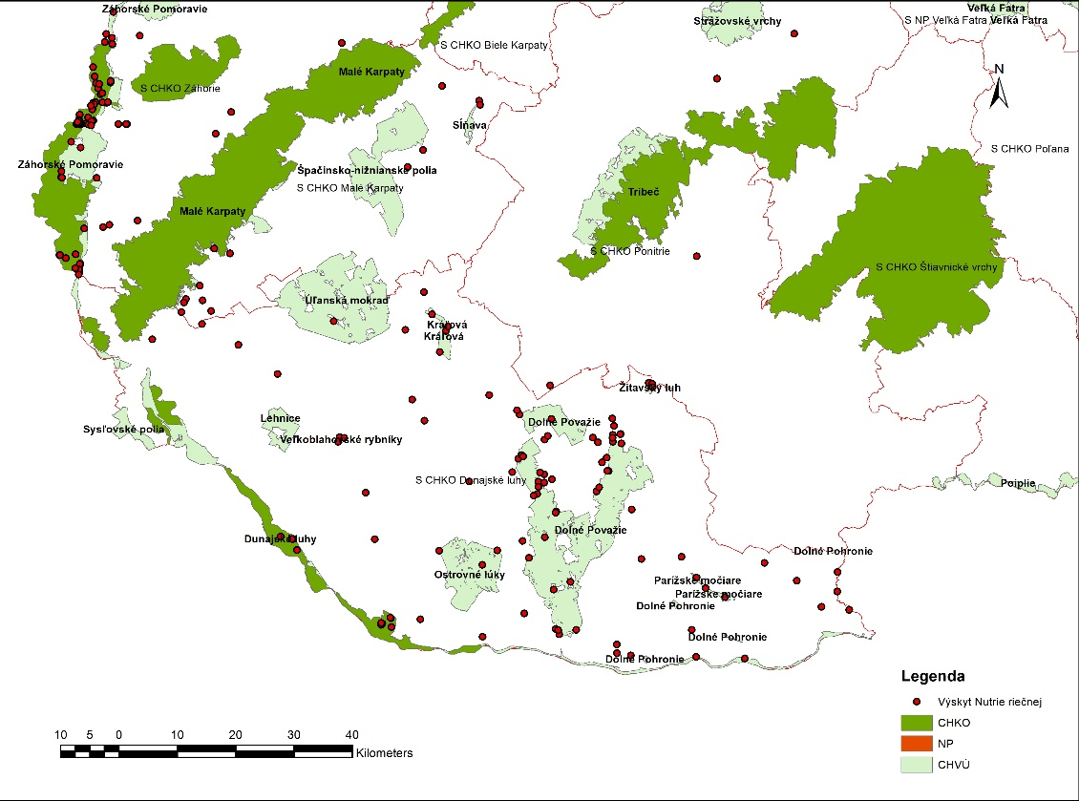
Maps of occurence of coypu

Slide 8
Nitra – pilot event
- The aim of the event was to verify the methodology of capturing this species in cage traps, eliminating the large population of coypu in the urban area of the city of Nitra, and monitoring their health status
- November 2023
- State Nature Conservancy with cooperation of volunteering organizations
- Total: 27 individuals
Veterinary sampling to determine possible health risks, euthanasia
Conclusions:
- no diseases of bacterial origin were detected in the controlled individuals
- parasites were detected in some individuals, but they are not transmissible to humans
- need for better public awareness and prohibition of feeding
- regular monitoring

Slide 9
Questions
1. How spread is population of coypu in Hungary?
2. Who does practical management of coypu in Hungary (e.g.catching)?
3. Do you already have a management plan for coypu?
4. Would you be interested in joint cross-border management for coypu?
5. Who did rapid eradication for Asian hornet?
6. Did you have some eradication plan or guidelines for Asian hornet prepared in advance before actual first occurrence? If yes, which stakeholders have been involved?

Slide 10
THANK YOU
      Barbora Holická
      barbora.holicka@enviro.gov.sk
      Department on Biodiversity and Landscape Protection

