Slide 1

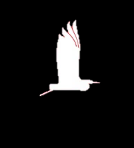
IAS activities in Hungary with a view to possible cooperation with Slovakia
Agrárminisztérium
SK-HU bilateral meeting
Bratislava, 12 June 2024
Based in information and ppt by Dr. GergőNagy and Laura Diószegi-Jelinek
Department for Nature Conservation, Ministry of Agriculture

Slide 2



Agrárminisztérium
Regulation (EU) No. 1143/2014 on IAS
88 species (41 plants 47 animals)
23 plants 31 animals known to occur

Slide 3
National legislation
Agrárminisztérium
Harmonisation with the EU Regulation:
  6 sectoral Acts amended→ Act on Nature Conservation, Act on Forestry, Act on Fishing, Act on Hunting, Act on Food Chains, Act on Sowing Seeds
  IAS Government Decree→ IAS responsibilities of authorities
  Government Resolution→ Funding of capacity building:
    A total of 78 new staff members:
      66 at County Government Authorities,
      10 at national park directorates,
      2 at Dept. For Nat. Cons., Ministry of Agriculture
Notes:
TÖRVÉNYI SZINT - 2016. évi CXXXVII. tv. - 6 ÁGAZATI TÖRVÉNY MÓDOSÍTÁSA
Természetvédelmi (1996. évi LIII.) tv.
Erdőtörvény (2009. évi XXXVII. tv.)
Halgazdálkodási (2013. évi CII.) tv.
Vadászati (1996. évi LV.) tv.
Élelmiszer-lánc felügyeleti (2008. évi XLVI.) tv.
Vetőmag (2003. évi LII.) tv.

Slide 4
National activities
Agrárminisztérium
Annual state budget for on-the-ground measures against IAS by NPDs: 250 000 euros – planned to be doubled from 2025 (
Q1: experience with Coypu eradication? Is it huntable in SK?
Q2: Asian hornet?
ID leaflets, management plans
Preparation of national list of IAS has started (max. 100-150 species planned)
Q3: does SK has a national IAS list?
Communication:
    IAS forums
    workshops
    websites (http://www.invaziosfajok.hu/hu)
    publications

Slide 5
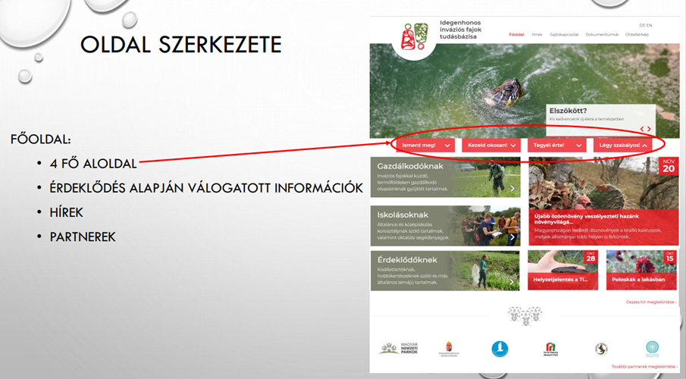
Knowledge base on IAS (www.invaziosfajok.hu)
Agrárminisztérium
Get to know IAS!
Manage IAS!
Prevent IAS! (gardens, homes)
Comply with legislation!
For farmers on IAS
For students on IAS
For petkeepers on IAS
News

Slide 6
Management plans
Agrárminisztérium
Method | Goal | Efficiency and costs | Animal welfare
 |  |  | General effects on welfare | Lethal methods
Eradication by hand | Eradication/ Control/ Isolation | Manual eradication is only efficient if combined with other methods. Eggs can be removed and adult birds can be culled. Removed eggs may be replaced with wooden eggs. | Moderate effect | N.a.

Slide 7
New SK-HU LIFE project on IAS
Project acronym: LIFE23-NAT-SK-LIFE RESISTANCE
Project ID: 101148377
Title: Comprehensive restoration of Danube floodplain habitats and support for resistance to plant invasive alien species
1. coordinator:
BROZ OCHRANARSKE ZDRUZENIE (BROZ)
other beneficiaries include:
CENTRUM BIOLOGIE RASTLIN A BIODIVERZITY SLOVENSKEJ AKADEMIE VIED
NARODNE LESNICKE CENTRUM (NFC)
VYSKUMNY USTAV VODNEHO HOSPODARSTVA (VUVH)
PISZTRANG KOR WALDORF TERMESZETVEDO ES TERMESZETJARO EGYESULET (PKE)
FERTO-HANSAG NEMZETI PARK IGAZGATOSAG

Slide 8
New SK-HU LIFE project on IAS
Danube alluvial habitats (*91E0, 6440, 3270, 91F0) in 15 SCIs are targeted in Slovakia and Hungary.
Threats: altered water regime, intensive forestry, abandonment of traditional management, especially extensive grazing
120 ha of wetlands and 20 ha of floodplain forest will be restored and nature friendly grazing on 720 ha reintroduced.
Using the synergy of above-mentioned actions together with mechanical, biological and chemical methods of IAS eradication, target IAS will be removed on 850 ha.
Water regime will be restored
Various innovative methods:
- detection of IAS using drone and satellite data, - biological control of Ailanthus altissima,
- improvement of tree seedling survival by implementing usage of local mycorrhizal fungi, detected by DNA analyses
- monitoring of project impact on fauna by eDNA metabarcoding methods
Awareness raising and dissemination actions
Improving policies and agro-envi scheme (CAP).
Duration: 1 June 2024 – 30 September 2030
Budget: 6 465 129.60 EUR

Slide 9
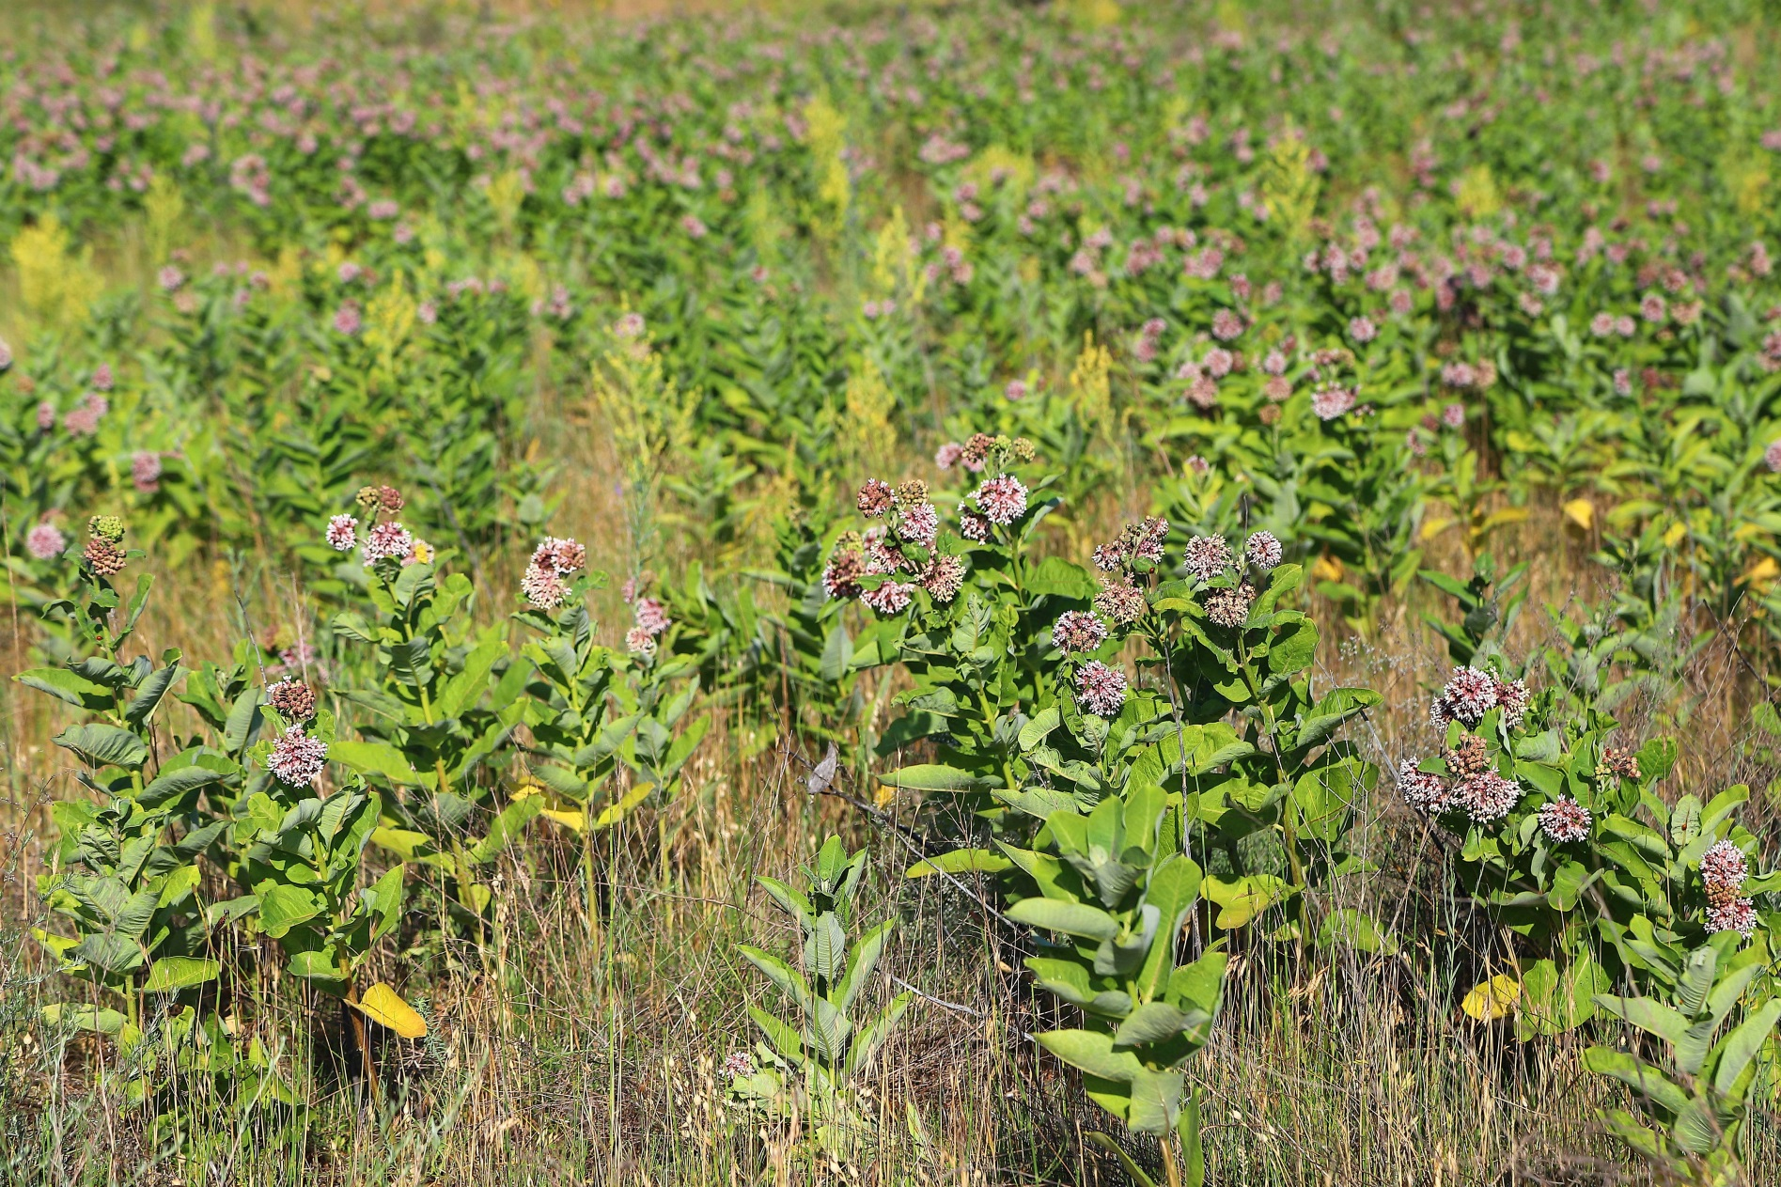
Thank you for your attention!

