Slide 1
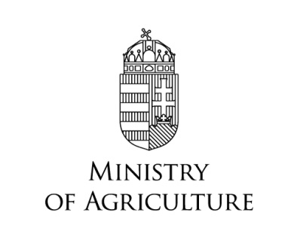

EU financing of projects in Hungary
Örs Marczin
Department for Nature Conservation

Slide 2
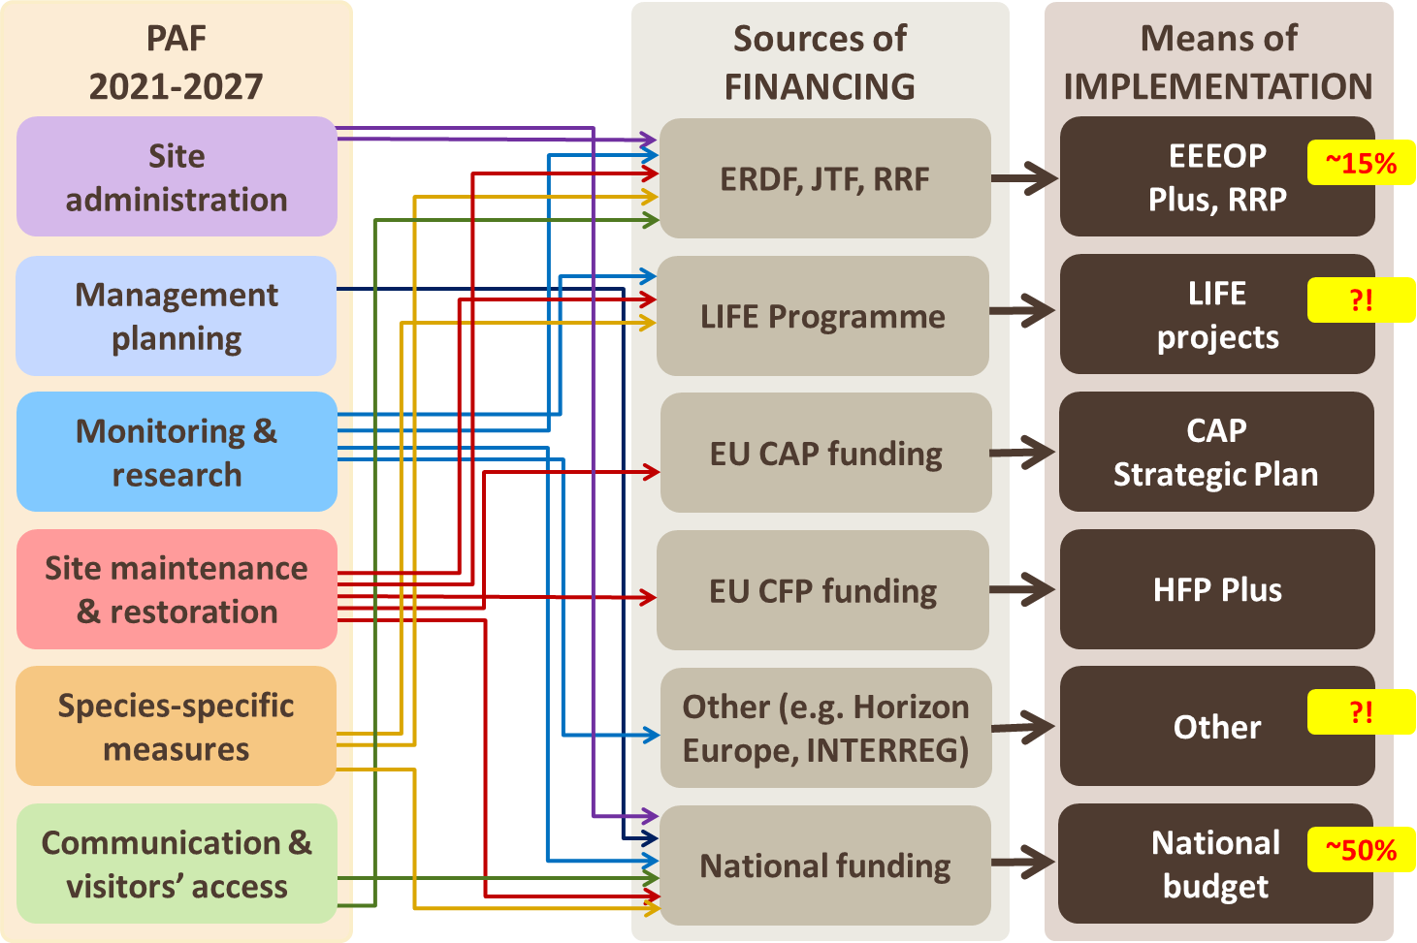
PAF implementation – integration of funding needs
Notes:
A Kohéziós forrásokat szinte mindenre használjuk. De alapvetően az egyszeri beruházásokra (one-off projects), elsősorban az NPI-knél, 300 ezer ha

Slide 3
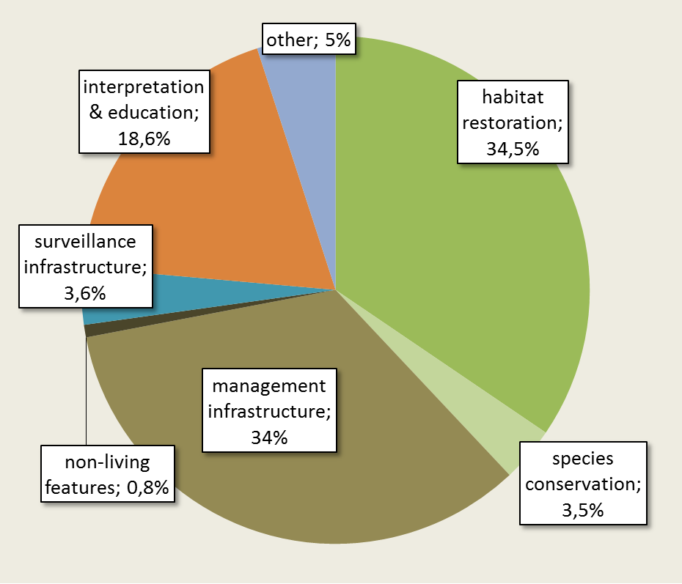
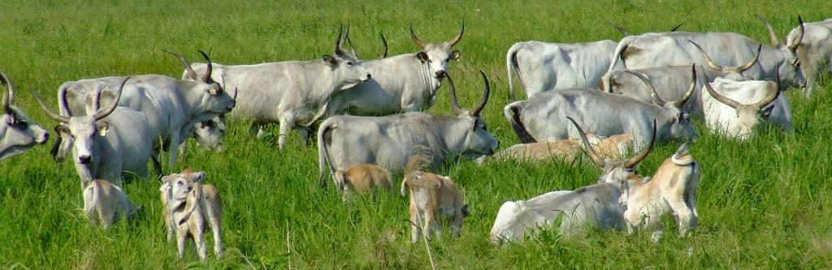
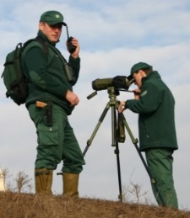
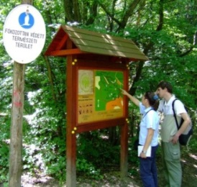
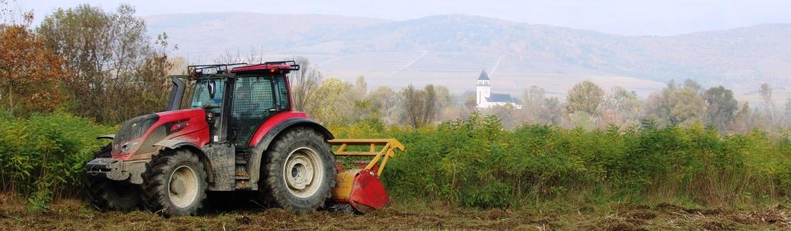
Environment and Energy Efficiency OP Plus, 2021-2027 – nature investments
Distribution of the allocation for nature investments
Allocation: 112,4 M EUR (ERDF) ~ 2,6% of the OP budget
More than 70% of funds for direct measures
Project pipeline: 67 projects worth app. 120 M EUR
Focus: green infrastructure outside settlements; Natura 2000 and protected areas in state ownership and under the management of state nature conservation
Expected results:
  direct interventions on app. 138 000 ha, restoration on app. 70 000 ha
  nationally significant occurrences of 23 habitat types targeted, improvements expected in case of 21 habitats
Notes:
NPI-k információi alapján 21 élőhelytípusnál lesz előrelépés az érintett site-okon; a felhívás megjelenését várjuk, év közepén várható (22 dec-ben elfogadta a Bizottság). 21 már rögtön indulhatna, az előkészítésük már az előző időszakban volt. A forrás leosztása már eleve intézményre specifikált, könnyíti a természetvédelmi szereplőknek a pályázást, de nem erősíti az együttműködést más ágazatokkal.

Slide 4
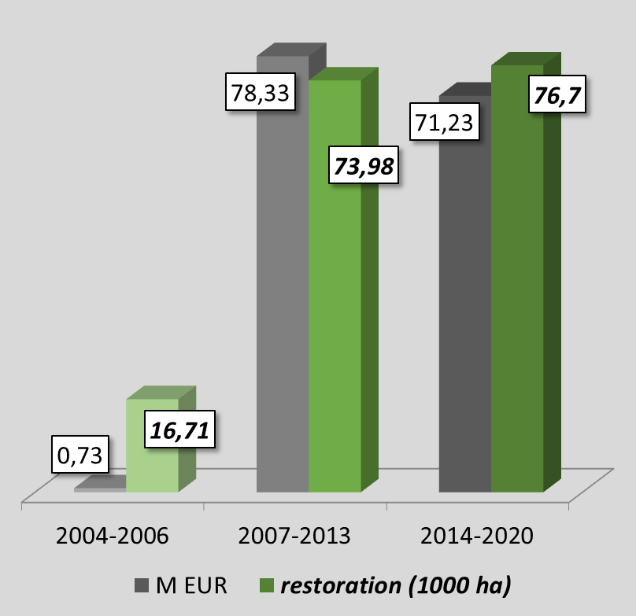
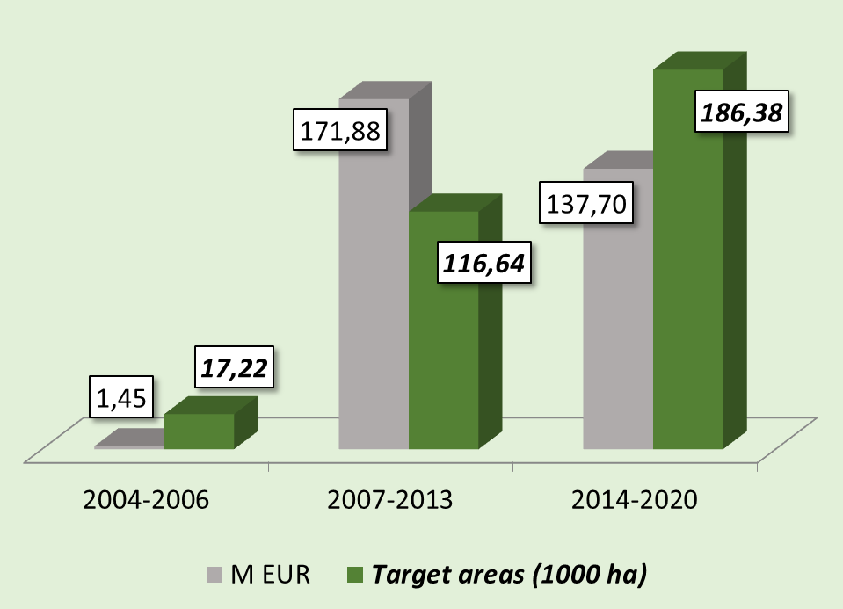
Investments to date statistics
Restoration 2004-2020
Nature investments: launched in 2004, „boosted” from 2007, maintained after 2014
Funding from ERDF OPs: 311 M EUR, 479 projects
App. 0.3-0.6% of available EU funds
Restoration, management infrastructure, species’ conservation, interpretation, site surveillance and monitoring; strategic planning (national)
Nature investments 2004-2020
45-50% of funds spent on restoration
Restored areas on 4%-8% of the Natura 2000 network
Projects implemented by State Nature Conservation (i.e. national park directorates)
Focus primarily on state owned land under nature conservation management
Notes:
Korábban próbáltunk vízügynek, erdészetnek, önkormányzatnak lehetőséget adni, de nem volt területük (ÖK) és főleg motivációjuk; most már csak konzorciumi partnerek lehetnek. Az NPI-k mindegyikénél van pályázati osztály, intézményrendszer van a pályázatokra. AM saját projektek is vannak – policy feladatokra (mert nincs rá elég hazai forrás), monitorozás, kommunikáció, informatika

Slide 5
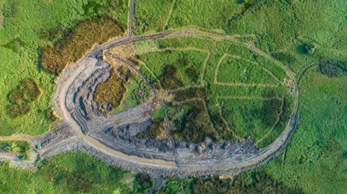
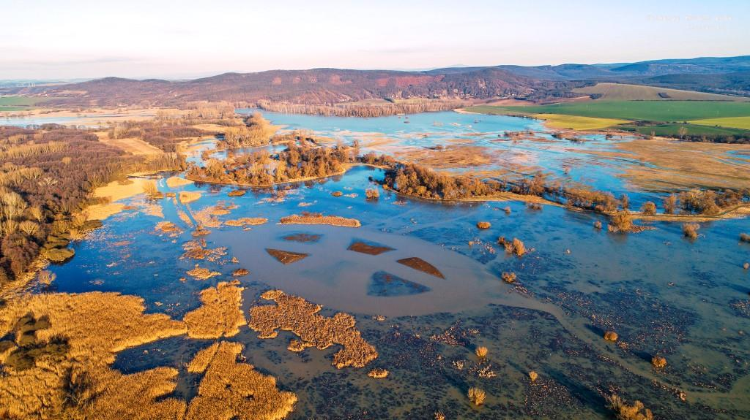
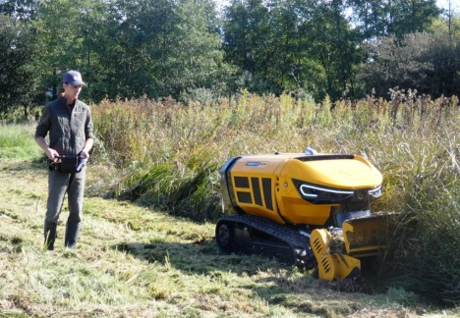
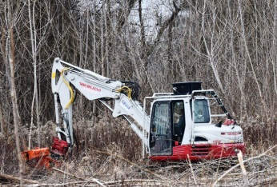
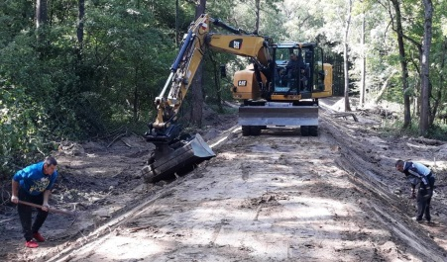
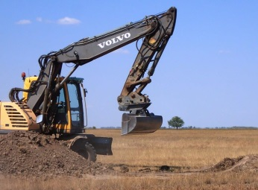
Investments to date content
Restoration measures
Restoring the natural/close-to-natural water regime
Complex rehabilitation of wetlands
Managing processes of succession on open habitats by controlling the spreading of shrubs
Restoration of forest habitats to improve the natural state of forests (e.g. diverse species’ and age composition, micro-habitats, dead wood etc.)
Fighting the aggressive spreading of invasive alien plant species
Land purchase as the basis for later restoration or management
Creation of new habitats (e.g. as buffer zones, ecological corridors)
Removing artificial features from the landscape, eliminating illegal dumpsites and restoring former military sites
Protective measures against large game species
Reintroduction of key species
Identification of investment needs: mostly bottom-up, along with some centrally defined principles – not as systematic as foreseen in the restoration regulation

Slide 6
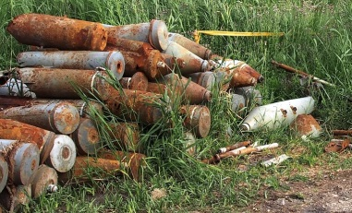
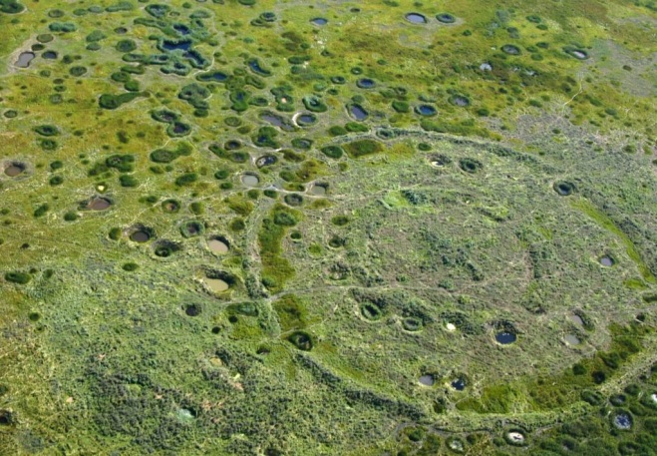
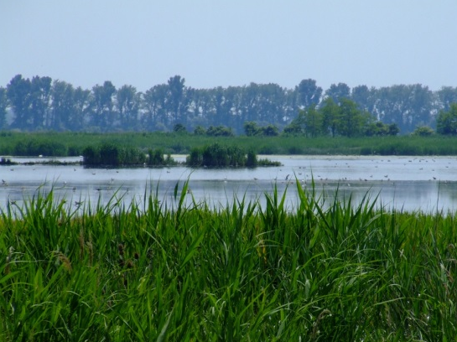
Investments to date examples
Rehabilitation of a 4161 ha large bombing site in the Hortobágy National Park:
Launched in 2012, completed in 2018 – 4 projects, ≈10.6 M EUR ERDF; 25% MFF 2007-2013; 75% MFF 2014-2020
Elimination of shells and explosives (40 720), refilling of bomb-craters (app. 5 000), creation of wetlands and recreation of grasslands – creating conditions for conservation management
Values: salt steppes and marshes (1530), loess steppic grasslands, natural eutrophic lakes (3150)
Improving the water regime of the „Hanság” Natura 2000 site on app. 12 000 ha
Launched in 2016, to be continued (?) until 2024/2027 – 3 projects, ≈14.7 M EUR; MFF 2014-2020 (≈7 M EUR), RRF (≈6.6 M EUR) and MFF 2021-2027 (≈1.1 M EUR)
Restoration and rationalisation of water management and water retention infrastructure, rehabilitation of wetlands, grasslands and forests
Values: tundra vole (Microtus oeconomus), European mudminnow (Umbra krameri), Hungarian Meadow Viper (Vipera ursinii rakosiensis); alkaline fens (7230), alluvial meadows (6440) and forests (91E0), Molinia meadows (6410) etc.

Slide 7
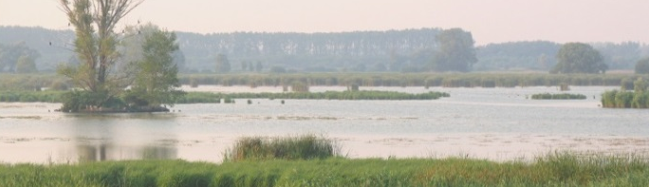
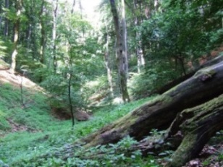
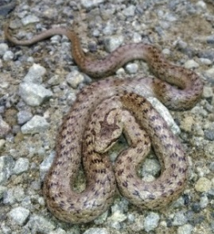
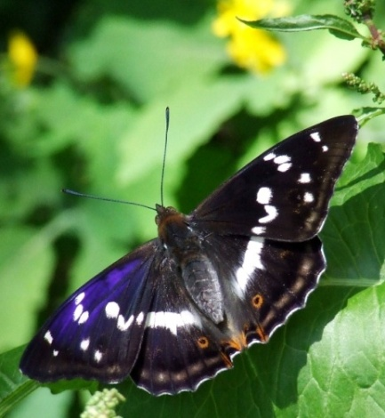
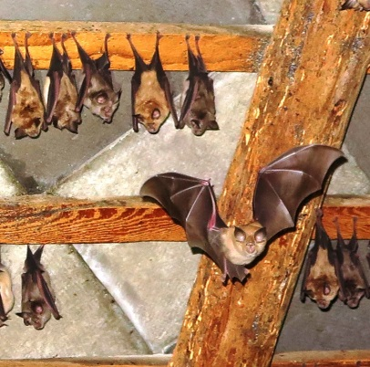
Investments to date results 2014-2020
Results anticipated: 10% of species and 10% of habitats of community interests show improvement in conservation status in at least one parameter
 | Relevant projects |  |  | Results achieved |  | Target value
 | # | Funding |  | 2021 | 2023
 |  | (M EUR) | (%)
Habitats of community interest showing an improving conservation status (%) | 60 | 90,18 | 79% | 9% 4 habitats | 16% 7 habitats | 10%
Species of community interest showing an improving conservation status (%) |  |  |  | 7% 15 species | 13% 27 species | 10%
Data is based on the assessment of project implementers (national park directorates), performed twice: at project launch and upon project closure
Focus is on the level of effort and the scope of interventions rather than proven changes in conservation status
More significant impacts can be expected mostly in case of species and habitats with limited occurrence
Actual influence on conservation status is expected on a longer term – should become visible in future conservation status reports

Slide 8
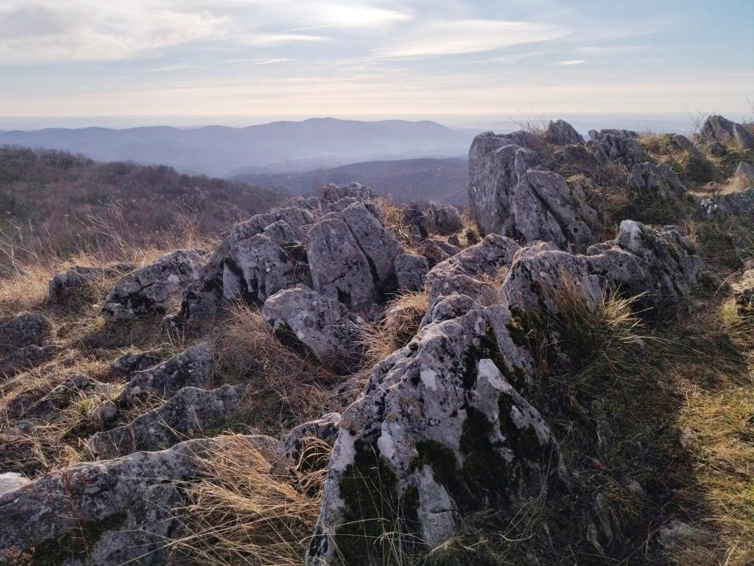
Thank you for your attention!

