Slide 2

UNESCO World Heritage Sustainable Tourism Toolkit
- in a Swedish Practice
Bardejov, 5 May 2017
Lena Johansson
Swedish National Heritage Board
Notes:
Dear Ladies and Gentlemen,
Thank you for inviting me to speak at this conference.
My name is Lena Johansson and I work for the Swedish National Heritage Board.
For the past two years, I have been managing a project commissioned by the government.
In this, we have been testing UNESCO’s Toolkit for Sustainable Tourism,
and I am delighted to be able to share our experiences from that, with you here today.
Hopefully, some of it can inspire you!

Slide 3
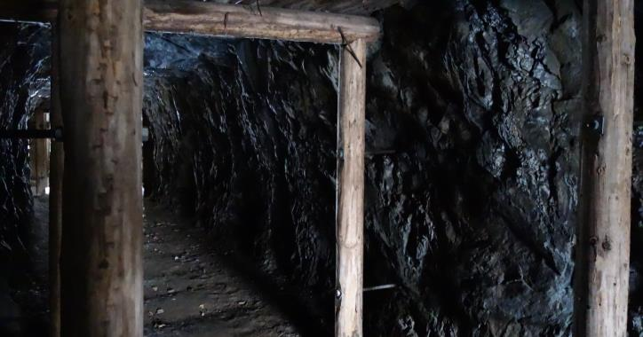
It started with a commission
from the Swedish government
”Develop, collect and disseminate
good exemples of how cultural heritage
can be a resource in mining communities”
Notes:
In early 2014, we were commissioned by the government to show how cultural heritage can contribute to attractiveness.
This was unusual for us, in the sense that it was given by the Ministry of Enterprise and Innovation, and not from by the Ministry of Culture.
That fact clarifies that Swedish actors in the field of cultural heritage need to operate at the arena of sustainable development
– In cooperation with other policy areas – not in parallel tracks.
The overall aim of the commission was to strengthen competitiveness in the Swedish mining and mineral industries.
Our task was to ”develop, collect and disseminate good examples of how cultural heritage can be a resource in mining communities”.
We organised the work in seven sub-projects. During the three-year mandate period, we interacted with over 50 actors at local, regional, national and international levels.

Slide 4
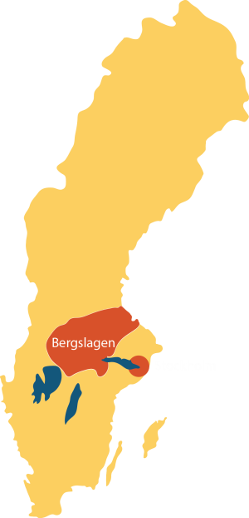
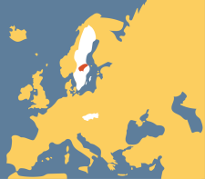
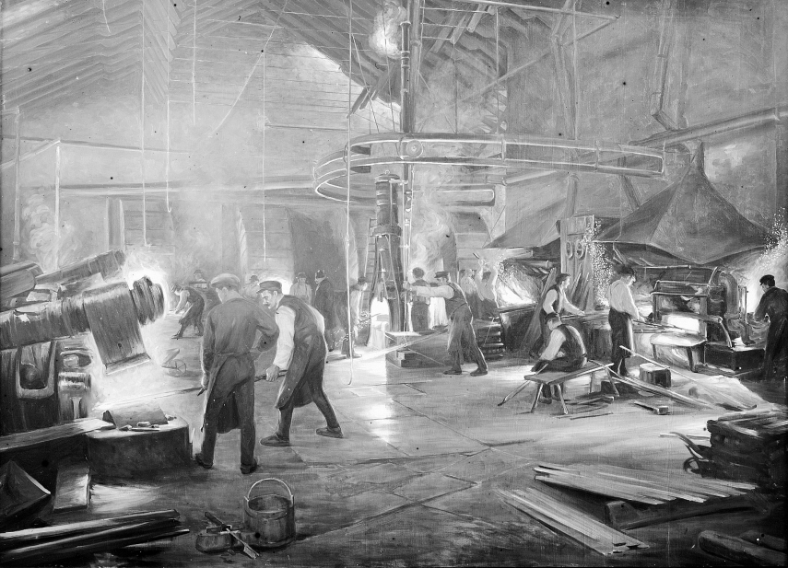
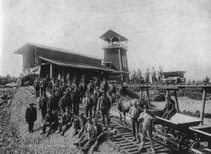
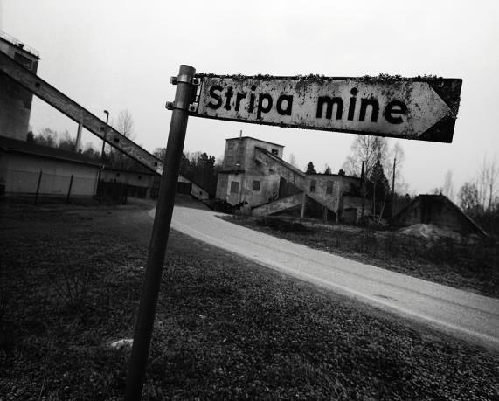
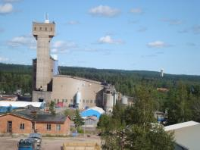
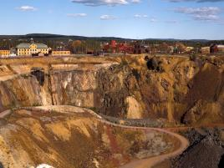
Bergslagen and its challenges
2016
1912
1935
1952
1992
Notes:
The area assigned for the commission is a part of Sweden known as Bergslagen.
Bergslagen is situated in central Sweden.
It comprises several counties, and has the same size as Slovakia, but only 20% of your population.
Bergslagen is one of the areas with the largest amounts of ore in Sweden.
For more than 2 000 years, inhabitants have earned their living and forged their identity from mining and processing of minerals.
This is where Swedish industrialism began in the nineteenth century. And prosperity emerged from it, was instrumental in shaping modern Sweden.
But since the 70s, Bergslagen has been hard hit by globalisation and technological development.
It has undergone extensive dismantling of its old primary industry, accompanied by high unemployment, depopulation – and everything that goes with it! The last iron ore mine closed in about 1990.
During the last five years Bergslagen has received many refugees. Some municipalities has increased their population up to 15%.

Slide 5
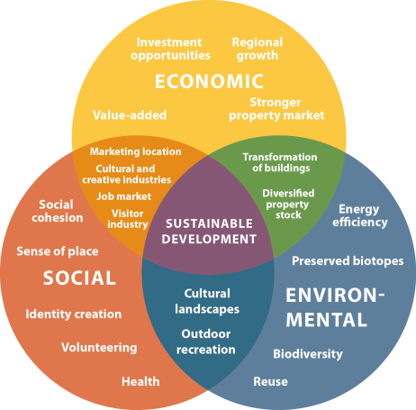
Opportunities for Bergslagen from cultural heritage
Vision for Swedish cultural heritage management until 2030:
‘Everyone, irrespective of background,
feels that they can relate to the cultural heritage which has shaped Sweden’
Notes:
A key task for our work was attempting to enable people to find new opportunities to stay and to live in Bergslagen, which in turn might contribute to development and social transformation of the region.
The substantial results from our work are from two different areas, but both link to how cultural heritage can be a sustainable resource.
The results supports, firstly, the cultural heritage importance for people’s understanding of themselves and their being.
This in turn, create a sense of connection with other people, and contribute to integration.
For example, immigrants possibilities to establish in Sweden.
It also supports our vision for cultural heritage.
Secondly, the results – which I will present here – address the relationship between cultural heritage, tourism and the visitor industry.

Slide 6
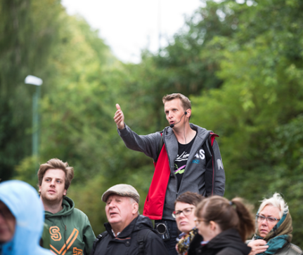
Incentives to work with tourism
The national objectives for cultural heritage protection
and management in Sweden aims to promote:
A sustainable society with a great diversity of cultural heritage sites which are to be preserved, used and developed,
People’s participation in cultural heritage management and their potential to understand and take responsibility for the cultural heritage,
An inclusive society with the cultural heritage as a shared source of knowledge, education and experiences,
A landscape management perspective in which cultural heritage is utilized in the development of society.
Notes:
We all know that cultural heritage, as well as Nature, are important resources for tourism.
And naturally there are a number of conflicts of interest, and examples of tourism that tears tangible and intangible cultural values.
However, we are also recognising that tourism and visitor industry gives us an opportunity to reach our objectives.
But - the practice is in need of relevant methods and effective tools.

Slide 7
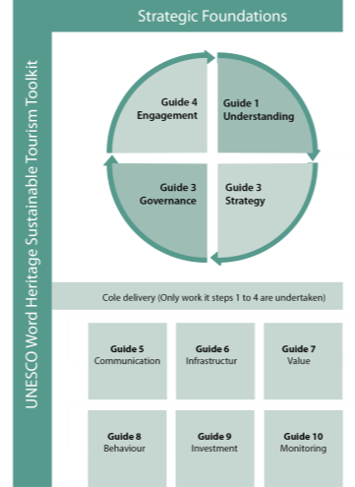
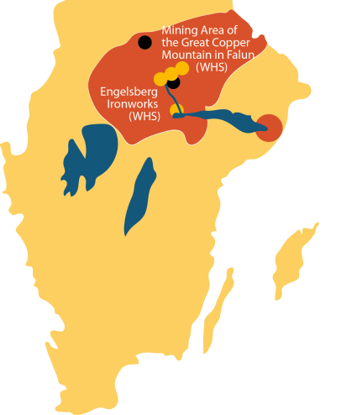
Developing cultural heritage tourism
Notes:
When we started our work with the commission, we were familiar with UNESCOs toolkit for sustainable tourism.
We were attracted by its ideology in combining preservation of cultural heritage values, with market perspectives.
To examine the method, and to initiate a process in which we could develop co-operation with the visitor industry, a number of actors from Bergslagen were invited.
The World Heritage Site Falu Copper Mine was a central actor, but as the destination-perspective is crucial to the method, we also invited representatives from five other industrial historical sites to take part.
We decided to test the four first how-to-guides. We organised the work in four workshops with tasks to be carried out in-between them.
The role of the Swedish National Heritage Board was to facilitate the process, without taking over local and regional ownership, which was quite a challenge, but crucial for the durability of the results.

Slide 8
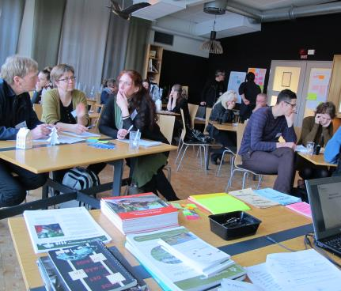
What has this work led to,
in terms of results at local and regional level?
Energy boost
A long-term strategy. An identified direction.
Professionalization
Mayor opportunities for continued development of cultural heritage tourism in Bergslagen by engagement in an international context.
Notes:
It is difficult to see long-term results as the process ran over a relatively short period of time, and only just finished.
But, with regard to that, some results can be pointed out:
The work has, indeed, provided an energy boost for local and regional ambassadors, and for developing the region’s cultural heritage tourism.
The local and regional actors have launched a long-term strategy for sustainable tourism. In this, they have identified some focal areas for progressive work, and how they can handle challenges in a more strategic and systematic way.
They have thereby become more professional. Today there is a greater understanding, in both policy-work and practice, of how cultural heritage work and tourism can reinforce each other and how it impacts on sustainability.
Since the World Heritage Site in Falun also is part of UNESCO’s project European Heritage Journeys, the work is continuing within an international framework. This offers major opportunities for the future heritage tourism in Bergslagen – and for Swedish tourism in general.

Slide 9
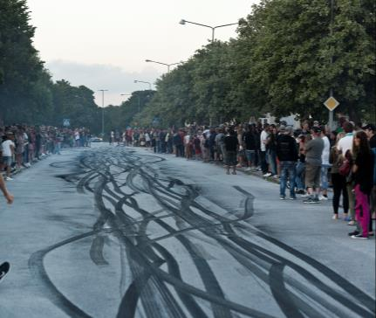
Some results at national level
Work on equal terms. Shared approach between the Swedish National Heritage Board and the Swedish National Agency for Economic and Regional Growth.
The method is generic as it supports sy systematic process.
The work has helped us to provide support and advice more distinctly.
Notes:
I would also like to point out some result at the national level:
Our work has led to a mutual understanding between our body and the Swedish National Agency for Economic and Regional Growth. Thereby we can approach the difficult issues of cultural heritage as an asset - on more equal terms.
We recognize that the method is generic as it supports a systematic process. It is not a template in the sense that others can copy best practice and repeat it. Its strength is that it meets local and site-specific characteristics, and has stakeholders to collaborate to find their own optimal management.
We have now also increased our awareness of UNESCO’s programme and method, which means that we can provide support and give advice more distinctly.

Slide 10
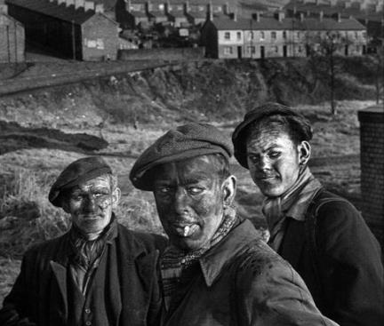
Cultural heritage is of vital importance for
every society’s development
Notes:
To wrap up this presentation, I would like to show you a film, which has been produced within our commission.
The film aims at showing the importance of mining, and its role in the development of Swedish society.
It also show their interdependence - in the past, today and for the future.
+ film 5 minuter

Slide 11
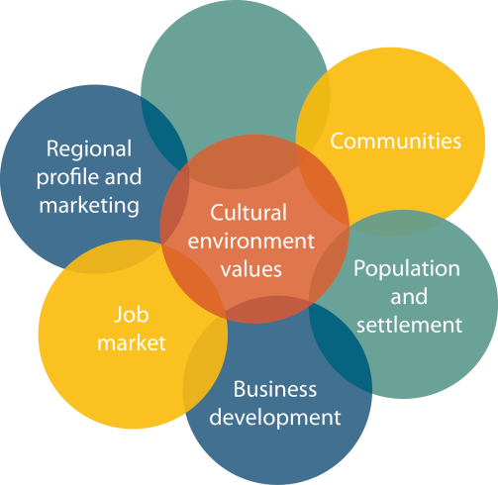
To end
”To succeed,
you have to start!”
Notes:
We believe that World Heritage sites are important for illustrating history, but also as an arena in contemporary society, and as an active partner in dialogue with different actors, visitors and local people.
In ten years, I hope that we will be able to say that the application of UNESCO’s toolkit was a door opener to tackle structural challenges like those which Bergslagen exemplifies.
Finally, I humbly, would like to quote with a Chinese saying: “To succeed, you have to start!”

Slide 12
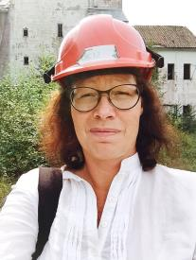
Thanks!
lena.johansson@raa.se

