Slide 1
Proactive & efficient flood prevention
Martin Gális

Slide 2
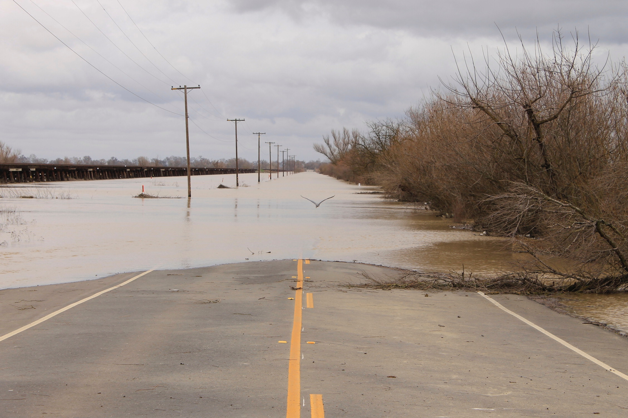
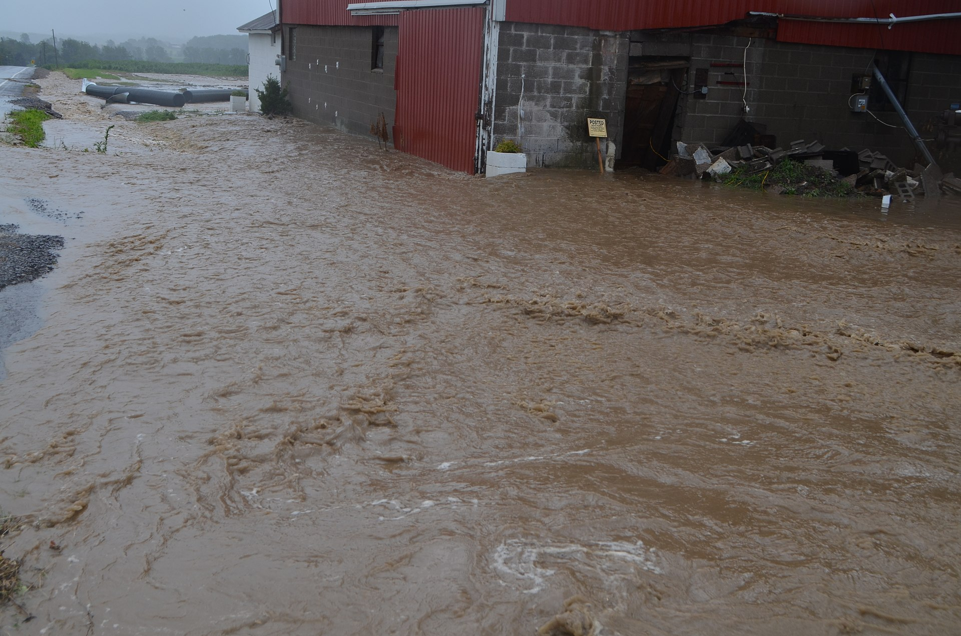
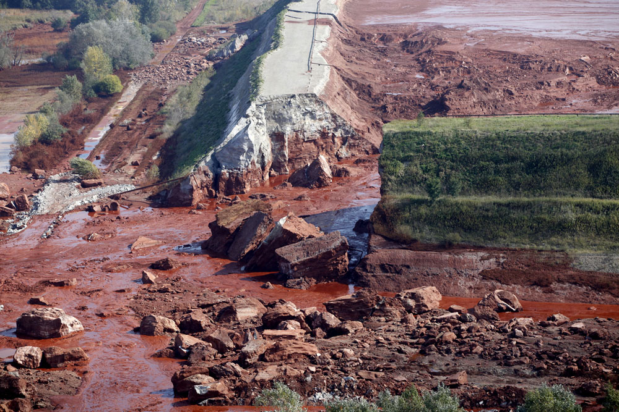
Floods
Natural occurrence
Types
  Coastal
  Fluvial (river)
  Pluvial (surface)
  Other: barrier, flash flood, landslide, accident

Slide 3
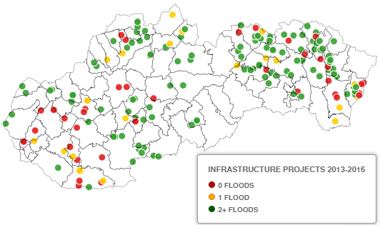
Prevention is better than cure
1 € invested saves at least 4 € avoided damage
Let the water flood
Urban planning
Build infrastructure where necessary
Tools (maps, plans, monitoring & warning)

Slide 4
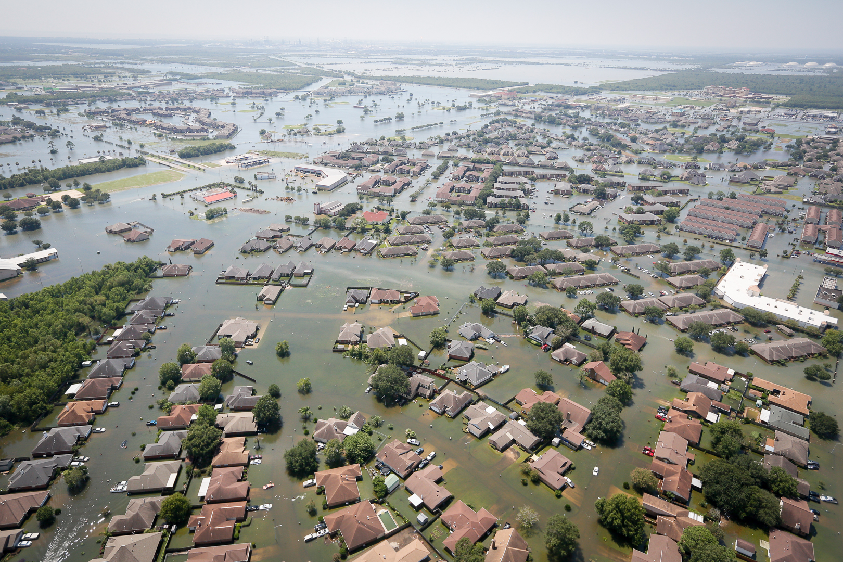
Causes
Rain ☺
Climate change
Human development
Bad country management
Insufficient flood management

Slide 5
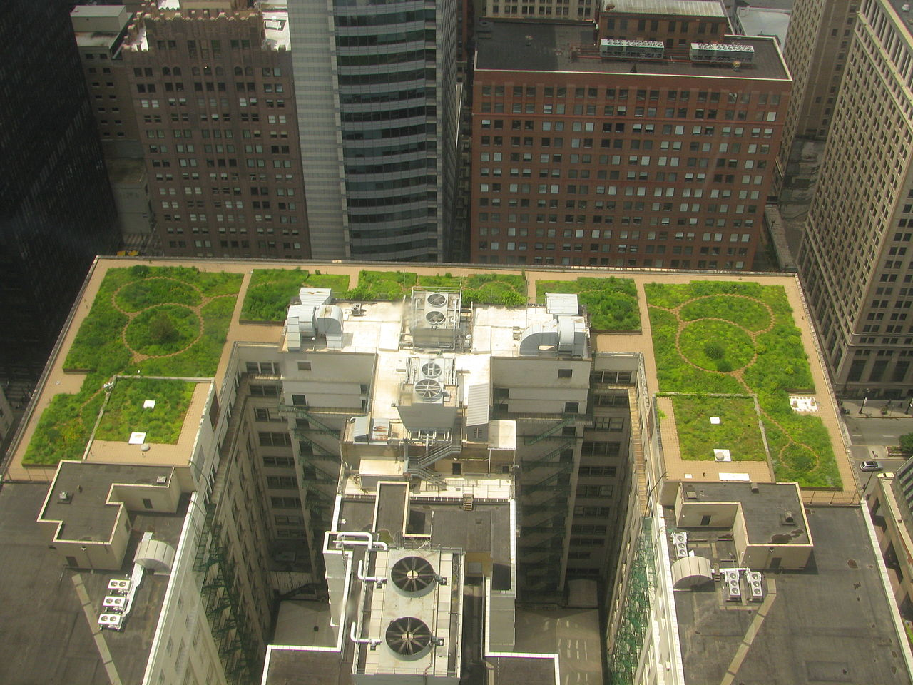
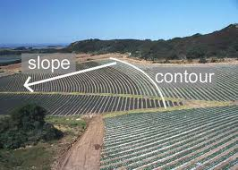
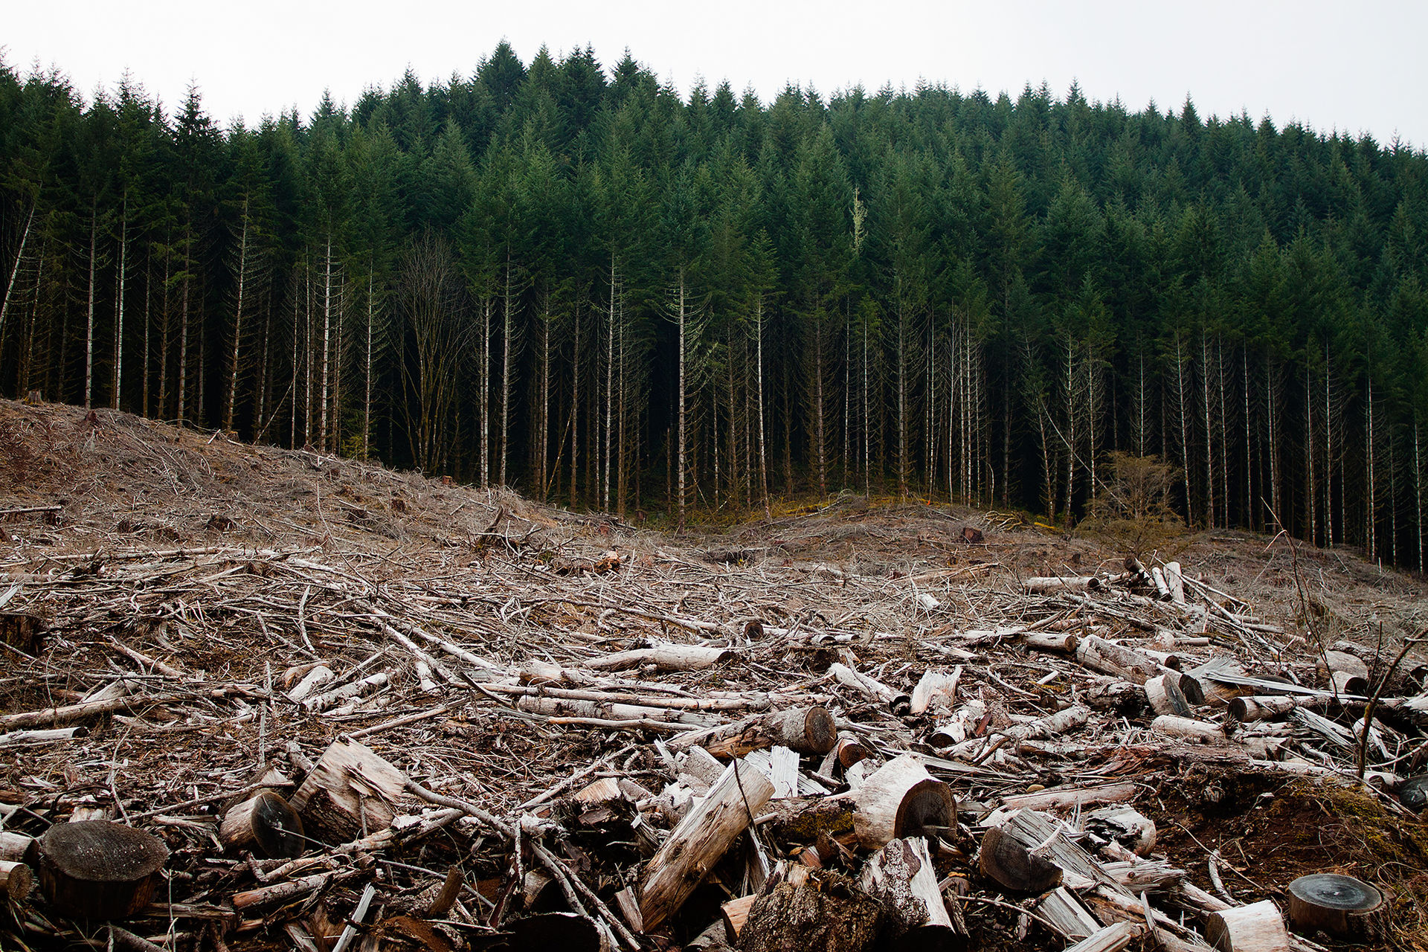
Country management
Urban country
  Planning and building according to maps
  Less development in flood prone areas
  Rain retaining infrastructure
Agricultural land
  Contour line plowing
  Green field boundaries
  Growing adequate crops
Forests
  Forest is a rain retainer
  Clearcuts retain 50x less water
  Danger of flash floods

Slide 6
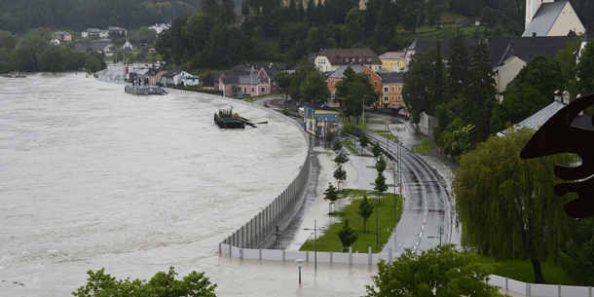
Flood infrastructure
Where and what to build. Better planning could save 13 mil. € in damages in Slovakia yearly.
Benefits vs. costs
Green vs. technical infrastructure
Mobile infrastructure
Sustainable infrastructure
Procurement and unit prices

Slide 7
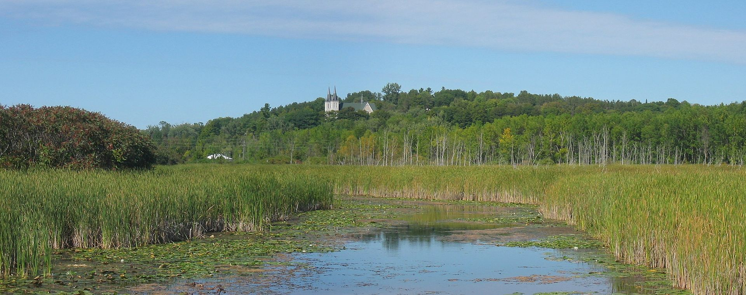
Green infrastructure
Hard to calculate the impact, but cheaper
Other environmental benefits (Anti-erosion, biodiversity, ...)
De-centralized
Slowing water drainage
Examples
  Floodplains reoccurrence
  Dry polder (semi-green)
  Infiltration ponds

Slide 8
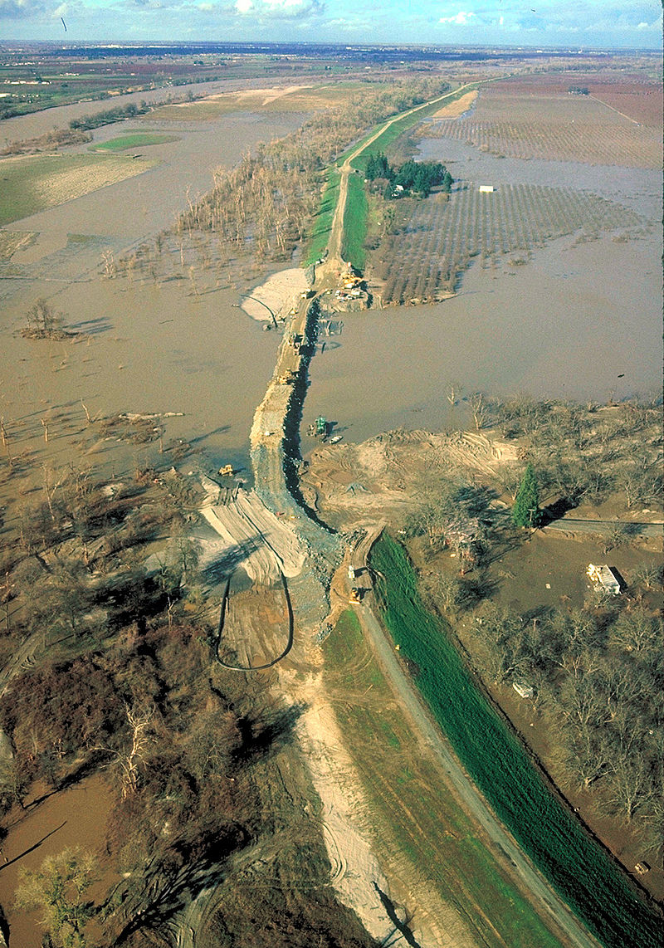
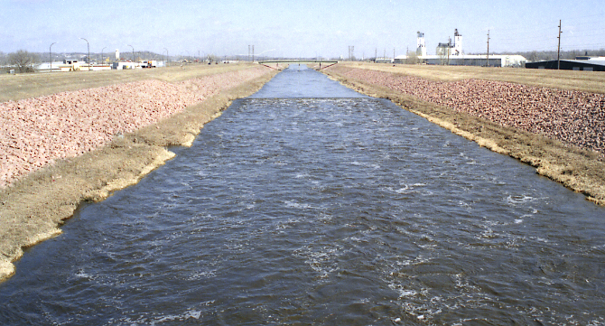
Technical (grey) infrastructure
Easy to predict water levels
More expensive, more efficient
Other benefits (Recreational, industrial, ...)
Examples
  Dikes, levees
  Dam reservoirs
  River regulations

Slide 9
Financial solutions
State and public money
„User pays“ principle
  Fund
  Financial participation on prevention
  Insurance
  Local taxes
  Mandatory flood infrastructure on the property

Slide 10
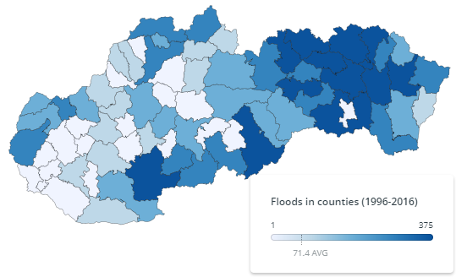
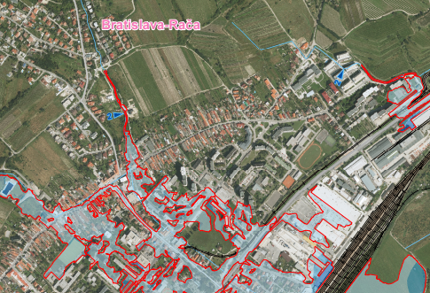
Data
Always push for data availability
Actual, precise maps
Place, time and cost of
  Flood events
  Existing infrastructure
  Planned infrastructure
Research on flood causes

Slide 11
IEP
Analytical unit at Ministry of Environment
  Value for Money principle
  Evidence based policy making
Projects
  Spending review in environment. Over 100 mil. € potential savings identified.
  Environmental state strategy till 2030
  Low carbon strategy
  Circular economy
  Waste management
Facebook (https://www.facebook.com/iep.mzp )
Web (http://www.minzp.sk/iep)

